Slide 1
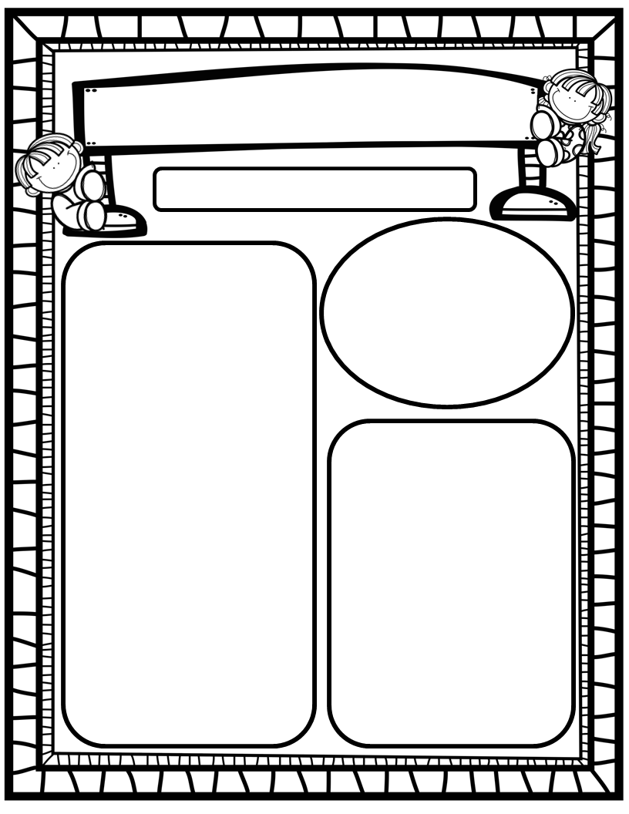
Manuel’s Weekly Blast
February 12th, 2024
Homework:
Read to and with your child each night/Record books on Reading Rally Logs
Go Math Practice pages for Chapters 1-9
Practice the HFW’s: a, and, I, the, is, in, as, said, do, to, of, see, be, he, me, from, look, are, was, yes, you, what, have
Go over Weekly Behavior/Work Study grades and weekly work pages with your kiddos.
We Are Learning About…
Reading: We will review Short Vowel Aa and Nasalized Aa (identification, mouth placement to make sounds, blending/sounding-out words containing these letters), and all sight words we have learned so far. We will continue to discuss the types of stories we like best. Weekly Question: What is our favorite story?
Writing: We will print letters, sight words, as well as our first names! We will stretchy-spell our words and write to describe different topics using a complete sentence!
Math: We will continue to work through and finish Ch. 9: Put Together and Take Apart Numbers to 5!
Science: We will begin Unit 4: Day and Night!
Social Studies: We will review I-Care Rules and our Hawks Rise Character Trait: Patience! We will continue learning about important and impactful African Americans from the past and the present in honor of Black History Month!
Important Dates:
February 14: Valentine’s Day Exchange
February 19: Presidents Day; No School
February 20: Class Picture Day, 10:30 AM
February 29: Field Day, 8:30-10:30

