Slide 1
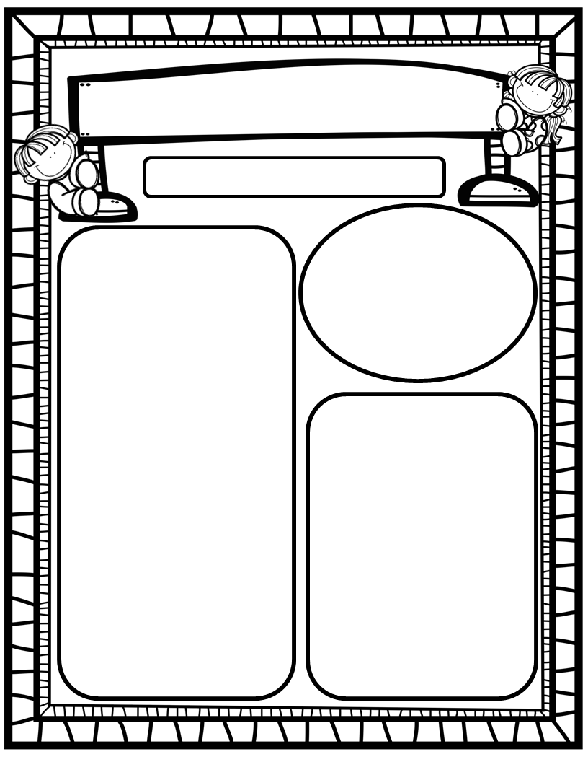
Manuel’s Weekly Blast
February 26th, 2024
We Are Learning About…
Reading: We will focus on the FLSZ Spelling Rule (F,L,S and Z are doubled after short vowel sound), -all, -oll, -ull Spelling Rule, and HFW’s your, want, go, no, so. We will read stories that help us learn from the past. Weekly Question: How do we learn about the past?
Writing: We will print letters, sight words, as well as our first names! We will stretchy-spell our words and write to tell how we are helpers using at least 1 complete sentence!
Math: We will continue Ch. 10: Put Together and Take Apart Numbers to 10!
Science: We will continue Unit 4: Day and Night!
Social Studies: We will review I-Care Rules and our Hawks Rise Character Trait: Cooperation! We will learn about George Washington and continue learning about important and impactful African Americans from the past and the present in honor of Black History Month!
Homework:
Read to and with your child each night!
Go Math Practice pages for Chapters 1-10
Practice the HFW’s: a, and, I, the, is, in, as, said, do, to, of, see, be, he, me, from, look, are, was, yes, you, what, have, your, want, go, no, so
Go over Weekly grades and weekly work pages with your kiddos.
Important Dates:
February 29: Field Day, 8:30-10:30 (more info to come ☺)

