Slide 1
Welcome to your Virtual orientation! I am so excited to have your child in my class this year. While I wish we could be together for this time, I have compiled all of the information virtually for you.
*Please click the tabs at the top to be directed to information about each topic.
It’s going to be a great year!
Love, Mrs. Morales

Slide 2
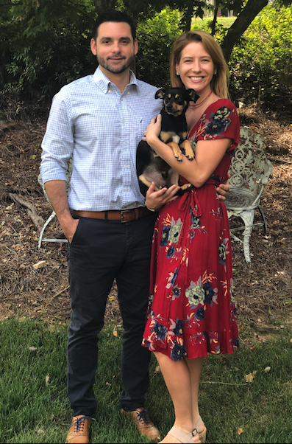
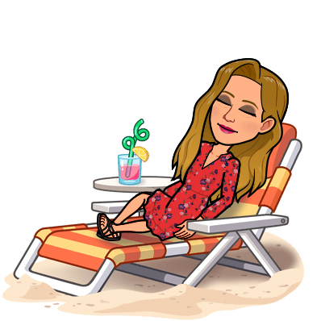
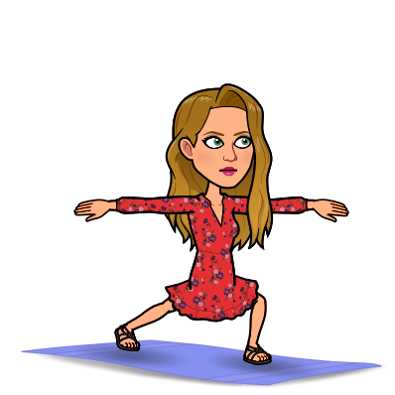
Hello there! My name is Neely Morales and I am so excited to be working with you and your kiddo this year!
I have a Masters degree in Special Education from FSU and have been teaching for seven years now. This is my fifth year teaching at Fort Braden, so hopefully I will be a familiar face to your child!
My husband’s name is Ricky, and we LOVE our little pup, Marshall!
My favorites include:

Slide 3
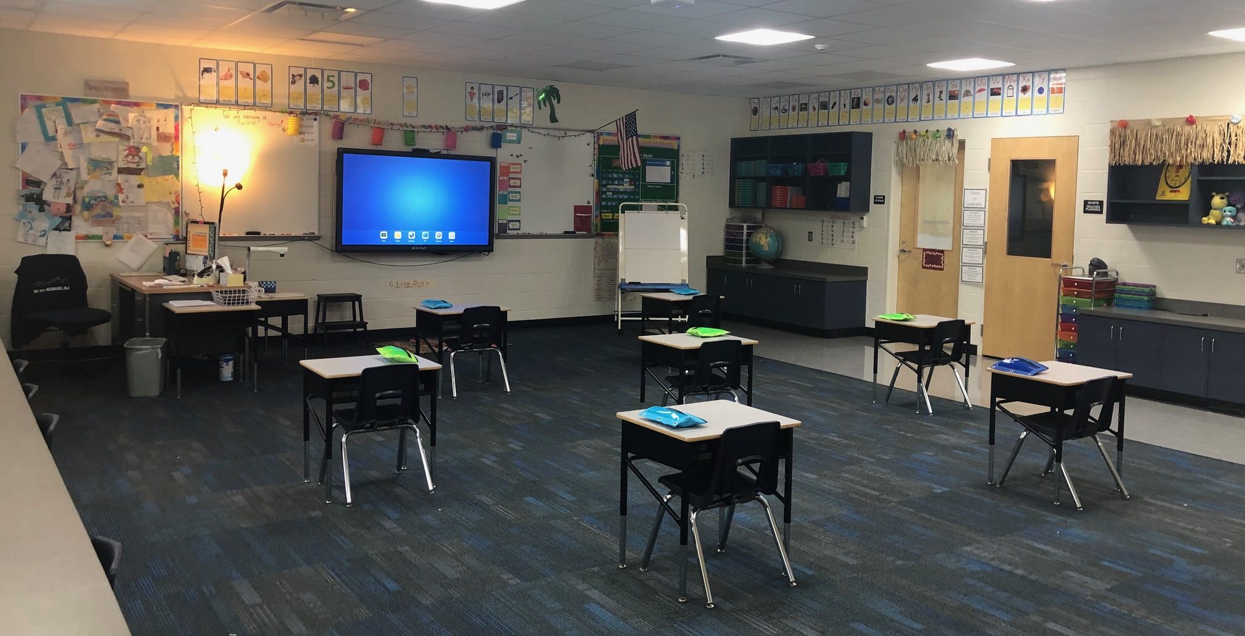
Whether you’re tuning in from home or here at school, we are going to have an amazing year together in 2nd grade!!!

Slide 4
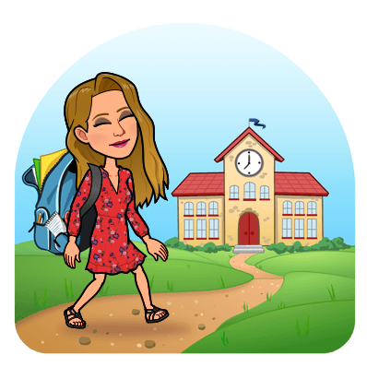
Morning Meeting 8:35 – 9:15
Special Area 9:15 – 9:55
Math 10:00 – 11:00
Lunch 11:00 – 11:25
Developmental Play 11:40 – 12:10
ELA 12:15 – 1:45
Science / Social Studies 1:45 – 2:20
School-Wide Reading Time 2:25 – 2:45
Dismissal 2:50
*Schedule subject to change

Slide 5
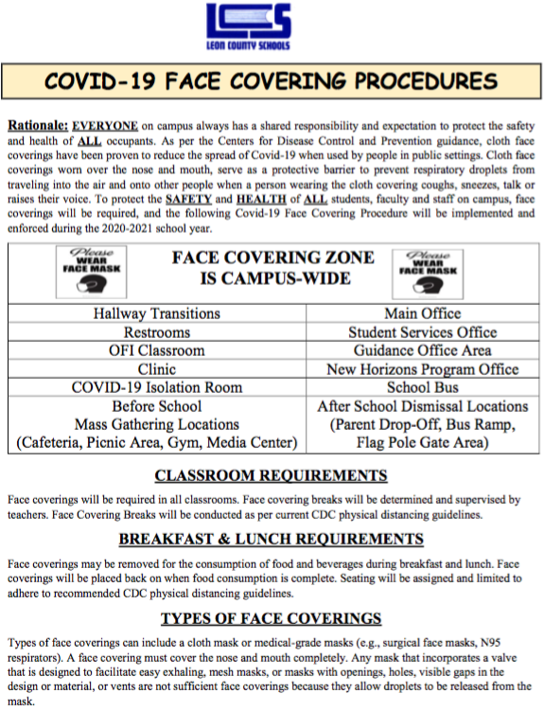
For ongoing updates and detailed info regarding LCS’ response and plans regarding the impact of Covid19, please visit the Covid19 site. HTTPS://WWW.LEONSCHOOLS.NET/COVID19
Additional info about Fort Braden school, Brick and Mortar and Digital Academy can be found on the school’s website.
https://www.leonschools.net/ftbraden

Slide 6
Student Supply List:
Crayons
Markers
Dry erase markers
Classroom Wish List:
Clorox/Lysol Wipes
Clorox/Lysol Spray
Hand Sanitizer
Hand Soap
Baby Wipes
Tissue

Slide 7
Contact Information:
E-mail: moralesn@leonschools.net
Phone Number: (850) 488-9374

