Slide 1
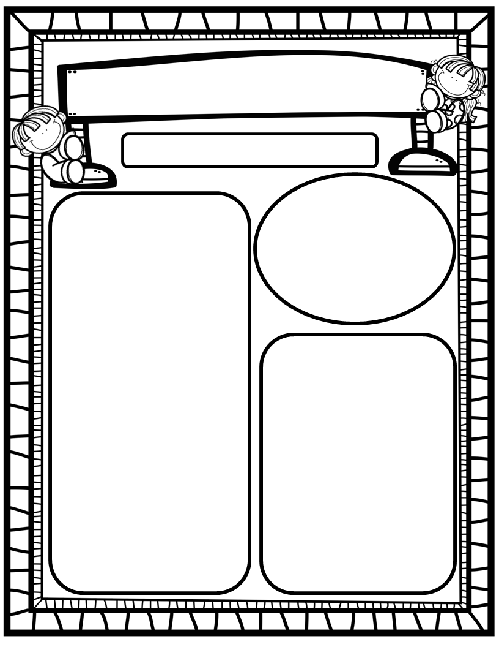
Manuel’s Weekly Blast
April 1st, 2024
We Are Learning About…
Reading: We will focus on Digraphs WH, PH, NG and HFW’s could, would, should, or, for. We will read and discuss stories about various kinds of inclement weather. Weekly Question: How have people learned to live in bad weather?
Writing: We will print letters, sight words, as well as our first names! We will stretchy-spell our words and write sentences to tell how we help others. Math: We will begin Ch. 16: Counting to 100!
Science: We will continue to focus on Living and Non-Living things!
Social Studies: We will review I-Care Rules and our Hawks Rise Character Trait: Cooperation! We will also continue our Community Helpers unit by writing to tell how we help others in our community.
Homework:
Read to and with your child each night!
Go Math Practice pages for Chapter 16
Practice the HFW’s: a, and, I, the, is, in, as, said, do, to, of, see, be, he, me, from, look, are, was, yes, you, what, have, your, want, go, no, so, goes, says, she, we, they, their, were, talk, walk, could, would, should, or, for
Go over Weekly grades and weekly work pages with your kiddos.
Important Dates:
April 5: First Friday/Nest Lunch; PTO Silent Auction, 6:30pm
April 14-19: Teacher Appreciation Week ☺
April 26: Killearn Lakes Taekwondo on-campus demonstration
April 27: HRES Carnival

