Slide 1
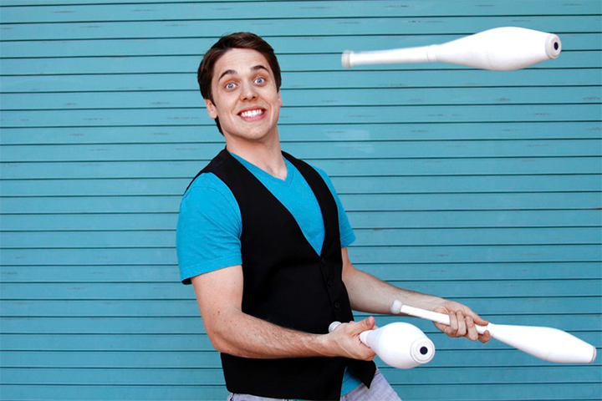
Josh Horton
Instagram Juggler

Slide 2
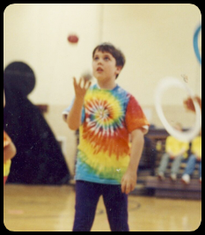
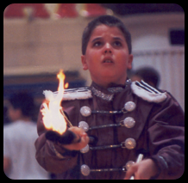
Start Of His Career
Josh Horton was born May 24, 1990 (27yrs)
Born in Austin Texas, grew up in Bloomington, Illinois
Found juggling in an after school circus program in Normal, Illinois
Moved to Malibu, California after freshman year of HS
Showed off his talent in a talent show leading him to discover the World Juggling Federation

Slide 3
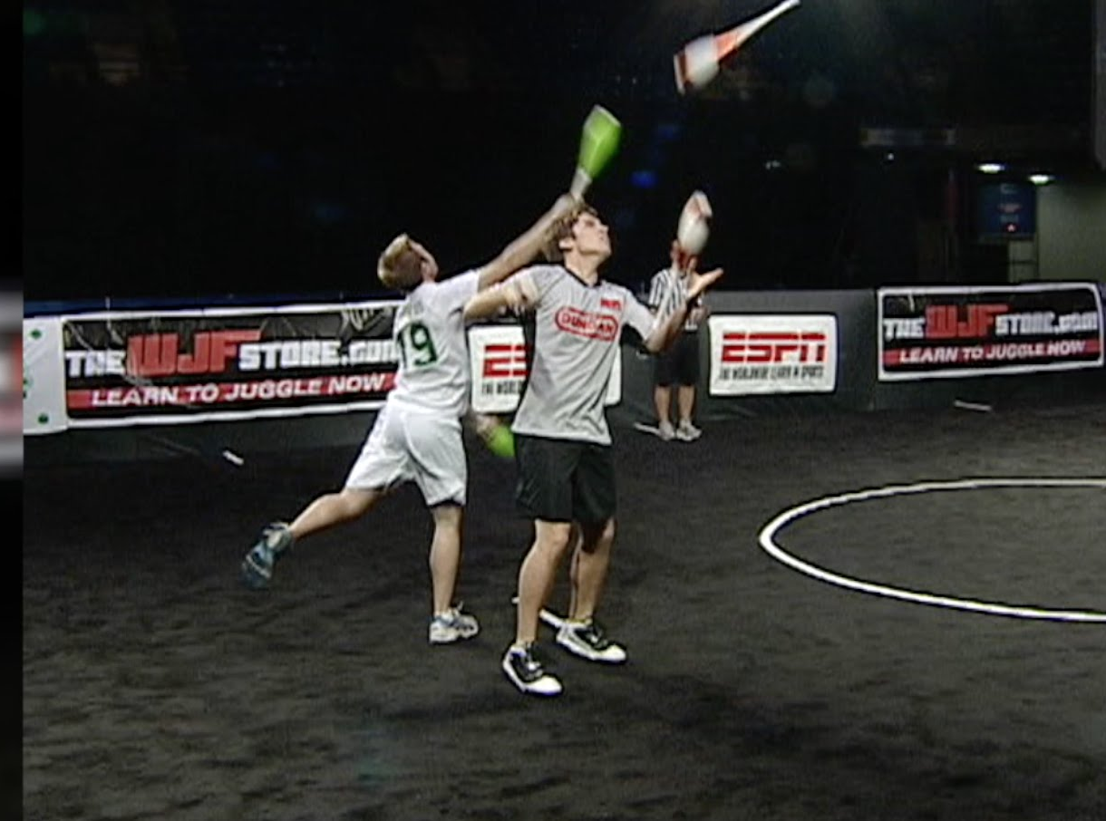
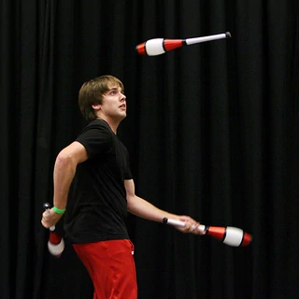
Some Competitions
Shortly after HS, Josh began competing in world championships of juggling
Josh has won a combined 9 gold medals from WJF (World Juggling Federation) and IJA( International Jugglers Association)
WJF4: 3rd place, Intermediate Ball and Club
WJF6: 2nd Place advanced Ring and Club as well as 1st place 2 club freestyle
IJA 2010: 1st place, 3 Rings, Ring passing, 3 Clubs – 1st place in Extreme 5 Balls as well as 4 Rings

Slide 4
What is Josh doing today?
Josh is now a full time Juggler, using his skills for several things
Performs at halftime shows, camps, schools, and on the streets
Competes in competitions around the world
Runs several social media outlets, showcasing the endless set of tricks and props he has mastered over the years
Josh is likely the most versatile juggler to this date and has yet to show any signs of disinterest for the hobby, as he is still producing new material every day, only to challenge himself while entertaining and educating others

Slide 5
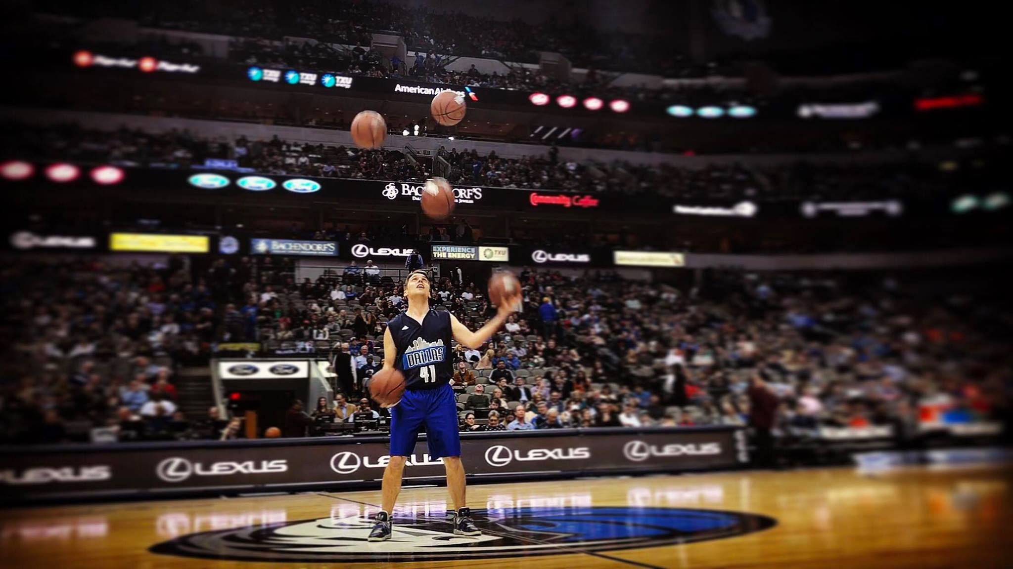
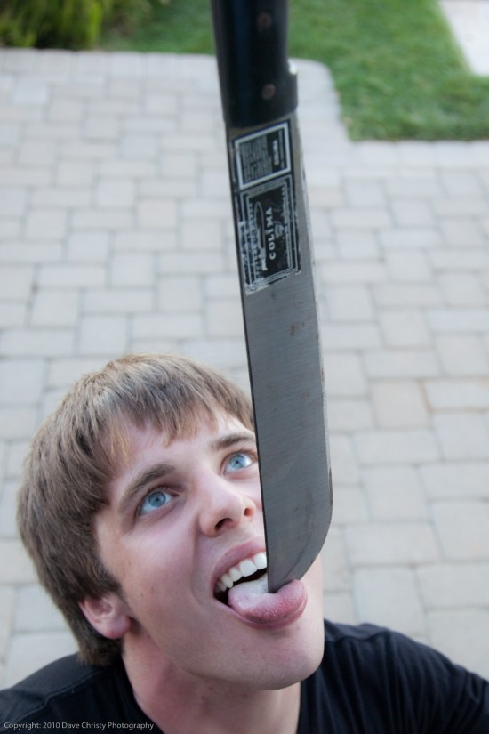
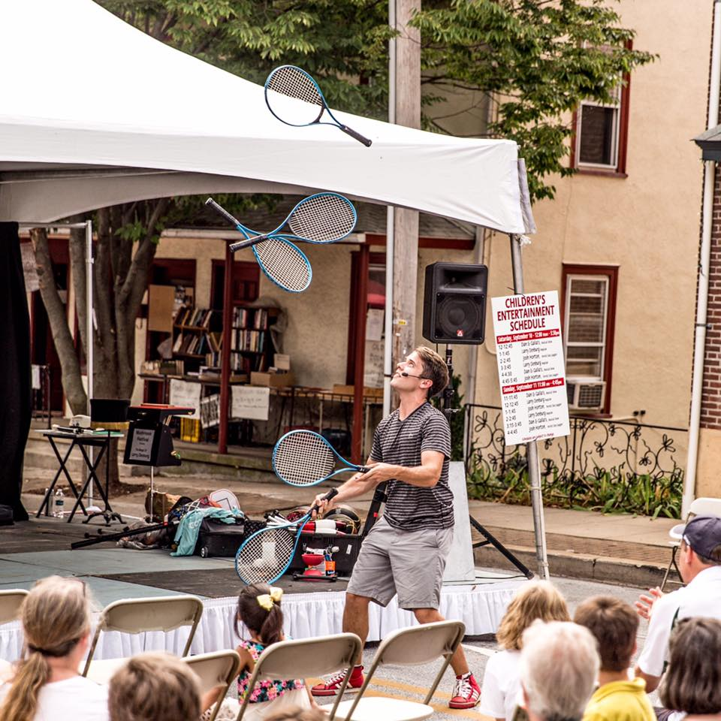
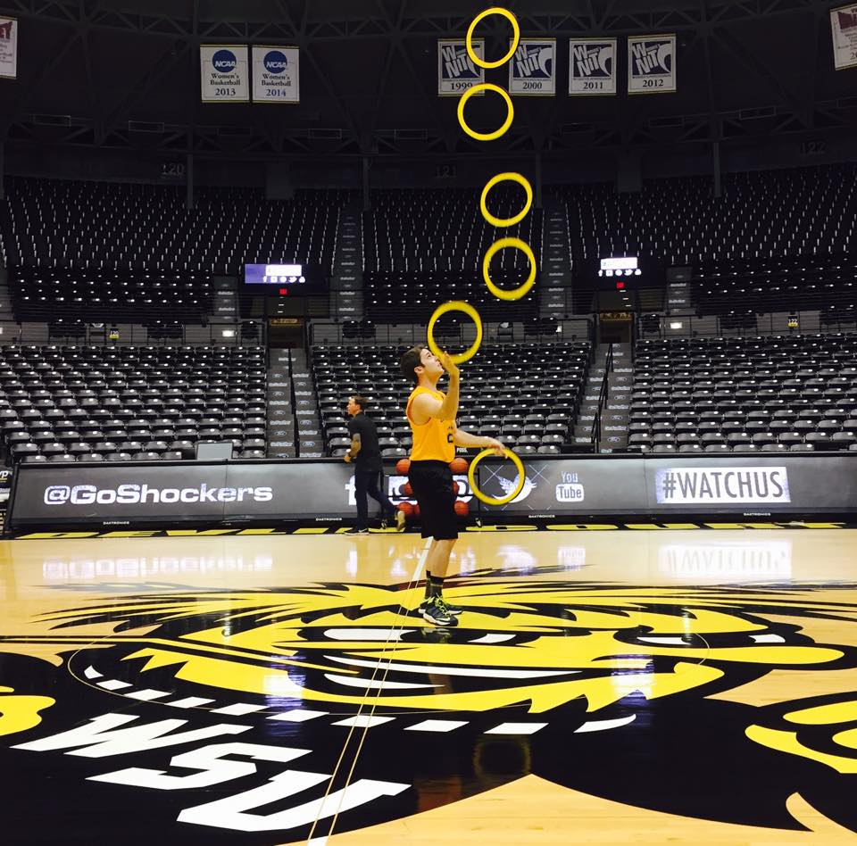
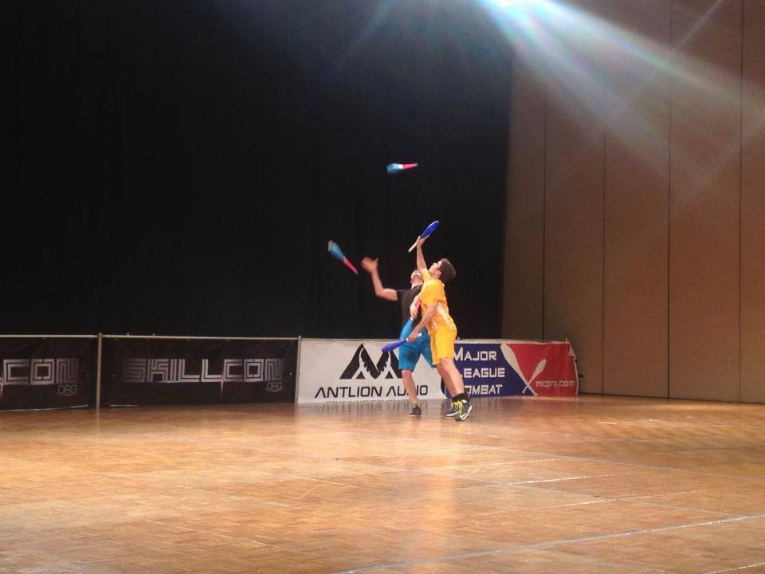
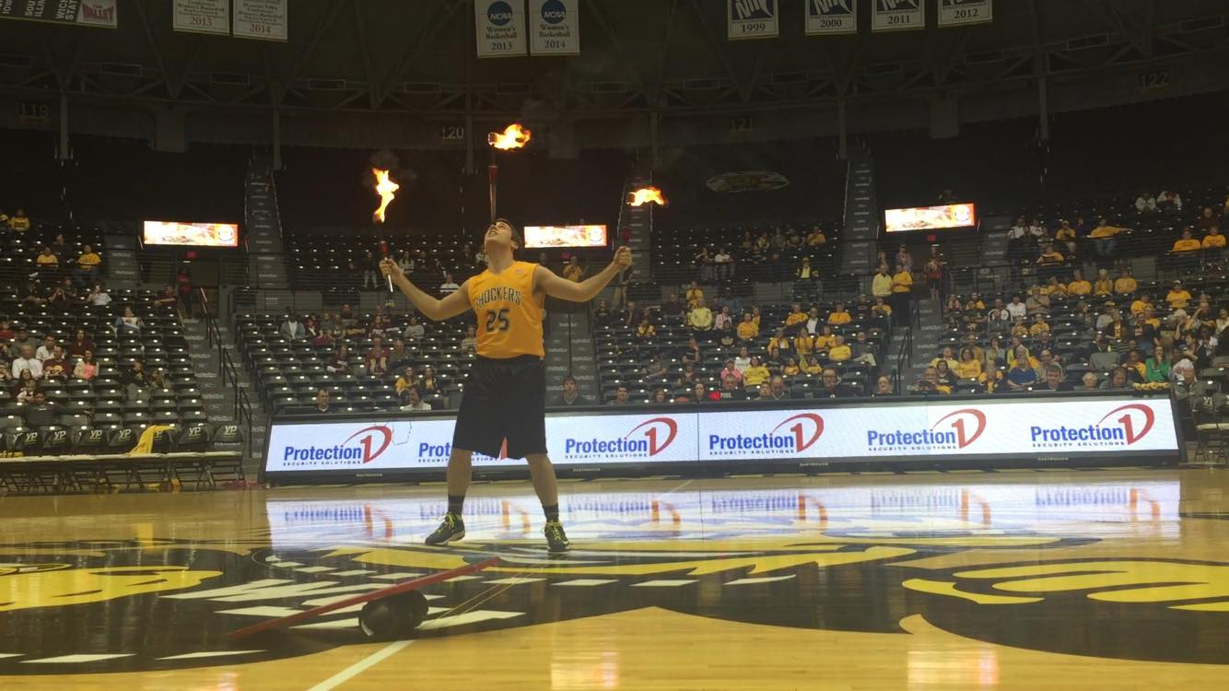

Slide 6
Media links
Facbook: (Josh Horton – Juggler/ @jugglinjosh) https://www.facebook.com/jugglinjosh/
Instagram: (@jugglinjosh) https://www.instagram.com/jugglinjosh/?hl=en
YouTube: (Jake & Josh) https://www.youtube.com/user/jugglinjosh/featured
Twitter: (@jugglinjosh) https://twitter.com/JugglinJosh?ref_src=twsrc%5Egoogle%7Ctwcamp%5Eserp%7Ctwgr%5Eauthor
Website: http://www.jugglerjoshhorton.com/home.html

