Slide 1
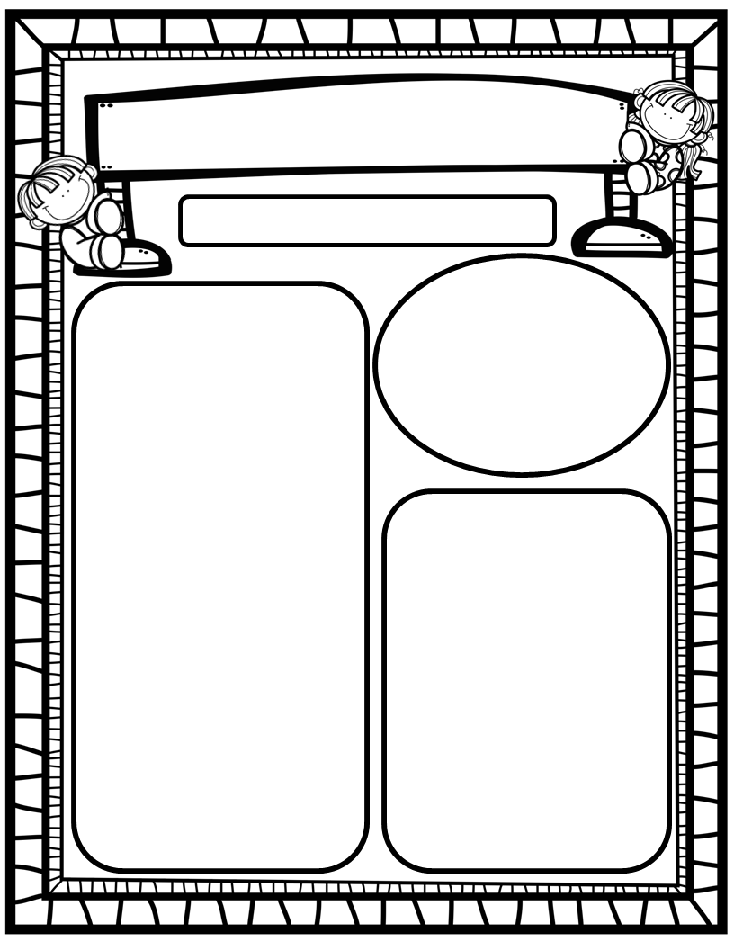
Manuel’s Weekly Blast
March 4th, 2024
We Are Learning About…
Reading: We will focus on the CK grapheme (sounds like /k/), the SH grapheme (makes its own sound) , and HFW’s goes, says, she, we. We will read a variety of stories about St. Patrick’s Day. Weekly Question: Which similar story do we like the very best?
Writing: We will print letters, sight words, as well as our first names! We will stretchy-spell our words and write about various topics using at least 1 complete sentence!
Math: We will finish Ch. 10: Put Together and Take Apart Numbers to 10!
Science: We will finish Unit 4: Day and Night!
Social Studies: We will review I-Care Rules and our Hawks Rise Character Trait: Self-Control! We will begin learning about important and impactful women from the past and the present in honor of Women’s History Month!
Homework:
Read to and with your child each night!
Go Math Practice pages for Chapters 1-10
Practice the HFW’s: a, and, I, the, is, in, as, said, do, to, of, see, be, he, me, from, look, are, was, yes, you, what, have, your, want, go, no, so, goes, says, she, we
Go over Weekly grades and weekly work pages with your kiddos.
Important Dates:
March 6: Inclusion Day-wear blue or gray (optional)
March 11-15: Spring Break; No School
March 18: Teacher Planning Day; No School
March 19: Students Return; Beginning of 4th Quarter
March 21: Field Trip to Publix, 9:45-1:00

