Slide 1
What’s Your Problem?
This Photo by Unknown Author is licensed under CC BY-NC-ND

Slide 2
On your paper, list 3 global problems and 3 local problems.

Slide 3
homelessness
Equal Pay
POVERTY
Racial Unrest
CRIME
Drugs

Slide 4
health
$$$$$$
future
RELATIONSHIPS

Slide 5
Essay #4 – Problem Analysis
1st – find an issue
2nd – break it down into different parts.
3rd – present this exploration to the reader

Slide 6
DO NOT SIMPLY SUMMARIZE/DESCRIBE
Instead, find out
Who?
What?
Where?
When?
Why?
How?

Slide 7
Get to the ROOT of the problem!
This Photo by Unknown Author is licensed under CC BY

Slide 8
I don’t think I like your TONE!
Stay objective!
Show no bias!
Stick to the facts!
Be professional!
Keep it formal!

Slide 9
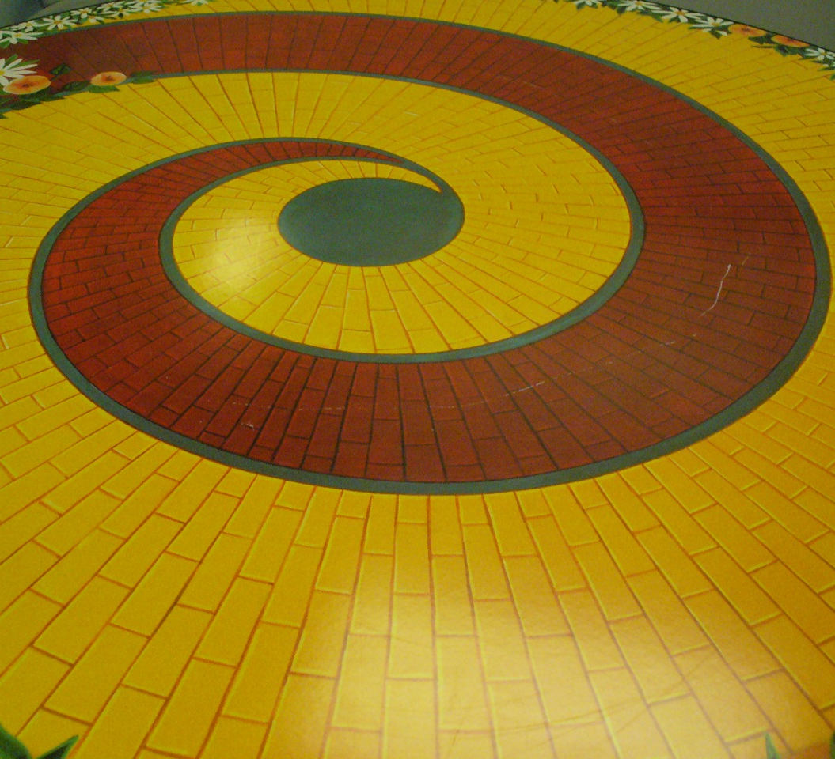
Where do I start? Well, at the beginning, of course! Look at the causes & effects of the problem.
This Photo by Unknown Author is licensed under CC BY-SA-NC

Slide 10
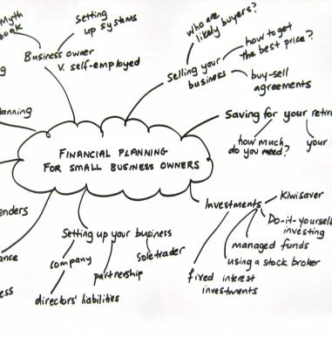
Free writing, Clustering, Listing, Brainstorming
This Photo by Unknown Author is licensed under CC BY-SA-NC
This Photo by Unknown Author is licensed under CC BY
This Photo by Unknown Author is licensed under CC BY-SA-NC

Slide 11
Example: Causes for Global Warming
Global Warming
burning fossil fuels
deforestation
farming
other human activities

Slide 12
So, what’s the effect?
After your research, you should be able to come up with the effect(s).
Look at short-term and long-term effects.

Slide 13
Example of Effects
global warming
increasing temperatures
extreme weather events
ide melts
rise in sea levels
extinction of animals

Slide 14
Do I have to have a solution?
You can draw fact-based conclusions at the end.

Slide 15
The final step is to identify possible solutions or one major solution.
Each cause can have many solutions.
Usually, the solution will become the focus of a different type of essay assignment.
I will help you decide how far you have to identify and explain solutions in your paper.

Slide 16
Solutions/Example for Global Warming
use of renewable energy
wind
solar
geothermal
increasing energy efficiency
homes
businesses
“greening” transportation
increasing miles-per-gallon ratio
use of low-carbon fuels
improving mass transportation

