Slide 1
Energy
kinetic energy: energy of motion; KE = ½ mv²
-- all particles have KE
-- Thermal energy is due to the KE of particles.
We measure the average KE of a
collection of particles as...
temperature.
potential energy: stored energy
Chemical potential energy
is due to electrostatic forces
between charged particles.
+
+
-- related to the specific
arrangement of atoms in the substance

Slide 2
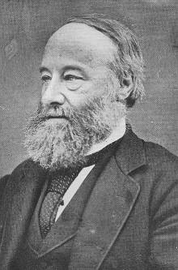
SI unit
Units of energy are
joules (J),
kilojoules (kJ),
calories (cal), or
nutritional calories (Cal or kcal).
James
Prescott
Joule
(1818-1889)
-- conversions:
4184 J = 4.184 kJ = 1000 cal = 1 Cal = 1 kcal

Slide 3
system: the part of the universe we are studying
surroundings: everything else
-- In chemistry, a
closed system
can exchange energy
but not matter with
its surroundings.
-- Usually, energy is transferred to...
…(1)
change an object’s state of motion
...or... (2)
cause a temperature change

Slide 4
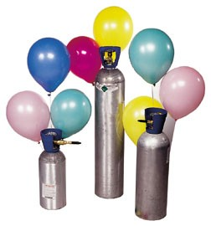
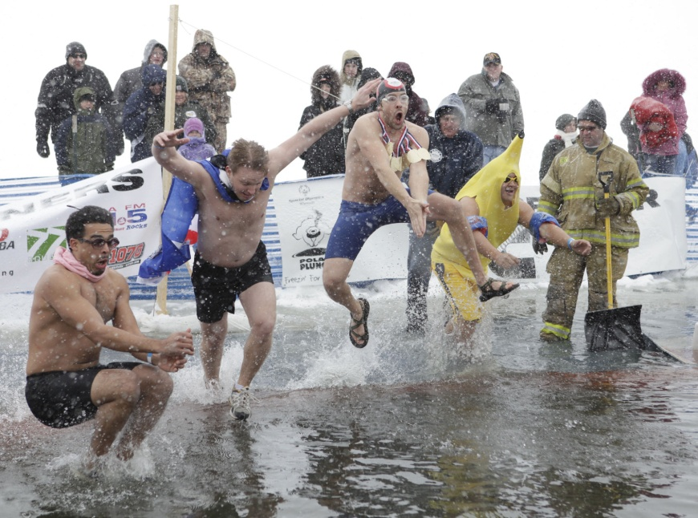
Work (w) is done when a force moves
through a distance.
W = F d
Heat (q) is an amount of energy transferred from
a hotter object to a colder one.

Slide 5
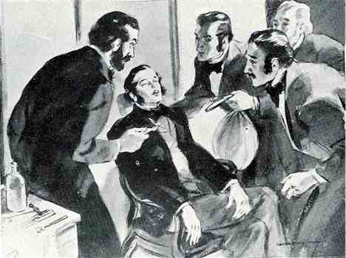
Find the kinetic energy of a
single dinitrogen monoxide
molecule moving at 650 m/s.
N₂O
(laughing gas)
KE = ½ mv²
?
m = 44 amu
= 7.31 x 10^{–26} kg
KE = ½ (7.31 x 10^{–26} kg) (650 m/s)²
= 1.5 x 10^{–20}
J

Slide 6
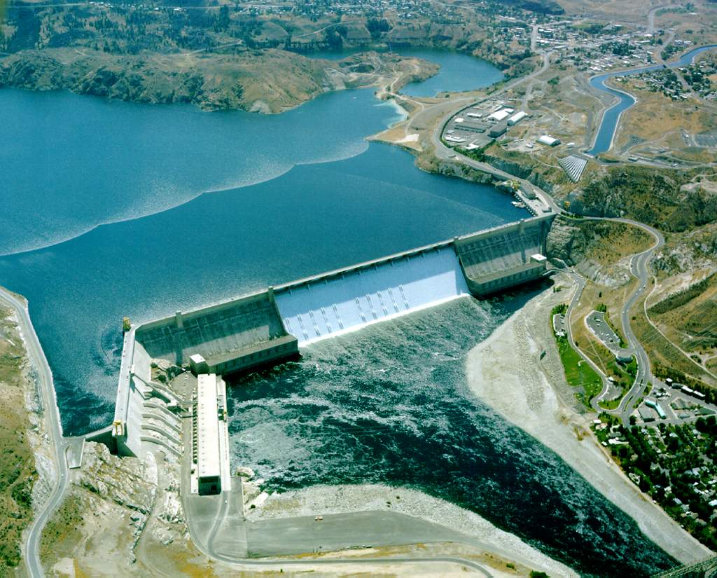
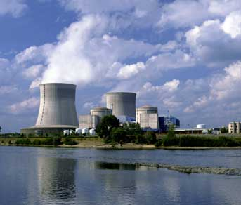
First Law of
Thermodynamics
Law of Conservation
of Energy
=
-- Energy morphs between its various forms,
but the total amount remains the same.
(pretty much)

Slide 7
internal energy (E) of a system: the sum of all the
KE and PE of the components of a system
(this is impossible for us to know)
-- The change in the internal energy
of a system would be found by:
ΔE = E_{final} – E_{initial}
And for chemistry, this equation would become:
ΔE = E_{products} – E_{reactants}
ΔE is + if E_{final} E_{initial} (i.e., system... )
>
gains energy
→ ENDOTHERMIC
ΔE is – if E_{final} E_{initial} (i.e., system... )
<
loses energy
→ EXOTHERMIC

Slide 8
But we ARE able to find ΔE by measuring two
types of “energy” quantities:
ΔE = q + w
q = heat:
+/– q = system absorbs/releases heat
w = work:
+/– w = work done on/by system
** KEY: Sign conventions
are based on the
system’s point of view.
The Titanic was propelled by massive steam
engines. The internal energy of the water
molecules of the steam changed from instant
to instant, depending on how much heat they
were absorbing and how much work they
were doing during a given time interval.

Slide 9
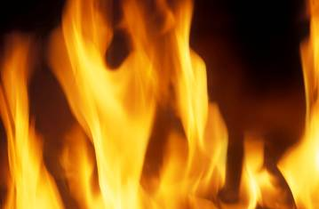
absorbed
In endothermic processes, heat is _________ by
the system.
e.g.,
melting
boiling
sublimation
released
In exothermic processes, heat is ________ by
the system.
e.g.,
freezing
condensation
deposition

Slide 10
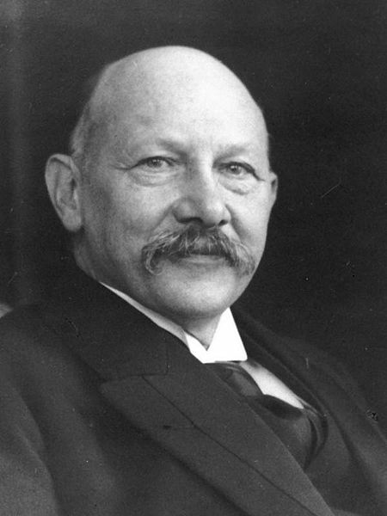
To go further, we must introduce
the concept of enthalpy (H).
-- Enthalpy (H) is defined as... H = E + PV
where E = system’s internal energy
P = pressure of the system
V = volume of the system
The Dutch physicist and Nobel laureate H.K. Onnes coined the term enthalpy, basing it on the Greek term enthalpein, which means “to warm.”
Heike Kamerlingh Onnes
1853–1926

Slide 11
-- There is much that could be said about
enthalpy, but what you need to know is:
If a process occurs at constant pressure,
the change in enthalpy of the system
equals the heat lost or gained by the system.
i.e., ΔH = H_{final} – H_{initial} = q_{P}
_{P} indicates constant pressure conditions.
When ΔH is +, the system...
has gained heat.
(ENDO)
When ΔH is –, the system...
has lost heat.
(EXO)
Enthalpy is an extensive property, meaning that…
the amount of material affects its value.

Slide 12
enthalpy
of reaction:
ΔH_{rxn} = H_{products} – H_{reactants}
(also called “heat of reaction”)
For exothermic rxns, the heat content of the
reactants is larger than that of the products.

Slide 13
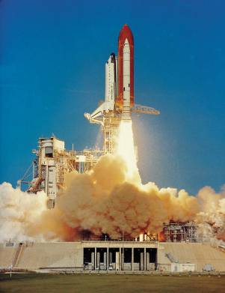
2 H₂(g) + O₂(g) → 2 H₂O(g) ΔH = –483.6 kJ
What is the enthalpy change when
178 g of H₂O are produced?
178 g H₂O
ΔH = –2390 kJ
The space shuttle was powered
by the reaction above.

Slide 14
ΔH for a reaction and its reverse
are the opposites of each other.
Enthalpy/energy
is a reactant.
2 H₂(g) + O₂(g) 2 H₂O(g) (ΔH = –483.6 kJ)
2 H₂O(g) 2 H₂(g) + O₂(g) (ΔH = +483.6 kJ)
Enthalpy change depends on the
states of reactants and products.
2 H₂(g) + O₂(g) 2 H₂O(g) (ΔH = –483.6 kJ)
2 H₂(g) + O₂(g) 2 H₂O(l) (ΔH = –571.6 kJ)

Slide 15
Calorimetry: the measurement of heat flow
-- device used is called a...
calorimeter
heat capacity of an object: amount of heat needed to
raise object’s temp. 1 K = 1ºC
molar heat capacity: amt. of heat needed to raise
temp. of 1 mol of a substance 1 K
specific heat (capacity): amt. of heat needed to raise
temp. of 1 g of a substance 1 K
i.e.,
molar heat capacity = molar mass X specific heat

Slide 16
We calculate the heat a substance loses or gains using:
q = m c_{P} ΔT
AND
q = ⁺/– m c_{X}
(for within a given
state of matter)
(for between two
states of matter)
where q = heat
m = amount of substance
c_{P} = substance’s heat capacity
ΔT = temperature change
c_{X} = heat of fusion (s/l)
or heat of vaporization (l/g)

Slide 17
Typical Heating Curve
g
← heat removed (–q)
l/g
l
Temp.
s/l
heat added (+q) →
s
HEAT

Slide 18
What is the enthalpy change when 679 g of water at
27.4ºC are converted into water vapor at 121.2ºC?
g
c_{f} = 333 J/g
l/g
c_{v} = 40.61 kJ/mol
Temp.
l
c_{P,l} = 4.18 J/g-K
s/l
c_{P,s} = 2.077 J/g-K
c_{P,g} = 36.76 J/mol-K
s
HEAT
Heat liquid…
q = m c_{P} ΔT
= 679 g (4.18 ^{J}/_{g-K}) (100 – 27.4)
= 206 kJ
Boil liquid…
q = +m c_{X}
= +37.72 mol (40.61 ^{kJ}/_{mol})
= 1532 kJ
Heat gas…
q = m c_{P} ΔT
= 37.72 mol (36.76 ^{J}/_{mol-K}) (121.2–100)
= 29.4 kJ
ΔH = 1767 kJ
+

Slide 19
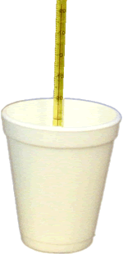
With a coffee-cup calorimeter, a reaction is
carried out under constant pressure conditions.
-- Why is the pressure constant?
calorimeter isn’t sealed,
atmospheric pressure is constant
-- If we assume that no heat is exchanged
between the system and the surroundings, then
the solution must absorb any heat given off by
the reaction.
i.e., q_{absorbed} = –q_{released}
the specific heat
of water
-- For dilute aqueous solutions, it
is a safe assumption that c_{P} =
4.18 J/g-K

Slide 20
When 50.0 mL of 0.100 M AgNO₃ and 50.0 mL of
0.100 M HCl are mixed in a coffee-cup calorimeter,
the mixture’s temperature increases from 22.30ºC to
23.11ºC. Calculate the enthalpy change for the
reaction, per mole of AgNO₃.
Assume:
AgNO₃ + HCl →
AgCl + HNO₃
-- mixture c_{P} = c_{P} of H₂O
-- mixture mass = 100 g
0.05 L,
0.1 M
0.05 L,
0.1 M
338.58 J
ΔH =
0.005 mol
0.005 mol
0.005 mol AgNO₃
q = m c_{P} ΔT
kJ
–
67.7
= 100 (4.18) (23.11–22.30)
mol AgNO₃
= 338.58 J
(for 0.005 mol AgNO₃)

Slide 21
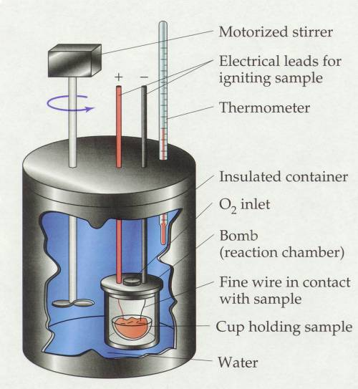
Combustion reactions are studied using constant-
volume calorimetry.
This technique requires
a bomb calorimeter.
-- The heat capacity of
the bomb calorimeter
(C_{cal}) must be known.
unit is J/K
(or the equivalent)
bomb calorimeter

Slide 22
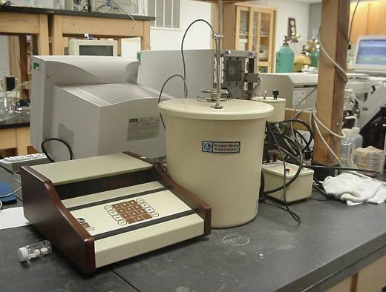
-- Again, we assume that no energy escapes into the
surroundings, so that the heat absorbed by the bomb
calorimeter equals the heat given off by the reaction.
Solve bomb calorimeter problems by
unit cancellation.
another bomb
calorimeter

Slide 23
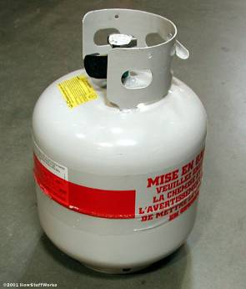
A 0.343-g sample of propane, C₃H₈, is burned in a
bomb calorimeter with a heat capacity of 3.75 kJ/ºC.
The temperature of the material in the calorimeter
increases from 23.22ºC to 27.83ºC. Calculate the
molar heat of combustion of propane.
kJ
3.75
(27.83ºC–23.22ºC)
ºC
17.29 kJ
0.343 g
–2220 kJ/mol

Slide 24
Hess’s Law
The ΔH_{rxn}s have been calculated and tabulated for
many basic reactions. Hess’s law allows us to put
these simple reactions together like puzzle pieces
such that they add up to a more complicated
reaction that we are interested in. By adding or
subtracting the ΔH_{rxn}s as appropriate, we can
determine the ΔH_{rxn} of the more complicated reaction.
The area of a composite shape
can be found by adding/subtracting
the areas of simpler shapes.

Slide 25
Calculate the heat of reaction for the combustion of
sulfur to form sulfur dioxide.
2 SO₂(g) + O₂(g) 2 SO₃(g) (ΔH = –198.2 kJ)
S₈(s) + 12 O₂(g) 8 SO₃(g) (ΔH = –3161.6 kJ)
S₈(s) + 8 O₂(g) 8 SO₂(g)
(TARGET)
S₈(s) + 12 O₂(g) 8 SO₃(g) (ΔH = –3161.6 kJ)
8 SO₃(g) 8 SO₂(g) + 4 O₂(g) (ΔH = +792.8 kJ)
2 SO₂(g) + O₂(g) 2 SO₃(g) (ΔH = –198.2 kJ)
2 SO₃(g) 2 SO₂(g) + O₂(g) (ΔH = +198.2 kJ)
S₈(s)
+
8 O₂(g)
8 SO₂(g)
need to cancel…
ΔH = –2368.8 kJ

Slide 26
Calculate ΔH for the reaction…
5 C + 6 H₂ C₅H₁₂
given the following:
C₅H₁₂ + 8 O₂ 5 CO₂ + 6 H₂O (ΔH = –3535.6 kJ)
C + O₂ CO₂ (ΔH = –393.5 kJ)
H₂ + ½ O₂ H₂O (ΔH = –285.8 kJ)
5 CO₂ + 6 H₂O C₅H₁₂ + 8 O₂ (ΔH = +3535.6 kJ)
C₅H₁₂ + 8 O₂ 5 CO₂ + 6 H₂O (ΔH = –3535.6 kJ)
5 C + 5 O₂ 5 CO₂ (ΔH = –1967.5 kJ)
C + O₂ CO₂ (ΔH = –393.5 kJ)
6 H₂ + 3 O₂ 6 H₂O (ΔH = –1714.8 kJ)
H₂ + ½ O₂ H₂O (ΔH = –285.8 kJ)
5 C
+ 6 H₂
C₅H₁₂
ΔH = –146.7 kJ

Slide 27
Calculate ΔH for the reaction…
5 C + 6 H₂ C₅H₁₂
given the following:
C₅H₁₂ + 8 O₂ 5 CO₂ + 6 H₂O (ΔH = –3535.6 kJ)
C + O₂ CO₂ (ΔH = –393.5 kJ)
H₂ + ½ O₂ H₂O (ΔH = –285.8 kJ)
C₅H₁₂ + 8 O₂ 5 CO₂ + 6 H₂O + 3535.6 kJ
5 CO₂ + 6 H₂O + 3535.6 kJ C₅H₁₂ + 8 O₂
C + O₂ CO₂ + 393.5 kJ
5 C + 5 O₂ 5 CO₂ + 1967.5 kJ
6 H₂ + 3 O₂ 6 H₂O + 1714.8 kJ
H₂ + ½ O₂ H₂O + 285.8 kJ
5 C
+ 6 H₂
C₅H₁₂
+ 146.7 kJ
ΔH = –146.7 kJ

Slide 28
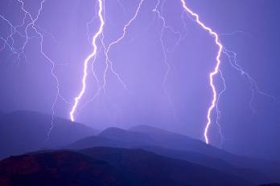
enthalpy of formation (ΔH_{f}): the enthalpy change
associated with the formation of a compound
from its constituent elements
-- also called… heat of formation
When finding the standard enthalpy of formation (ΔH_{f}º),
all substances must be in their standard states. The
“standard state” of a substance has arbitrarily been
chosen to be the state of the substance at 25ºC
(298 K). If more than one form
of the element exists at 298 K,
then the standard state is the
most stable form,
e.g., O₂ rather than O₃.

Slide 29
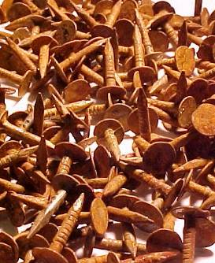
-- By definition, ΔH_{f}º for the most stable form of
any element in its standard state is zero.
e.g.,
ΔH_{f}º for O₂(g) or Al(s) or S₈(s), etc. is ZERO
-- ΔH_{f} values are for 1 mol of substance,
so the units are typically kJ/mol.
-- Many ΔH_{f} values have
been tabulated.
ΔH_{f}º for Ni(s) = 0, but is = 0 for Fe₂O₃.

Slide 30
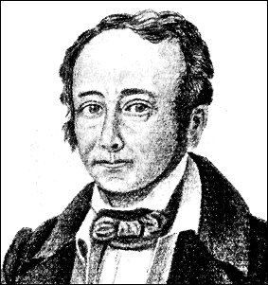
standard enthalpy of a reaction (ΔHº_{rxn}):
ΔHº_{rxn} is the change in enthalpy
of a reaction when all substances
are in their standard states
(i.e., at 25ºC).
-- Using Hess’s law, we can
easily calculate ΔHº_{rxn} from
the ΔH_{f}º of all R and P.
Germain Henri Hess
(1802 – 1850)
-- equation:
ΔHº_{rxn} = Σn ΔH_{f}º(products) – Σm ΔH_{f}º(reactants)
where n and m are the coefficients
in the balanced equation

Slide 31
Approximate the enthalpy change for the
combustion of 246 g of liquid methanol.
(Look these up.
See App. C,
p. 1112+.)
2
CH₃OH(l)
+
3
O₂(g)
2
CO₂(g)
+
4
H₂O(g)
–238.6 ^{kJ}/_{mol}
0 ^{kJ}/_{mol}
–393.5 ^{kJ}/_{mol}
–241.8 ^{kJ}/_{mol}
X 2
X 2
X 4
–477.2 kJ
–1754.2 kJ
ΔHº_{rxn} =
–1754.2 kJ – (–477.2 kJ)
= –1277 kJ
So…
for 2 mol
(i.e., 64 g)
of CH₃OH
X = ΔH = –4910 kJ

