Slide 1
Welcome, AP Parents and Guardians
October 22,2024 // Leslie Hyle, AP Coordinator

Slide 2
Agenda:
About Avanced Placement
AP at Leon High School
AP testing accommodations
Digital testing
Exam Expectations and Policies

Slide 3
Some information about Avanced Placement (AP)
AP classes are College-level courses that you can take in high school.
Taking AP courses can boost your GPA. - - AP classes are worth a full point towards the weighted GPA.
Research consistently shows that AP students are better prepared for college than students who don’t take AP, regardless of their exam score. They’re more likely to enroll and stay in college, do well in their classes, and graduate in four years.
AP classes and exams are all from a company called College Board.
AP” on your high school transcript shows colleges you're motivated to succeed, and taking the exam demonstrates your commitment to tackle and complete college-level work.

Slide 4
What is College Board?
College Board is a mission-driven, not-for-profit organization that connects students to college success.
Other programs from College Board:
PSAT
SAT
Big Future
Springboard
And more.
​
For more information, please visit : https://about.collegeboard.org/

Slide 5
AP classes at Leon High School:

Slide 6
AP at Leon High School :
2024 – 2025 School Year
AP classes:
AP Biology
AP Chemistry
AP Human Geography
AP United States Government
AP Statistics
AP World History Modern
AP United States History
AP Macroeconomics
AP English Literature and Composition
AP Calculus AB & BC
AP Music Theory
AP Seminar
AP Pre-calculus
AP Enviromental Science
AP English Language & Composition
AP Art History
AP Physics
AP Psychology
AP Reseach
AP Drawing & AP Studio Art 2
For the 2024-25 school year Leon has 22 AP class options
Leon has 23 outstanding AP teachers.
The number students enrolled in AP courses increased by 5% this year.
43% of the 2025 graduating class is enrolled in at least one AP course.
34% of all students are enrolled in at least one AP course this year.

Slide 7
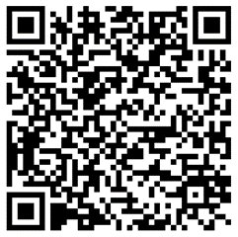
Jeannine Meis :
AP World History: Modern Teacher
AP Parent
Amazing human being
Insight into an AP classroom

Slide 8
Why take AP? (from a teacher)
Experience college-level coursework through scaffolded instruction.
Develop organization, study skills, and college-level learning strategies.
Improve writing and communication skills.
Critically evaluate the world around them
Students learn to take personal responsibility for their own education.
Exam grade is not tied to course grade

Slide 10
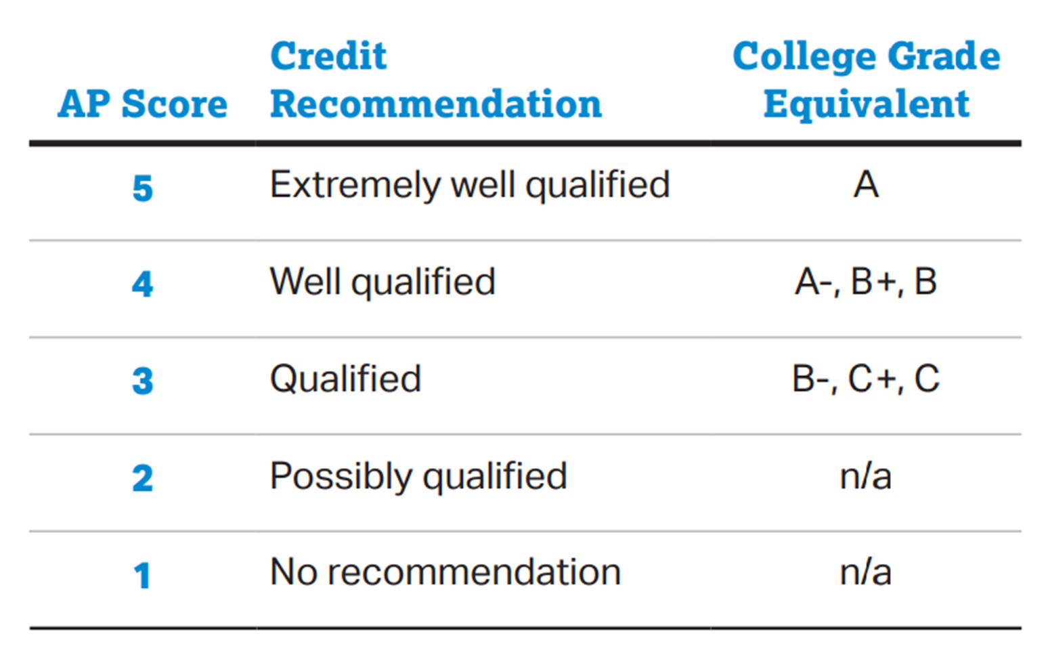

Slide 11
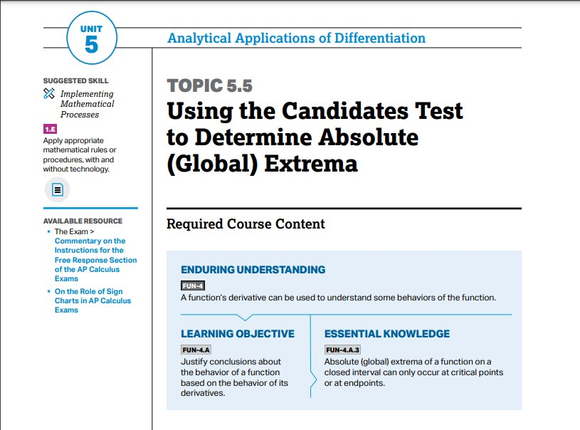

Slide 13
How to be successful in AP Courses (students)
Save course materials until after the AP exam
Students should study smarter, not harder:
Use CED
Prepare in stages: review materials as-needed, turn "learning goals" into questions
Interact frequently with content in class and at home
Study with friends.
Be more concerned with learning than grades.

Slide 14
How to be successful in AP Courses (parents)
Encourage your student to advocate
Encourage uninterrupted work time
Ask, "What did you learn in AP ____ today?"
Help your student make connections
Check Focus weekly

Slide 15
AP Exam Accommodations:
FAQ : Accommodations Hand out

Slide 16
What are testing Accommodations?
Testing accommodations are changes to the testing environment or process that help ensure that students with disabilities or other needs can demonstrate their knowledge and skills.
Some examples of Accommodations are:
Extended time 50% or 100%
Small group Setting
Large Block tests
Frequent Breaks

Slide 17
How do I apply for Accommodations?
To apply for accommodations please fill out the consent form for Accommodations request and return it to the main office.
Last day to apply for accommodations is January 24, 2025.
You can apply for accommodations after this date but they might
not be processed in time for testing

Slide 18
How can I check my student's accommodations:
There is no way to check accommodations through your students College Board account currently.
You can email the SSD Coordinator Kelly Folmar at folmark@leonschools.net
Or you can email the AP Coordinator Leslie Hyle at hylel@leonschools.net

Slide 19
Digital Exams 2025
Exam schedule handout

Slide 20
What to Know About Digital AP Exams :
Bluebook digital testing is user-friendly and designed to keep testing smooth and secure.
Exams will be taken on school-managed Chromebooks.
Students only need to be connected to the internet to start the test and at the end to submit their responses. If the internet drops during testing, students can continue testing without disruption.
After the proctor starts the exam, Bluebook controls the exam timing; exam responses are submitted automatically as soon as the exam ends.
In case of a widespread internet outage for an extended period or another unforeseen issue that prevents automatic answer submission at the end of the exam, students have up until 4 days after the exam to find an internet connection and submit their encrypted responses.
Accommodations such as extended time are provided in Bluebook.
Students will have ample opportunities to familiarize themselves with digital AP Exams, including test previews in the Bluebook app, AP Classroom practice assessments that closely mimic the look and feel of Bluebook exams, video tours of Bluebook features and tools, and more.

Slide 21
Digital Testing : AP Digital Testing uses the Bluebook APP
Completely digital exams:
AP Art History
AP Comparative Government and Politics
AP English Language and Composition
AP English Literature and Composition
AP Environmental Science
AP European History
AP Human Geography
AP Psychology
AP Seminar
AP United States Government and Politics
AP United States History
AP World History: Modern
Accommodations built in :
50% and 100% Time
Text to speech
Extra and extended breaks
Large print
Screen reader

Slide 22
Hybrid Digital Exams:
AP Biology
AP Calculus AB
AP Calculus BC
AP Chemistry
AP Macroeconomics
AP Physics 1: Algebra-Based
AP Precalculus
AP Statistics
What do they mean by hybrid?
Students complete multiple-choice questions and view free-response questions in Bluebook. They handwrite their free-response answers in paper exam booklets that are returned for scoring.

Slide 23
AP Exams that did not change:
AP 2-D Art and Design
AP Drawing
AP Music Theory
AP Research
These are exams with audio components and exams consisting solely of portfolio assessments.

Slide 24
AP Exam expectations and policies :

Slide 25
On Exam Day Student expectations:
Students should eat a good breakfast. ( Finish it before the exam, no food or drink is allowed in the exam room without an accommodation.)
Students should be at the LHS gym at the set arrival time for check-in.
Students should bring only the items approved by College Board.
Students should make sure their Chromebook is charged.
Students should bring a College Board Approve calculator. If it is allowed on the test.
Students should wear comfortable clothes; most AP exams are 3 hours long.

Slide 26
What can my student bring to AP exam?
School Chromebook
A College Board approved calculator. ( If allowed on their test.)
Pen (blue or black ink only) or pencil (must be number 2) for Hybrid tests
A watch that does not have internet access and does not make any kind of noise.
A ruler or straightedge only if you are taking an AP Physics Exam.

Slide 27
What can my student not bring to AP exam?
Backpacks or bags.
Cell phones or electronic communication devices of any kind.
Earplugs, highlighters, correction fluid, pencils that are not No. 2, or pens that are not blue or black ink.
Scratch paper - if your exam requires the use of scratch paper, you will be provided with it during the exam.
Any subject-related information on your clothing, shoes, or body.
You are not permitted to bring food or drink, including bottled water, into the exam room (unless you have an accommodation).
We will provide a small optional snack and water bottle during the break.
This is the list from 2024, College Board has not release the 2025 list yet.

Slide 28
Is my student excused from class on AP exam days?
Yes, your student is excused from class on days they are taking a AP exam. They are responsible for missed work on these days.

Slide 29
College Board exams start/end times:
On each exam day there is a morning exam window and an afternoon exam window.
College Board sets these windows, and we have no control over the start time. Once the Proctor has started reading the exam instructions no students will be admitted into the exam room. (See late to AP exam)
Bluebook will keep track of the testing time and students may not end their test early. No books or other materials are allowed into testing room, so students must sit quietly and wait for the time to end.
Even if a student is done with their exam, if they cause a disturbance in the testing room or talk to a fellow student their exam may be invalidated.

Slide 30
What if my student is late to an AP Exam:
Leon High Schools' Policy for students who arrive late to an AP exam:
Students have 48 hours after the late arrival to email the AP coordinator at hylel@leonschools.net to explain why they were late. A committee made up of Micheal Bryan, Rebecca Salvo and Leslie Hyle will meet to determine if the reason meets with College Boards late testing policy. If it is determined that it meets the College Board late testing policy a late test will be ordered for that student. If it does not meet with the College Board late testing policy, the student can take a late exam with the $45 fee.
If an email is not received with in the 48-hour period, the student will not be able to retake the exam and will owe $90 for the missed exam.

Slide 31
What if my student misses an AP Exam:
Leon High Schools' Policy for students who misses an AP exam:
Students have 48 hours after the missed exam to email the AP coordinator at hylel@leonschools.net to explain why they could not attend. A committee made up of Micheal Bryan, Rebecca Salvo and Leslie Hyle will meet to determine if the reason meets with College Boards late testing policy. If it is determined that it meets the College Board late testing policy a late test will be ordered for that student. If it does not meet with the College Board late testing policy, the committee will decide if the student can take a late exam with the $45 fee or if the student will not be allowed to re-take that exam and will owe a $90 missed exam fee.
If an email is not received with in the 48-hour period, the student will not be able to retake the exam and will owe $90 for the missed exam.

Slide 32
What if my student is sick on the AP Exam day:
Leon High Schools' Policy for AP Exam missed due to sickness:
Students have 48 hours after the missed exam to email a copy of their doctorts note to the AP coordinator at hylel@leonschools.net. Once the note has been accepted, they will be rescheduled to take a make-up exam. If a doctor's note is not provided the student will have to pay the $45 late fee before the make-up will be ordered.
If an email is not received with in the 48-hour period, the student will not be able to retake the exam and will owe $90 for the missed exam.

Slide 33
College Board approved: late-testing reasons allowed without incurring an additional fee are.
Academic contest/event
Athletic contest/event
Conflict with IB or Cambridge exam
Conflict with nationally, province-, or state-mandated test
Delayed shipment
Disabilities accommodations issues
Emergency: bomb scare or fire alarm
High school graduation
Language lab scheduling conflict
Makeup AP Exam due to an incident during the initial exam
Religious holiday/observance
School closing: election, national holiday, or natural disaster
Serious injury, illness, or family tragedy
Strike/labor conflict
Student court appearance
2 or more AP Exams on the same date at the same time

Slide 34
Free exam Help resources:

Slide 35
Free resources to help your student prepare:
1. AP Daily: Practice Sessions
Mark your calendars for new AP Daily: Practice Sessions, a video series focused on practicing free-response and multiple-choice questions. These short, 15-minute video sessions will be led by experienced AP teachers and released on April 22. All videos will be posted on AP Classroom and YouTube and can be watched at any time before your AP Exams.
2. AP Daily Videos
Review and continue building your knowledge of course content and skills with AP Daily. Watch these short videos, taught by experienced AP teachers, on your own time to review and practice all the content and skills that will be assessed on your AP Exam this year. Log in to AP Classroom to get started.

Slide 36
Free resources to help your student prepare:
3. AP Daily: Live Review Recordings
Did you know that you’re able to view last year’s AP Daily: Live Review videos? Access them in AP Classroom. Go to the Review page in the Course Resources section to view them. It’s never too early to start preparing.
4. Other AP Classroom Resources
AP Daily, AP Daily: Practice Sessions, and AP Daily: Live Review recordings are available in AP Classroom, along with these resources that your teachers may use to help you prepare throughout the year.
Reports: Personalized charts and data that show your understanding of course content and skills over time so you can view your progress from unit to unit.
Additional Tips: Use this handy interactive user guide to get the most out of your AP Classroom experience.

