Slide 1
Tuesday
May 12th 2020
Ms.Reshard’s Class

Slide 2
Today’s Office Hours:
10:00 am - 11:00 am
5:00 pm - 6:00pm

Slide 3
THis week’s Learning Goals
Reading
Math
Science
Social studies
I can combine 3-dimensional shapes to create a new shape (composite shape) and build new shapes from composite shapes.
can build and draw shapes that have specific defining attributes.
I can identify who is telling the story at various points in the the text.
I can identify ways Earth’s surface changes. Students will explain how Earth surface changes affect living things.
I can idenify what a community is and explain why its important.

Slide 4
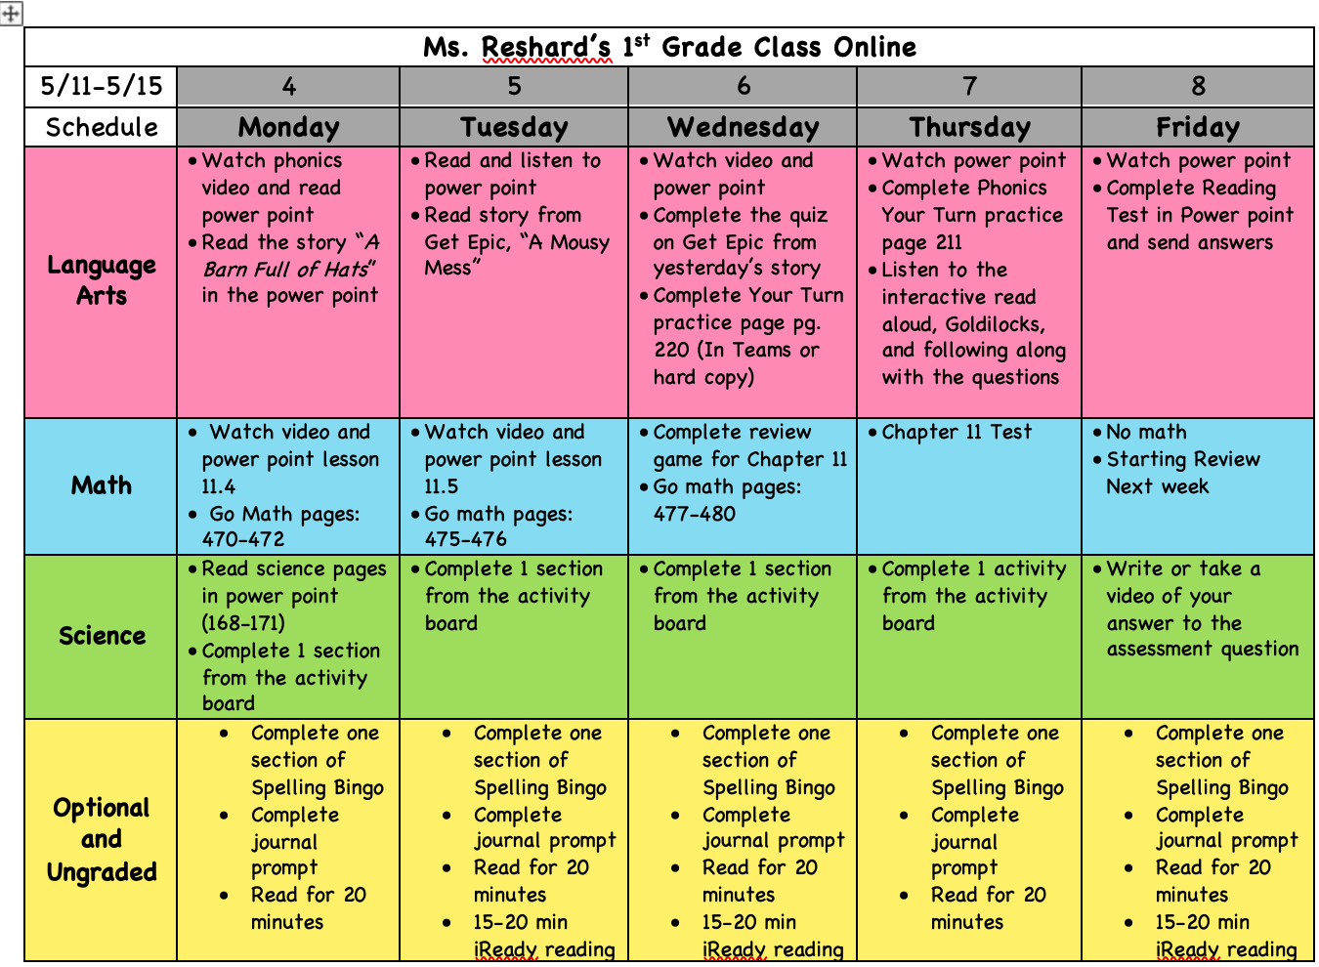
Weekly Calendar

Slide 5
Daily Affirmations
I can be anything I want to be.
I am an important person in this world.
I can dream dreams and make them come true.
Every new day is a chance to improve.
I can learn from my mistakes.
I can take risks and do hard things.
I can learn from others and they can learn from me.
I can make smart choices.
I control the good that happens to me.
I am kind. I am respectful. I am loved.

Slide 6
Reading

Slide 7
REading to do list
1.
3.
Review Focus Slide
2..
Review Spelling Words
Read a Mousey Mess on Epic

Slide 8
THis week’s skills
comprehension
phonics
grammar
Structural analysis
Essential question
Point of view
/ar/
Irregular plurals
Expanding and combining sentences
How can we classify and categorize things?

Slide 9
Unit 4 week 2 spelling words
Cart
Barn
Arm
Art
Yarn
6. Harm
7. Happy
8. Key
9. Four
10. None
11. Large
12. Only
13.Put
14. Round

Slide 10
Read the story A mousey Mess on epic.com
Login to getepic.com and read the story A mousey mess that is assigned to you!
Tomorrow you will be taking a quiz on the story, so remember good readers go back and reread.

Slide 11
mATH

Slide 12
math to do list
1.
Watch and participate in Lesson 11.5
Complete GoMath pages 475-476
2..

Slide 13
lesson 11.5: 2d and 3d shapes

Slide 14
YOU’RE ALMOST DONE!
Complete Gomath pages 475-476

Slide 15
SCIENCE

Slide 16
Science to do list
1.
Watch Erosion Demo
Complete one activity on the Checklist
2..

Slide 17
Erosion Demo

Slide 18
Science activities: Complete onE each day
1
5
2
4
3
Watch the video, “Volcanoes for Kids,” at https://www.youtube.com/watch?v=3Jxeh-yAXek. Write 3 facts you learned from the video.
Complete the experiment on the next slide.
Draw a quick picture and write a definition for the following fast change words: volcano, earthquake, flood
Draw a quick picture and write a definition for the following slow change words: weathering, erosion, drought
Watch the video, “Weathering and Erosion” at https://www.youtube.com/watch?v=R-Iak3Wvh9c. Write or draw to explain the meaning of weathering
and erosion.

Slide 20
TURN THESE THINGS INTO MS. RESHARD
Nothing to turn in
You can turn this in my sending the picture through remind or uploading to Microsoft Teams.

Slide 21
More practice These things are optional

Slide 22
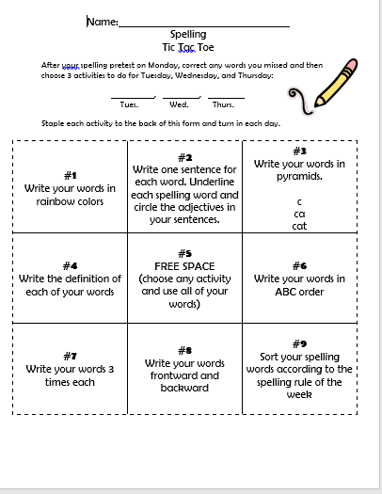
Spelling tic tac toe:
Pick one activity to complete! Pick a different one to complete every day of the week.

Slide 23
Getting ready for your daily journal:
Writing checklist
Copy the sentence and fill in the blanks, then add one sentence all on your own!
Check your punctuation and capitalization.
Check your spelling.
Make sure you use finger spaces.
Draw a picture about your writing.

Slide 24
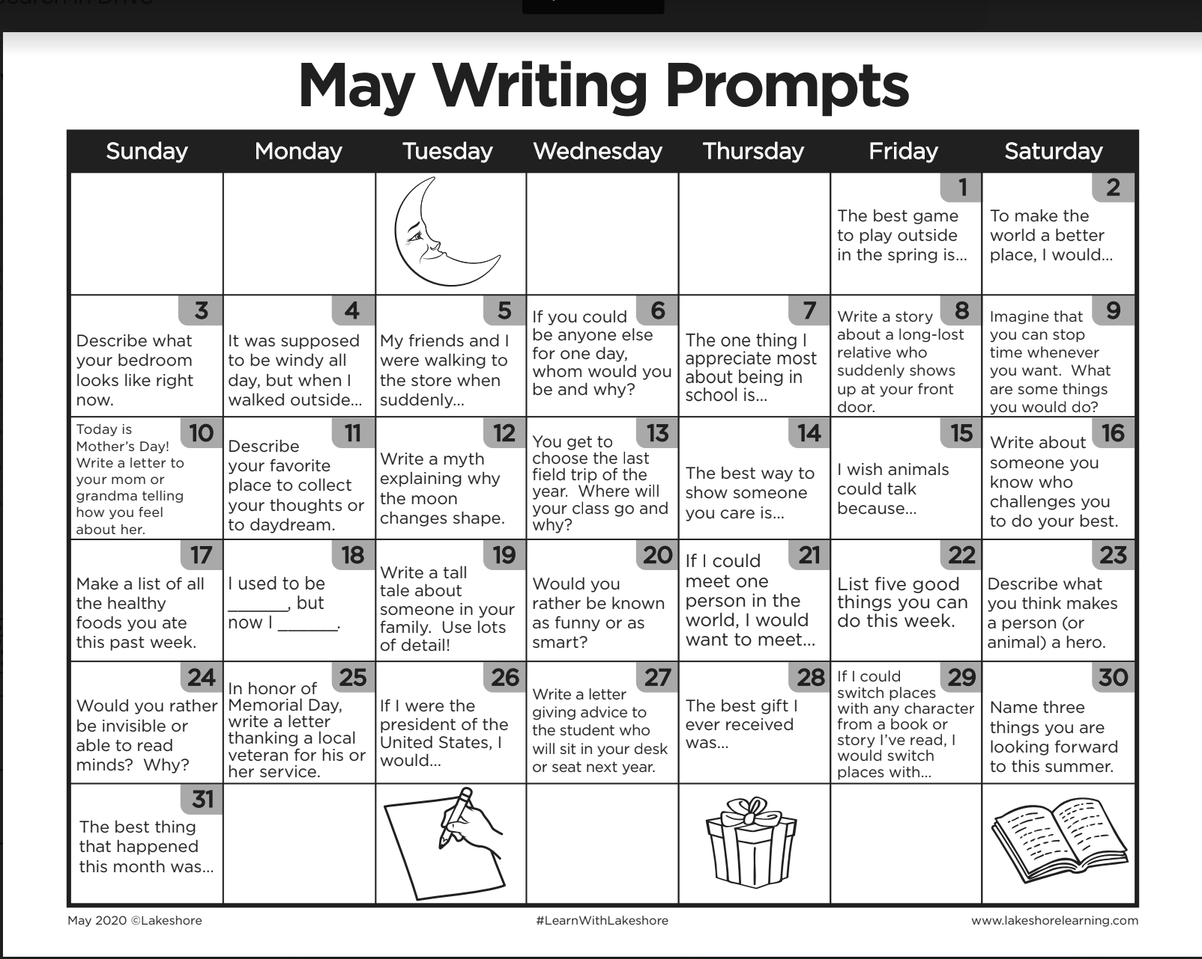
Writing prompt example response

Slide 25
YOU’RE ALMOST DONE!
COmplete 20 minutes of iready
Complete 20 minutes of independent reading

Slide 26
You're finished!

