Slide 1
Comparing Physical Structures of Plants and Animals
SC.5.L.14.2
Compare and contrast the function of organs and other physical structures of plants and animals, including humans, for example: some animals have skeletons for support — some with internal skeletons others with exoskeletons — while some plants have stems for support.
Notes:
Today we are going to compare and contrast the function of organs and other physical structures of plants and animals.

Slide 2
PLANTS & ANIMALS
Plants and animals are very similar in many ways. Several of their physical structures, although different, have common functions. Among these similarities are their support systems, protective coverings, vascular systems, sensory organs, means for respiration, and reproductive systems.
Notes:
Plants and animals are very similar in many ways. Several of their physical structures, although different, have common functions.

Slide 3
SIMILARITIES IN PLANTS AND ANIMALS
SUPPORT SYSTEM
PROTECTIVE SYSTEM
VASCULAR SYSTEM
SENSORY ORGANS
RESPIRATORY SYSTEM
REPRODUCTIVE SYSTEM
Notes:
Among these similarities are their support systems, protective coverings, vascular systems, sensory organs, means for respiration, and reproductive systems.

Slide 4
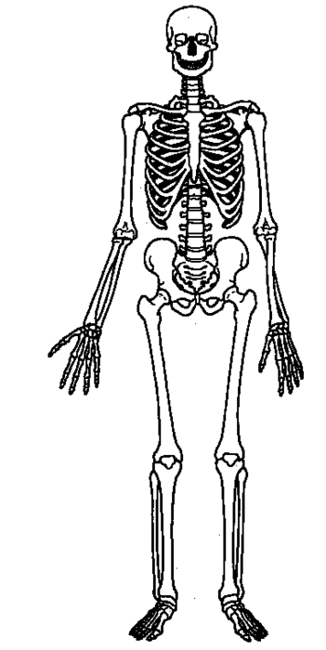
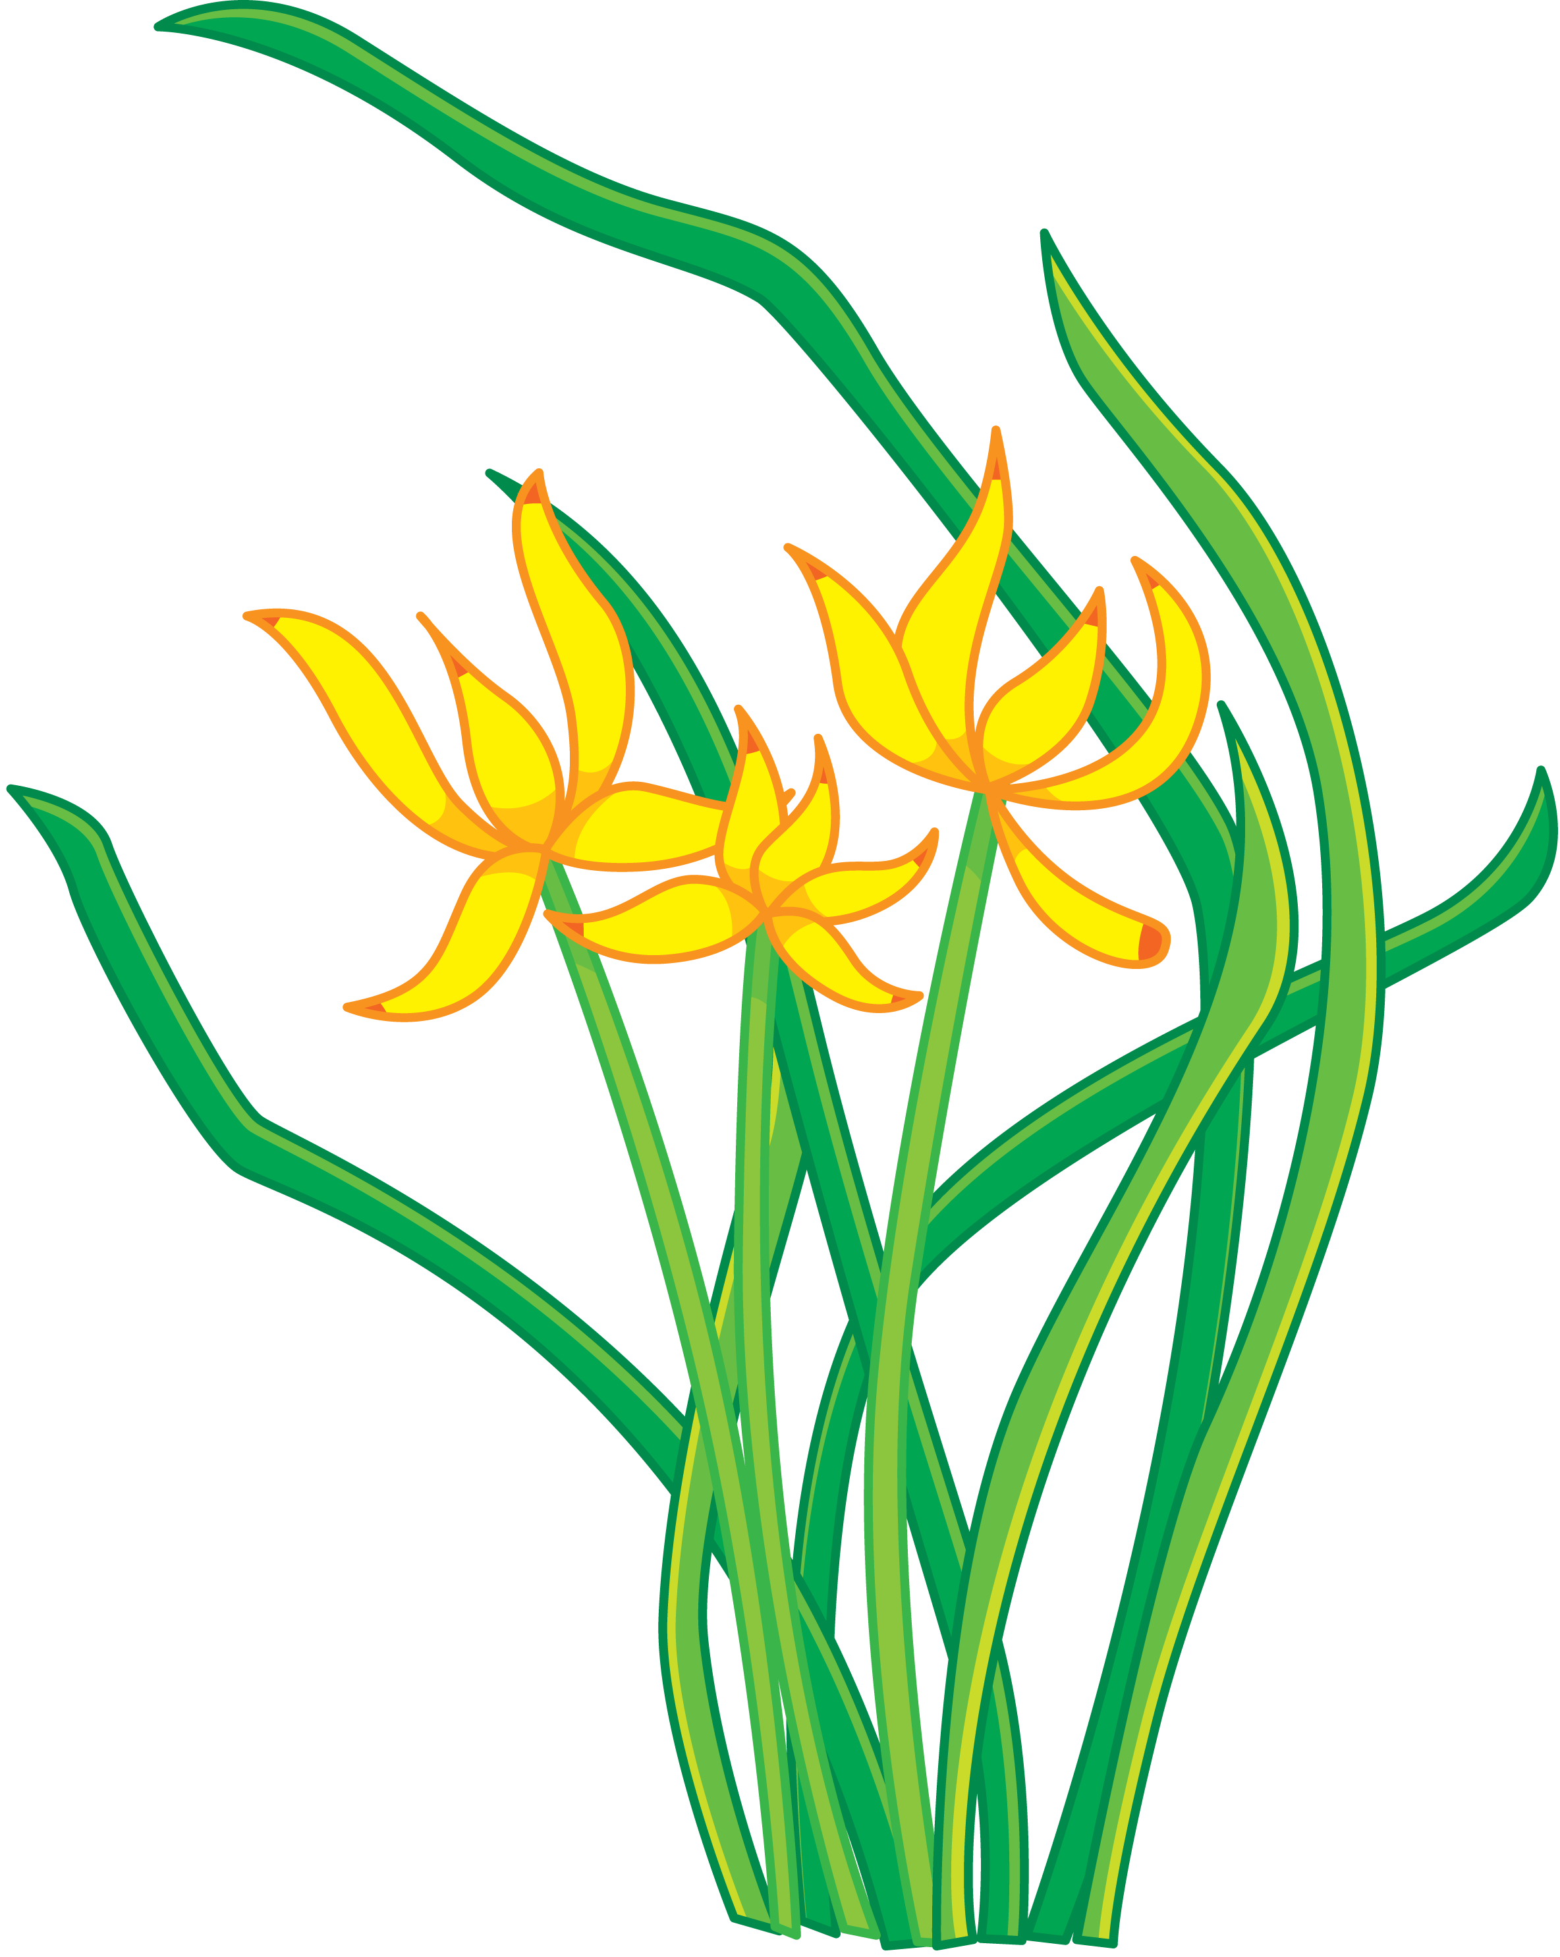
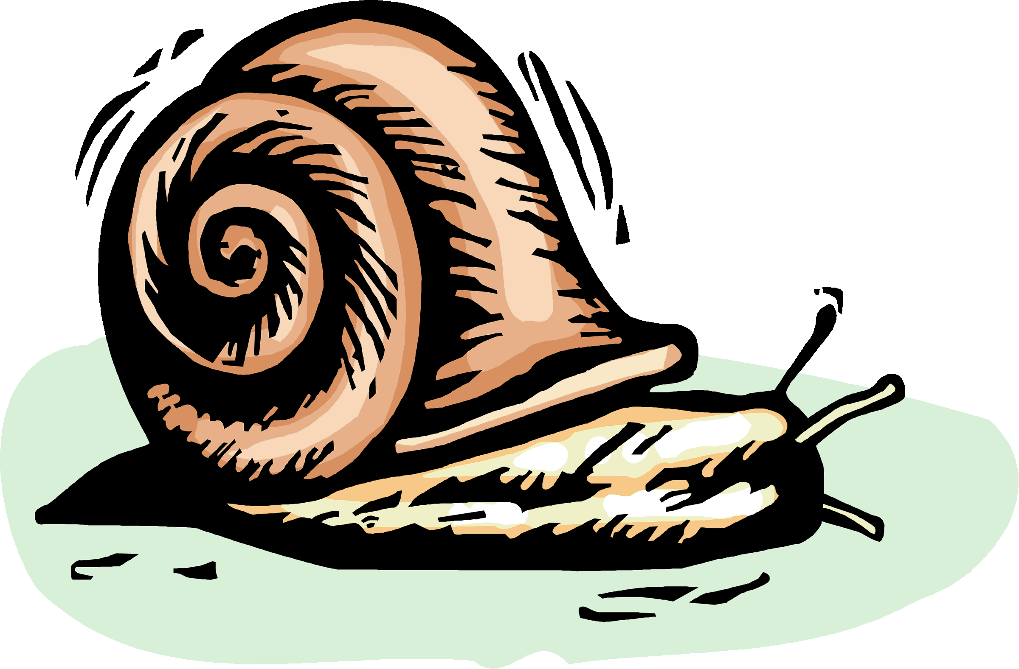
SUPPORT SYSTEM
ANIMALS
PLANTS
Endoskeleton
Stems
Exoskeleton
Notes:
Both plants and animals have support systems. Plants are held up by their stems which gives them both structural support and the ability to keep the leaves up toward the light. Animals, on the other hand, rely on their skeletal system for support. Some animals like humans, birds, and fish have internal skeletons made up of numerous bones called endoskeletons. Other animals including mollusks, insects and crustaceans have exoskeletons. Exoskeletons are hard outer coverings like shells.

Slide 5
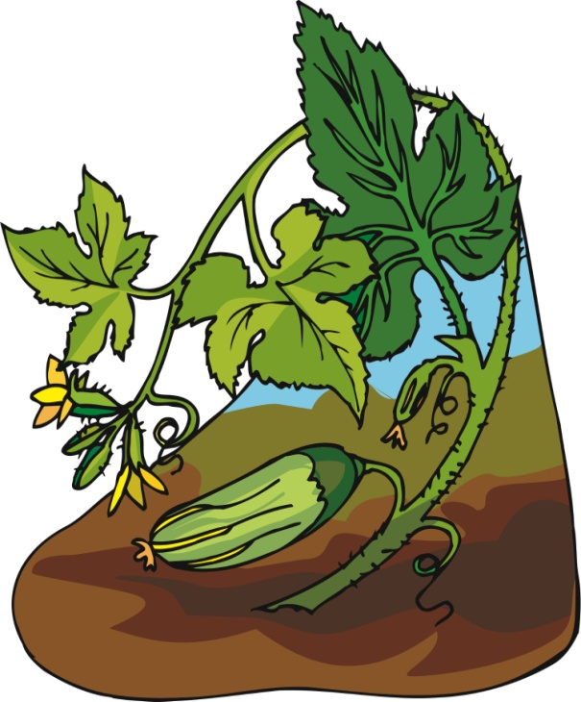
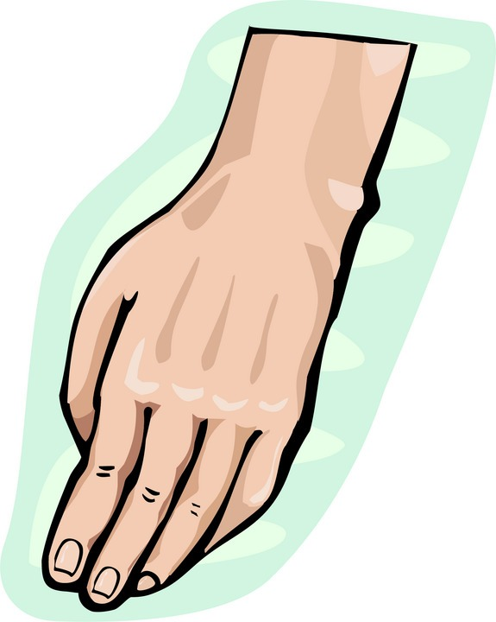
PROTECTIVE SYSTEM
ANIMALS
PLANTS
S K I N
WAXY COVERING
Notes:
Plants and animals also have protective coverings. Plants have a waxy outer covering that keeps them from losing water, where as animals have a layer of skin which protects them from the environment. The skin is the largest organ of the body and functions to protect and regulate body temperature.

Slide 6
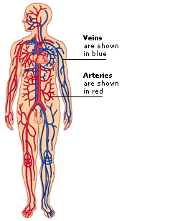
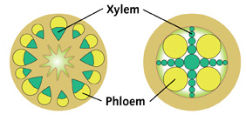
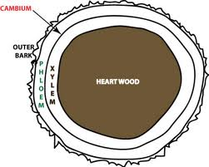
VASCULAR SYSTEM
ANIMALS
PLANTS
ARTERIES AND VEINS
XYLEM AND PHLOEM
Notes:
Vascular systems are another important system that plants and animals have in common. Plants have a vascular system that includes tissue called xylem and phloem. Xylem functions to take water and dissolved minerals to the leaves. The phloem transports the food made in the leaves to all parts of the plant. On the other hand, animals have a vascular system that includes arteries, veins, and capillaries. These blood vessels are a part of the circulatory system and function to transport oxygen, nutrients, and wastes to and from the body’s cells.

Slide 7
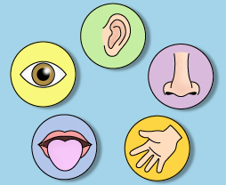
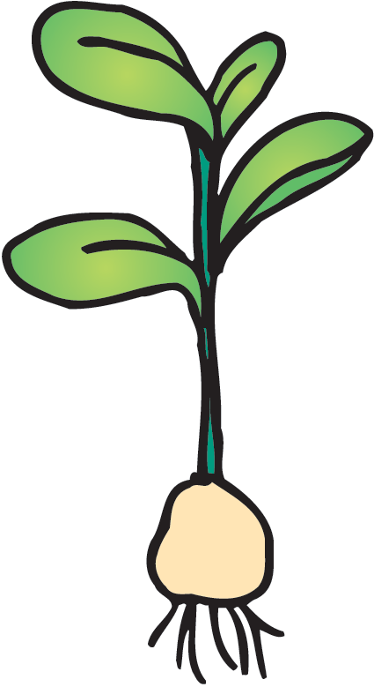
SENSORY SYSTEM
ANIMALS
PLANTS
LEAVES
STEMS
SENSORY ORGANS
ROOTS
Notes:
Both, plants and animals have sensory organs that are sensitive to a stimulus. The sensory organs for animals are the eyes, ears, nose, and the tongue. These organs allow animals to see, hear, smell, and taste things that send impulse back to the brain. Most plants do not have sensory organs yet, the roots, stems, and leaves are able to respond to stimuli including: light, touch, and gravity.

Slide 8
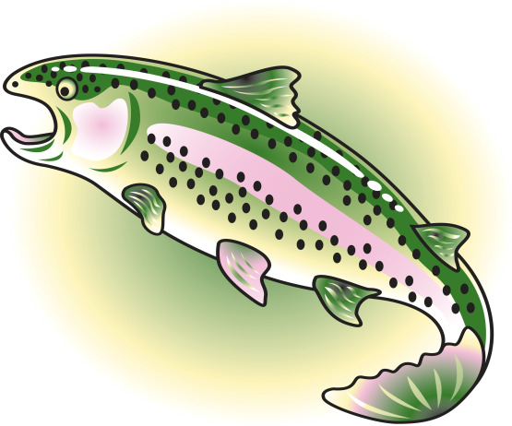
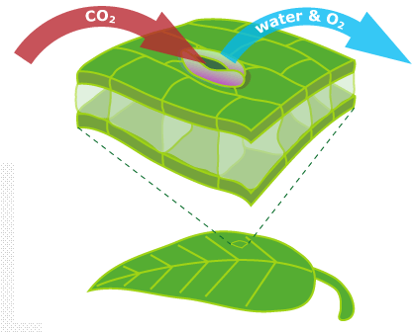
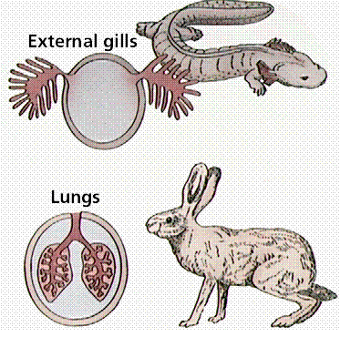
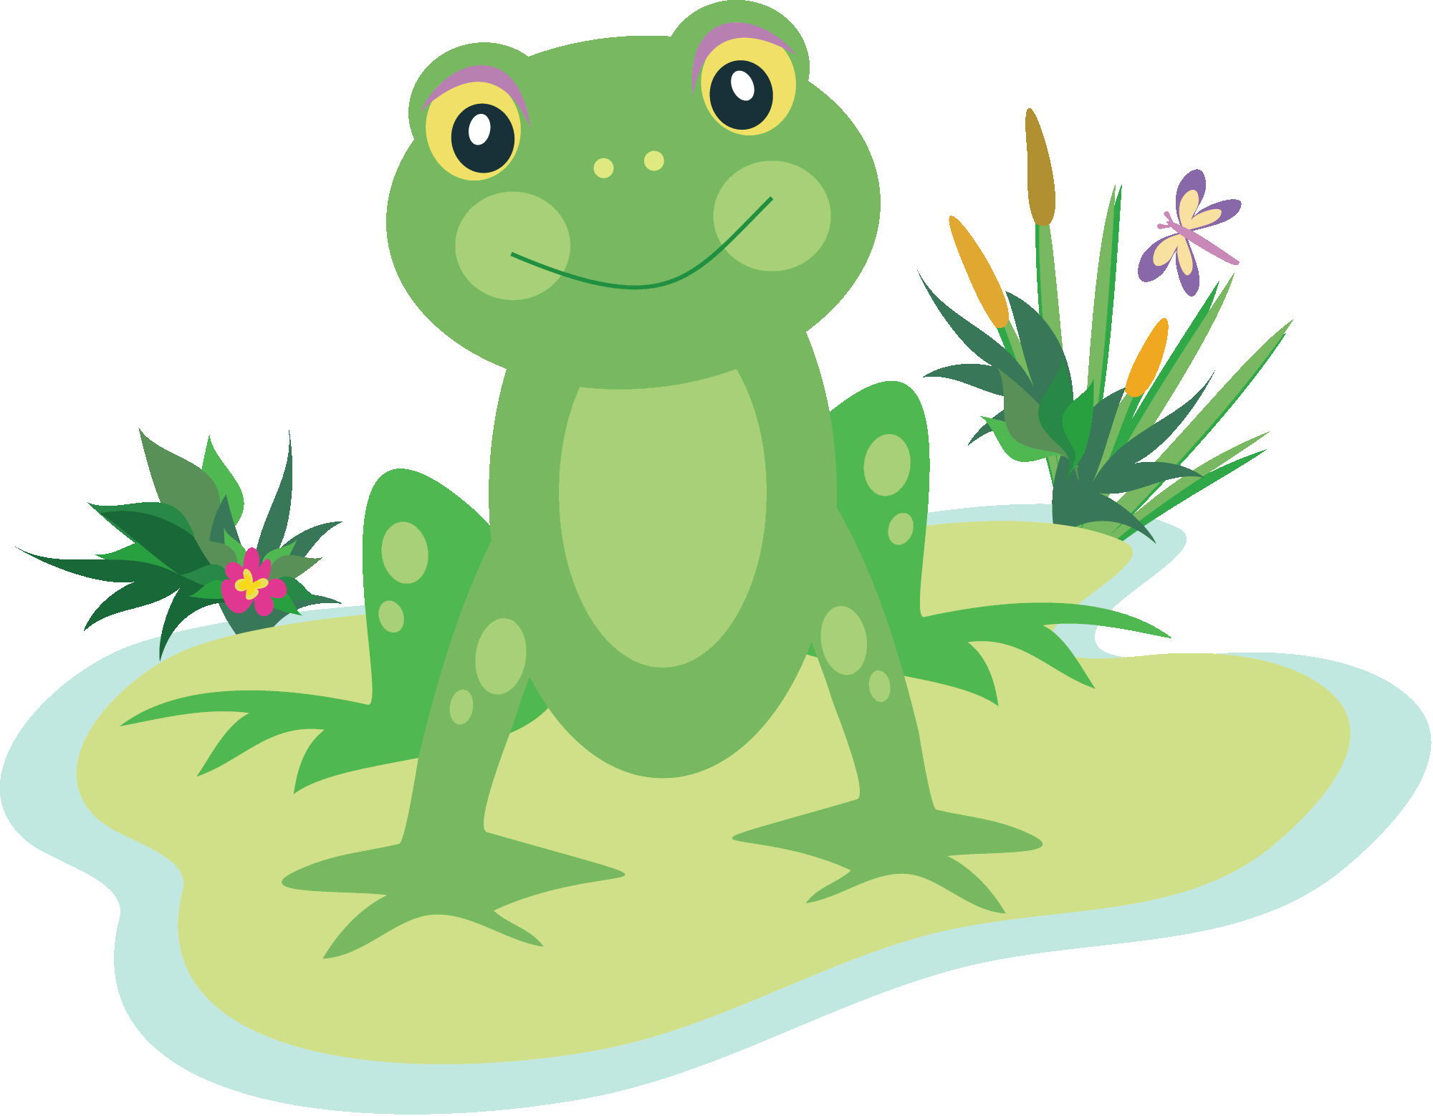
RESPIRATORY SYSTEM
ANIMALS
PLANT
GILLS
LUNGS
LEAVES
Notes:
The respiratory system in animals is similar to transpiration in plants. The respiratory system functions to take in oxygen through the nose and mouth into the lungs and exhale carbon dioxide gases into the atmosphere. Some animals such as amphibians and some worms are able to exchange gases through their moist skin. Fish have gills, while mammals, birds, and reptiles have lungs. During plant respiration, carbon dioxide gases are taken in through the stomata of the leaves and used in the process of photosynthesis. The oxygen is released from the leaves into the atmosphere.

Slide 9
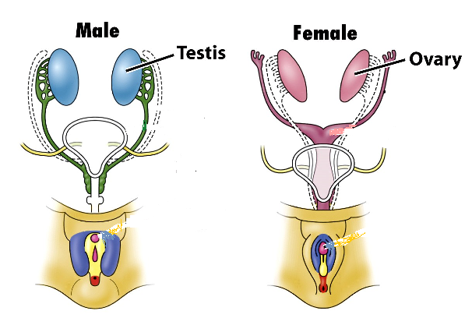
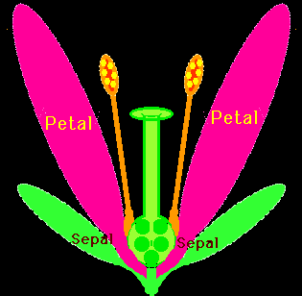
REPRODUCTIVE SYSTEM
ANIMALS
PLANT
ANIMAL
REPRODUCTIVE SYSTEM
PLANT
REPRODUCTIVE SYSTEM
Notes:
The reproductive system includes organs that work together for the purpose of reproduction. Animals have a female reproductive system or male reproductive system which includes organs such as ovaries and testes. The flower is the reproductive organ of most plants. The female reproductive organs of plants include petals and sepals while, the stamen, is the male reproductive organ. Plants differ in whether they reproduce with spores or seeds. Flowering plants reproduce by seeds, but non-flowering plants such as fungi reproduce from spores. Seeds and spores with the right conditions are capable of germinating and developing into a new adult plant.

