Slide 1
As I Lay Dying

Slide 2
The Southern Renaissance
Literary movement beginning in the 1920s.
Previous Southern writing romanticized and glorified the “Lost Cause” of the South and the culture of the South (known as the Antebellum South) prior to the Civil War.
The Southern Renaissance included authors such as Tennesse Williams and Zora Neale Hurston.

Slide 3
The Southern Renaissance focused heavily on three issues impacting the South:
1. “The burden of history” – the aftershock of slavery and Reconstruction (shifting from a slave-dependent economy to a state in which former slaves were citizens with rights).
2. The South’s Conservative culture – the culture of the South was founded on social philosophies promoting tradition, hierarchy, and authority. As a consequence, power dynamics, individual identity and desire, and breaking from traditional were troublesome issues.
3. Racial issues, tensions, and relations.

Slide 4
Modernism
Philosophical movement that arose from changes in Western society during the late 1800s and early 1900s.
Factors that shape modernism include industrial societies, the rapid growth of cities, and reactions of horror to World War I.
Following World War I (1914-1918) many American felt disillusioned.
The Modernists felt that prior traditions were “spiritually empty”.

Slide 5
Additionally, Moderism rejected the certainty of thought promoted during the Enlightenment (a movement with a heavy emphasis on reasoning) and questioned the nature of knowledge.
Many modernists rejected religious beliefs and viewed much of the culture of the past as obsolete.
A key factor of Moderism was the drive to “experiment” with art: new techniques, including experimentation with poetry and prose, was a staple of the era.

Slide 6
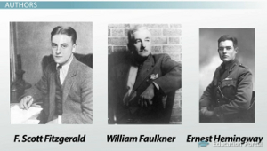

Slide 7
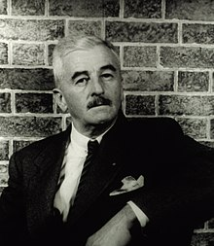
William Faulkner
Born September 25, 1897. Died July 6, 1962.
Is known for his novels and short stories, which are set in the fictional Yoknapatawpha County, based on Lafayette County, Mississippi.
Is included in the canon of Modernist authors.
Received the Novel Prize in Literature in 1949.
Known for his novel The Sound and the Fury (1929).
Published As I Lay Dying in 1930. Wrote the novel while working night shifts at the University of Mississippi Power House.
His novels are staples of the Southern Gothic genre.

Slide 8
Stream of Consciousness
A narrative mode that mimics internal thought processes.
The term “stream of consciousness,” coined by William James, captures the technique because according to James “consciousness flows. A ‘river’ or ‘stream’ are metaphors by which it is most naturally described.”
Differs from interior monologue because it seeks to portray the actual experience of thinking.
Stream of consciousness is not just an attempt to relay a character's thoughts, but to make the reader experience those thoughts in the same way that the character is thinking them.

Slide 9
Example:
“Because I said If you wouldn't keep on sawing and nailing at it until a man cant sleep even and her hands laying on the quilt like two of them roots dug up and tried to wash and you couldn't get them clean. I can see the fan and Dewey Dell's arm. I said if you'd just let her alone. Sawing and knocking, and keeping the air always moving so fast on her face that when you're tired you cant breathe it, and that goddamn adze going One lick less. One lick less. One lick less until everybody that passes in the road will have to stop and see it and say what a fine carpenter he is.”
-Jewel Bundren, As I Lay Dying

Slide 10
The Bundren Family
Addie Bundren: Mother of five, married to Anse Bundren. Former school teacher.
Anse Bundren: Married to Addie. Notoriously lazy. Often laments his bad luck when he simply makes poor choices.
Cash: The firstborn son. Skilled at carpentry and often helpful.
Darl: Two years younger than Cash. His narrations are very articulate, though his speech is plainer. Darl narrates 19 of the chapters.
Jewel: Third son. Addie’s favorite. Often hot-headed and angry.
Dewey Dell: The only daughter. Seventeen years old. Preoccupied with her “condition."
Vardaman: Youngest son. Somewhere between 7-10 years old.

Slide 11
Other Characters:
Vernon Tull: Farmer and neighbor to the Bundren’s.
Cora Tull: Wife of Vernon Tull. Very religious.
Eula and Kate Tull*: Daughters of Vernon and Cora
Whitfield: A local minister.
Lafe*: a local farm hand who sometimes works the Bundren farm.
Samson: A local farmer. Houses the Bundren’s on their journey.
Rachel*: Samson’s wife.
Armstid: 2 nd farmer to house the Bundren’s.
Gilliespie*: Another farmer who houses the Bundrens.
Quick*: a local farmer
Moseley: Older man. A pharmacist.
MacGowan: Young boy. A pharmacist.
*The character is not a narrator of a chapter.

Slide 12
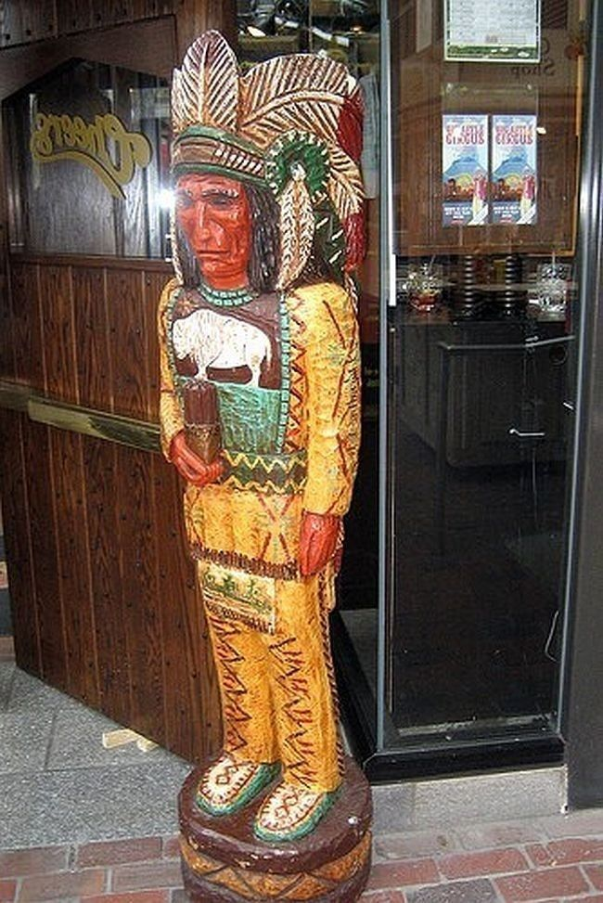
Cigar Store Indian

Slide 13
Cotton House 1930s Mississippi

Slide 14
Adze Blade -- The adze is a cutting tool shaped somewhat like an axe that dates back to the Stone Age. It can be any tool with a sharp cutting edge.[ Adzes are used for smoothing or carving wood in hand woodworking, similar to an axe but with the cutting edge perpendicular to the handle.

Slide 15
Gourd Dipper (Ladle)

Slide 16
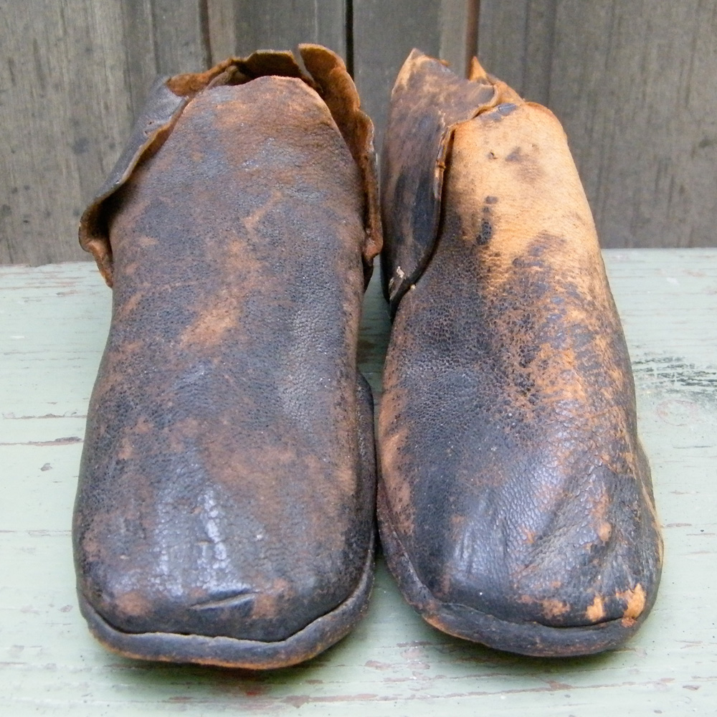
Brogans (work boots)

