Slide 1
OUR INCREDIBLE EARTH
OUR INCREDIBLE EARTH
UNIT
five
WEEK
6
Created by: Nicole Blanco
DAY 1

Slide 2
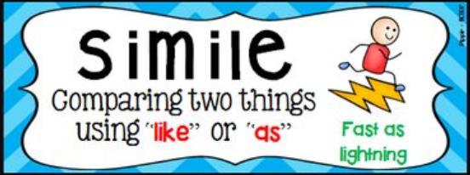
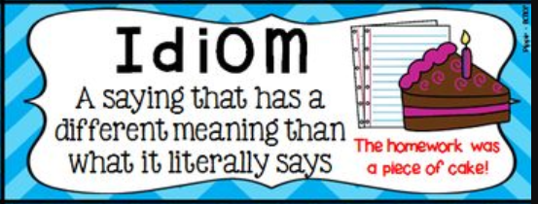
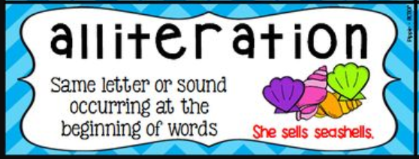
What is figurative language?
Why do we use figurative language?
“Figurative Language” Video
Running time 2:50
Video Opener

Slide 3
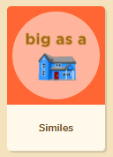
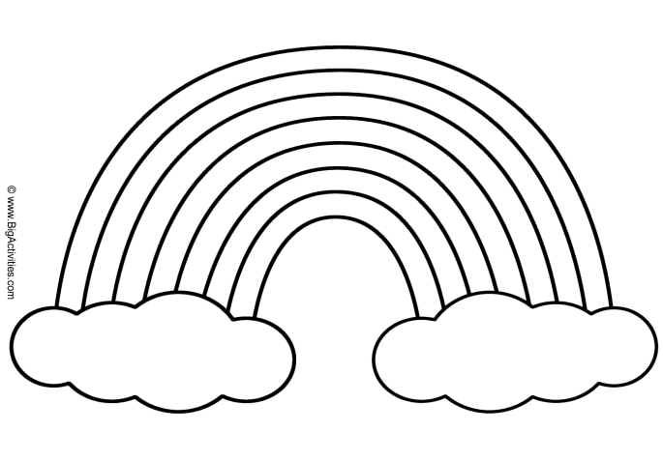
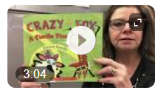
Similes Song
What is a Simile?
Create a colorful rainbow of similes
Crazy as a Fox Similes Read Aloud

Slide 4
Think about the meaning of each word
darkness
redness
thickness
illness
happiness
loneliness
shyness
laziness
kindness
boldness
Suffix -ness

Slide 5
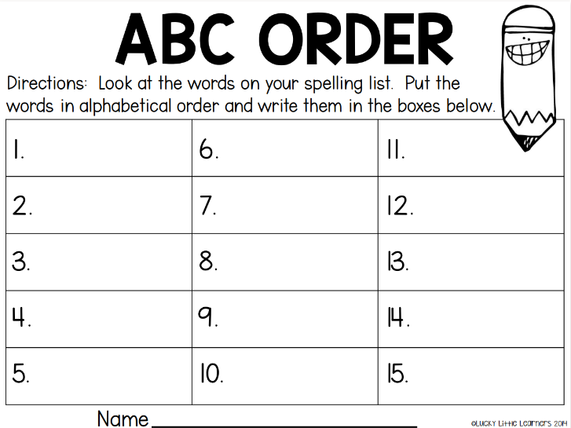
Write your abbreviations in the key and then color according to the code.
Complete your spelling words activity.

Slide 6
End of Day 1

