Slide 1
Unit 5 Week 3: Discover Heroes

Slide 2
Review
While reading Brave Bessie think about sequencing and summarizing. There will be questions after.
The sequence tells the order of ideas in a selection.
To summarize, means to use your own words to tell the most important details and events in a selection.

Slide 3
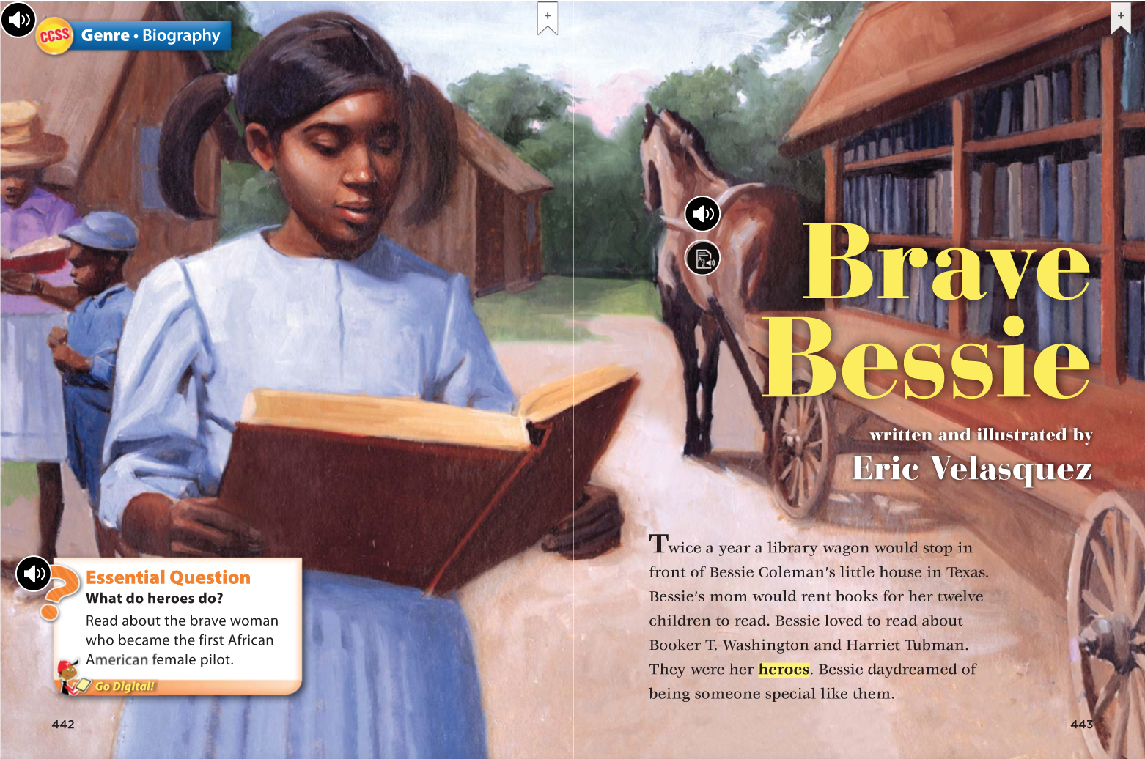

Slide 4
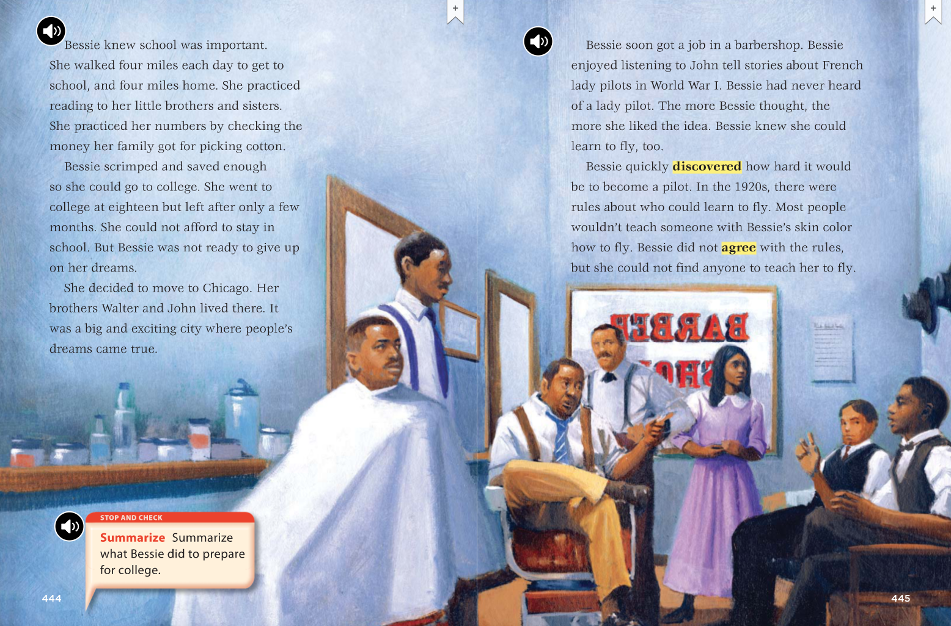

Slide 5
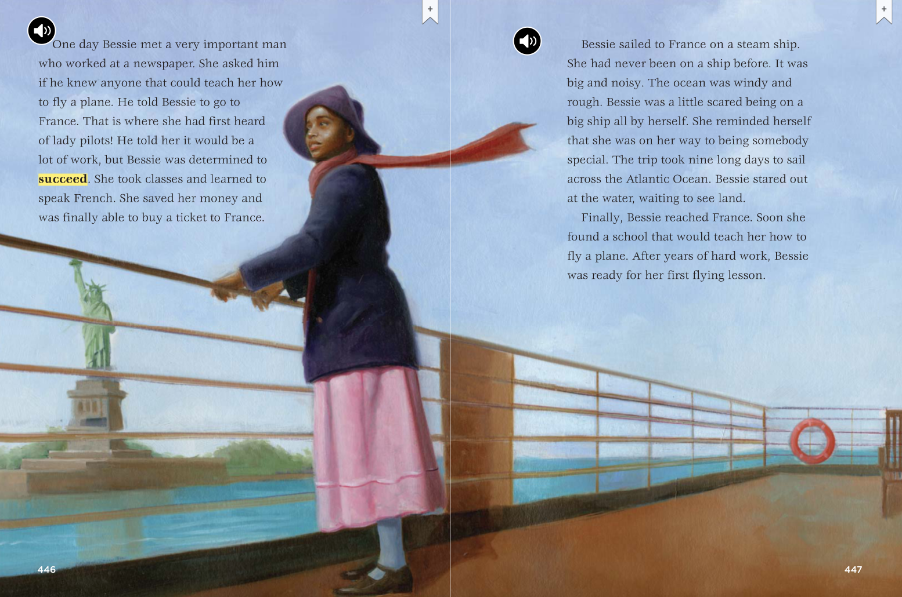

Slide 6
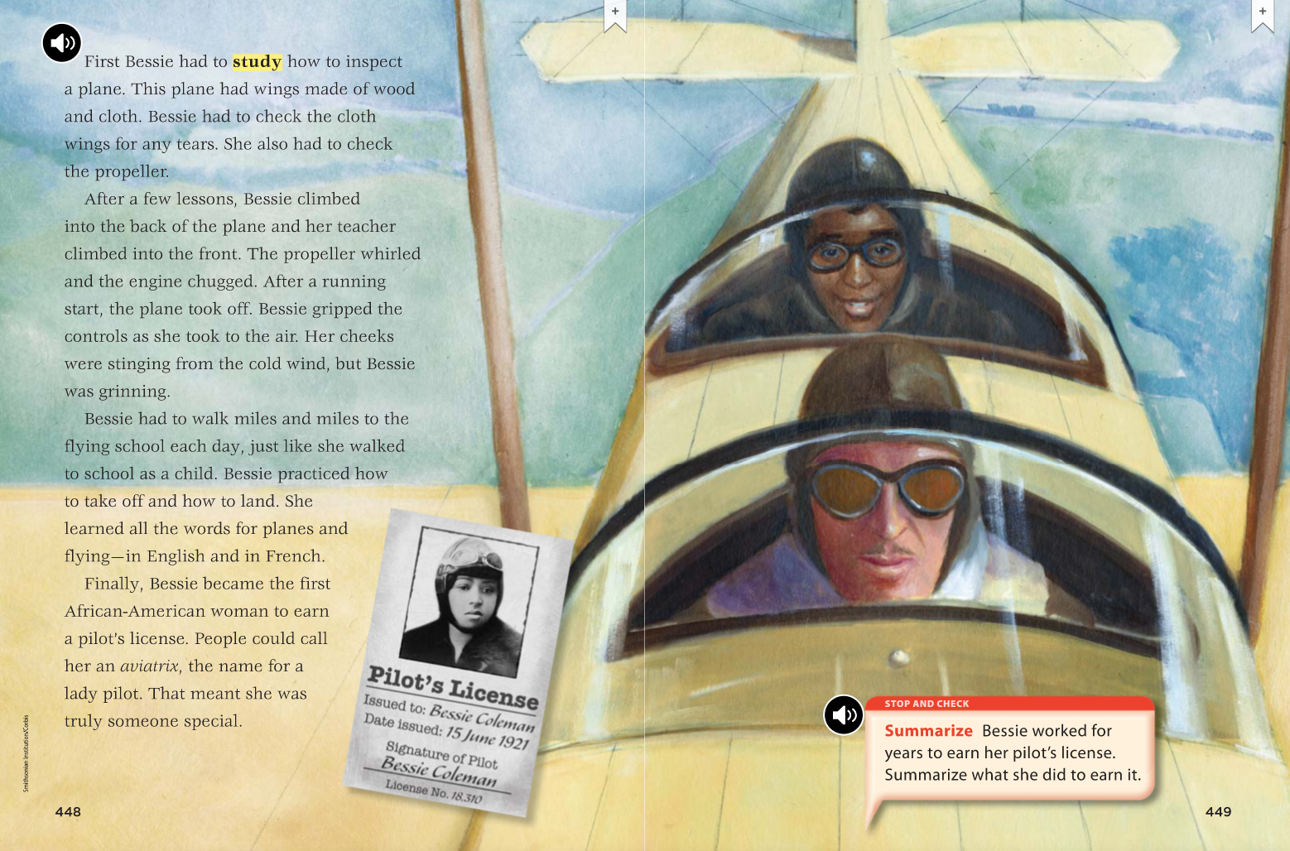

Slide 7
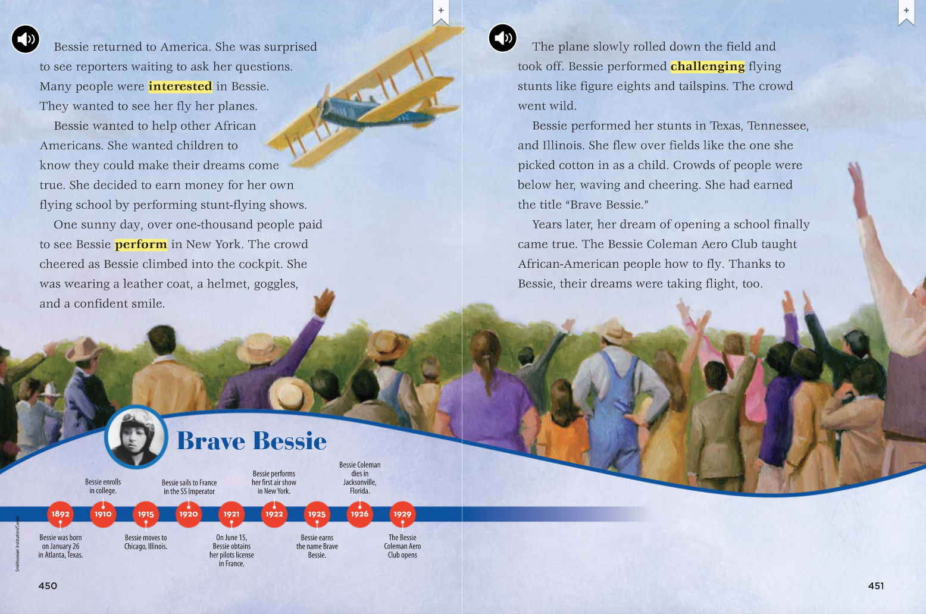

Slide 8
Sequencing
What happened first in Bessie Coleman’s life?
She read books about her heroes and it inspired her to work hard in school.
What happened after Bessie left college early?
Bessie moved to Chicago.
What was Bessie’s first job?
Bessie worked in a barber shop.
What was the first thing Bessie had to do before she could learn to fly?
She had to learn to inspect planes.
What was the last thing to happen in Bessie Coleman’s life?
Before she died: She was nicknamed “Brave Bessie”
After she died: The Bessie Coleman Aero Club was opened (a dream of hers).

Slide 9
Synonyms
Listen to the sentence from the passage:
“Bessie scrimped and saved enough so she could go to college”.
What word in that sentence has almost the same meaning as scrimped?
Saved

