Slide 1
Secondary B.E.S.T. Vignettes
Video #1
Notes:
Hello! Welcome to the first of many videos focusing on the new Florida Benchmarks for Student Thinking, aka B.E.S.T. These videos do not take the place of the self-paced B.E.S.T. courses being offered through Leon Leads, but rather, they add an extra layer of support for targeted sections of the B.E.S.T. document. The whole document can be downloaded from the FLDOE website, which is hyperlinked in the downloadable notes of this Power Point presentation.
Each video will be no more than 20 minutes. These videos are tailored to secondary ELA and Reading teachers, but are also helpful for administrators at the secondary level and anyone seeking to become more familiar with the B.E.S.T. document. These videos can be watched during department meetings, during your planning period or at anytime that is convenient for you as they will be housed here on the Secondary ELA/Reading Site.
Without further ado, let us begin.

Slide 2
01
Table of Contents
Page 1
Notes:
In this video (Video #1), we will discuss the Table of Contents, which can be found on page 1 of the B.E.S.T. Standards and the Coding Scheme, which is explained on page 9. Please note that as we reference page numbers, we are referring to the page number on the actual document, which can be found at the bottom of each page. If you are viewing your standards via the downloadable pdf copy, just make sure to follow along using the page numbers on the bottom of the page itself.

Slide 3
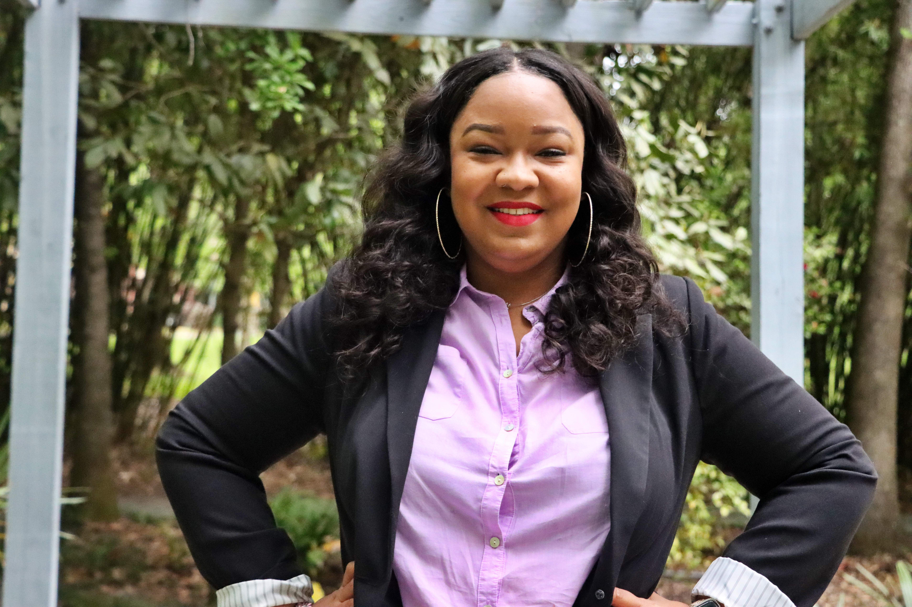
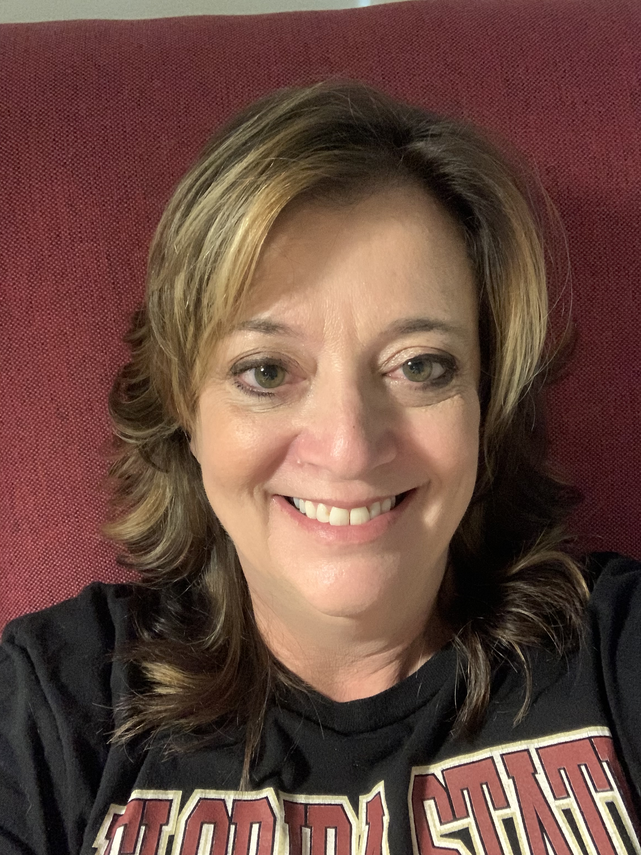
Introduction
SheKishma O'Reilly
Secondary Reading Instructional Developer
Sherri Winsett
Secondary ELA Instructional Developer
Notes:
First, let me introduce your Secondary ELA and Reading duo. I am SheKishma O'Reilly, your Secondary Reading Instructional Developer. Me and Sherri Winsett, your Secondary ELA Instructional Developer, will tag team on these videos to ensure you have a better understanding of your new standards, which will be in full implementation for the 2022-23 school year.

Slide 4
Trying to find something? Look at the TABLE OF CONTENTS
Notes:
Are you trying to find something in this lengthy document? Well, it may sound simple, but start with the Table of Contents. It is the easiest place to find what you are looking for and then place tabs accordingly. As a matter of fact, as we are going through these videos, you may want to have sticky notes or tabs ready so you can easily tag pages. Trust me, you will be referring to those pages often so an easy indicator, like a tab, makes this B.E.S.T. document easier to navigate. Let me point out a few places you may want to tab now...

Slide 5
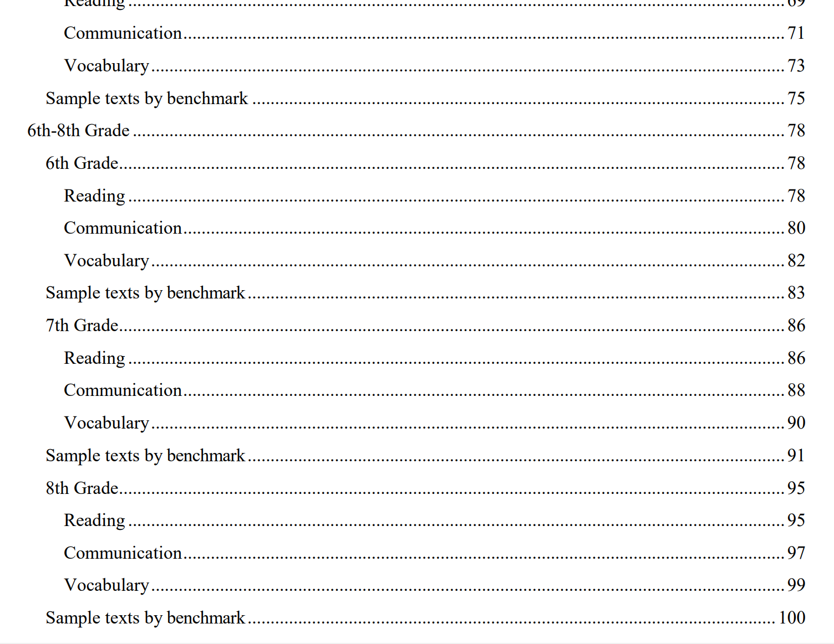
Are you a middle school teacher?
Middle School Standards
pg. 78
6th Grade- pg. 78
7th Grade- pg. 86
8th Grade- pg. 95
Notes:
Are you a middle school teacher? Well, your standards start on page 78. Go ahead and tab that page. You can pause the video while you do that. Now for a few more tabs. The 6th grade standards start on page 78, 7th grade start on page 86 and 8th grade starts on page 95. Pause the video while you tab the grade-level you teach or you can tab each grade level.

Slide 6
Are you a high school teacher?
High School Standards
pg. 104
9th Grade- pg. 104
10th Grade- pg. 114
11th Grade- pg. 125
12th Grade- pg. 136
Notes:
Are you a high school teacher? Your standards start on page 104. Go ahead and tab that page. You can pause the video while you do that. Now for a few more tabs. The 9th grade standards start on page 104, 10th grade starts on page 114, 11th grade starts on page 125 and 12th grade starts on page 136. Pause the video while you tab the grade-level you teach or you can tab each grade level.

Slide 7
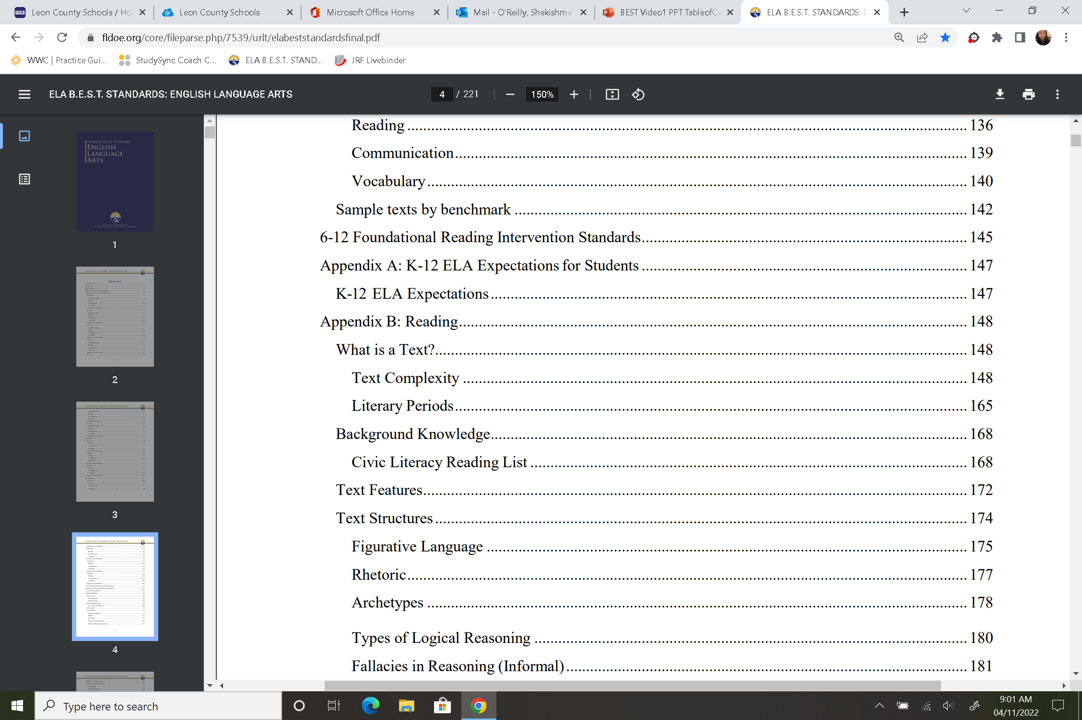
If you are the Teacher of Record for students needing Tier 3 intervention, you already know this, but the Foundation Standards can be found on page 145.
Notes:
If you are the Teacher of Record for students needing Tier 3 intervention, you already know this, but the 6-12 Foundational Reading Intervention Standards can be found on page 145. Tab this page if you do not already have it marked. Pause the video if you need to complete this task.

Slide 8
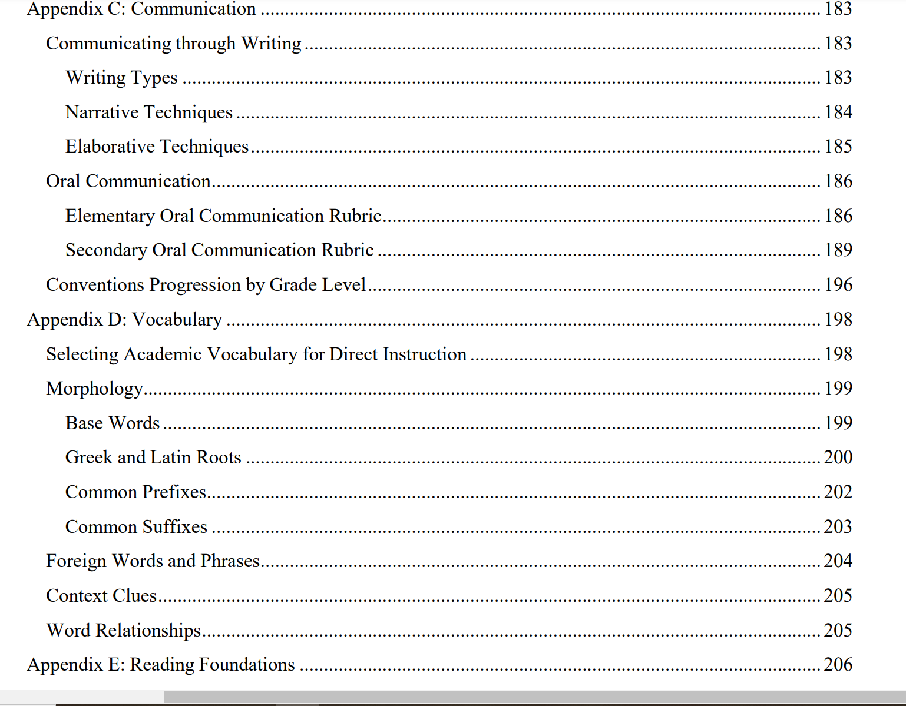
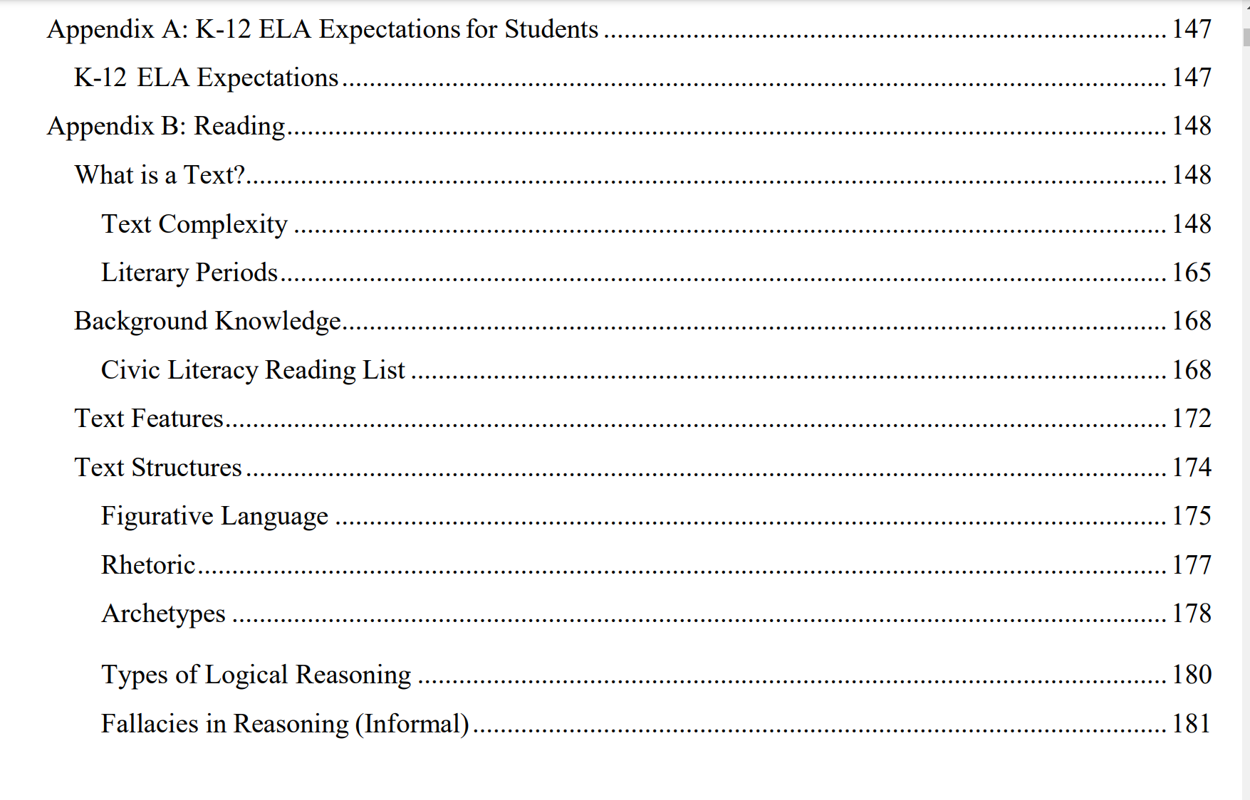
The Appendices!
There are 5: Appendix A-E
Notes:
Now, for the Appendices. You can tab each Appendix in the back of the standards, but it may be more helpful to tab the pages you will need. Our next video will give a brief overview of what can be found in each Appendix. If you wish to tab the beginning of each appendix, you can pause the video now to do that. Each appendix is identified on this screen. Appendix A starts on page 147, Appendix B starts on page 148, Appendix C starts on page 183, Appendix D starts on page 198 and Appendix E begins on page 206. The appendices, as well as the benchmark clarifications and the glossary, make it so that everything you need to understand your benchmarks for your grade-level are right here in this document.

Slide 9
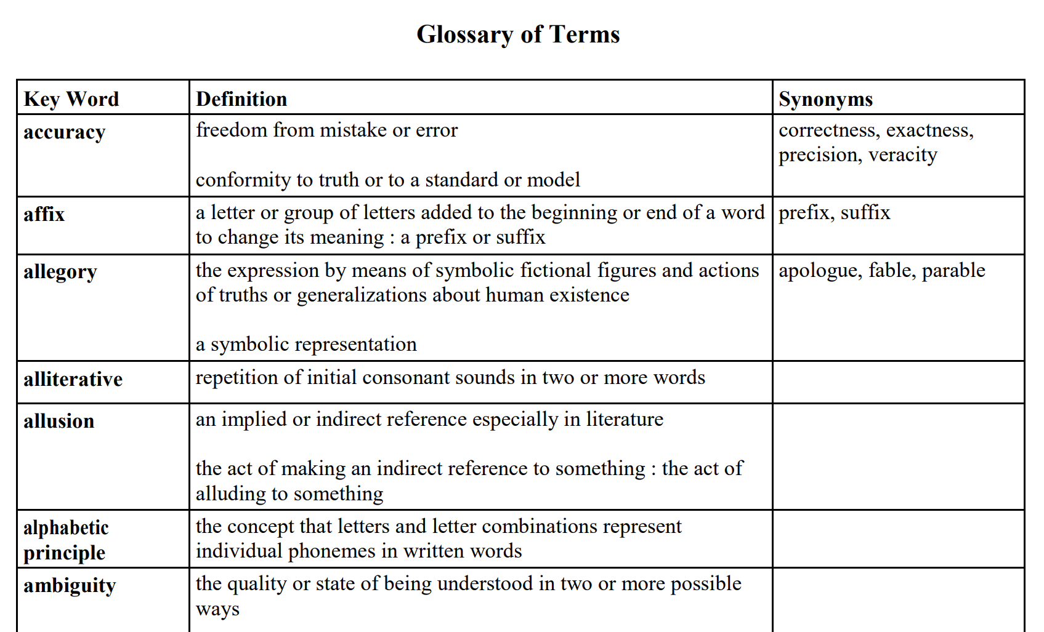
Glossary
Notes:
The last item I will point out in your Table of Contents is the Glossary. It can be found on page 212. Take a minute to tab this page. In previous standards, we leaned on our own understanding of some of the mentioned terms. The B.E.S.T. document clearly defines terms found in your standards if not already clarified in the appendices.

Slide 10
01
Coding Scheme
02
Page 9
Notes:
The final item we will discuss is the Coding Scheme for our new standards. This can be found on page 9.

Slide 11
Notes:
You will notice that there are five strands found in the B.E.S.T. Standards document. The Foundations strand is only applicable to students needing Tier 3 intervention. Reading, Communication and Vocabulary are the primary strands for each grade-level. Your ELA Expectations can be found on page 8 and in more detail in Appendix A. In our previous standards, we saw these expectations included in each grade-level's standards, now it is clearly noted that these skills are overarching and developed over time. We will talk more about the ELA Expectations in video 3.

Slide 12
Thank You!
Next Video: April 29th
Topic: Overview of Appendices
SheKishma O'Reilly
oreillys@leonschools.net
Sherri Winsett
winsetts@leonschools.net
Notes:
Thank you so much for joining us for this first video. Our next video will be posted in the same place on April 29th, 2022. That video will be an overview of the appendices. If you have any questions or concerns, feel free to contact me, SheKishma O'Reilly, or Sherri Winsett.

