Slide 1
Wonders lesson: Unit 5 Week 4 – day 4

Slide 2
Comprehension Skill: Text Structure – Cause & Effect Today we complete our level 2 check! Yay!
Day 4 – April 16, 2020
Learning Progression
3 - I can compare and contrast the overall structure of events, concepts, or information in two or more texts.
2 – I can describe a specific text structure using text evidence, and can explain the connection to the topic of the text.
1 – I can identify the overall structure of events, ideas, concepts or information in one or more texts. (you’ve already done this)

Slide 3
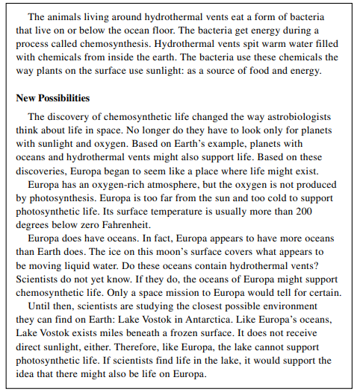
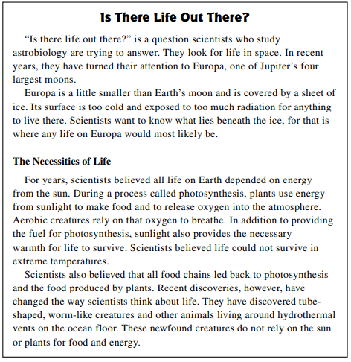
Day 4 – April 16, 2020
For your level 2 check read the passage here OR in your YT book p.233. Then, answer ONLY questions 2 & 3 on p.235.

Slide 4
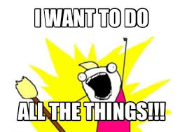
Day 4 – April 16, 2020
Today’s “To-Do” List
Email, text, Remind your answers to the following:
Level 2 check: Complete questions 2 & 3 ONLY on the worksheet I have provided for you.

