Slide 1
Welcome to our kindergarten orientation and meet the teacher for the 2020-2021 school year. This year will be a very exciting time as your child begins their educational journey. This year we have a hybrid learning approach where there will be students in the classroom and students in the digital classroom all making up our class. Together we will learn to read, write, do lots of math, science, and social studies concepts while mastering the Florida Standards for kindergarten. I can’t wait to get started! Please click on the tabs at the top to learn more information about our class.
Love,
Mrs. Wilson

Slide 2
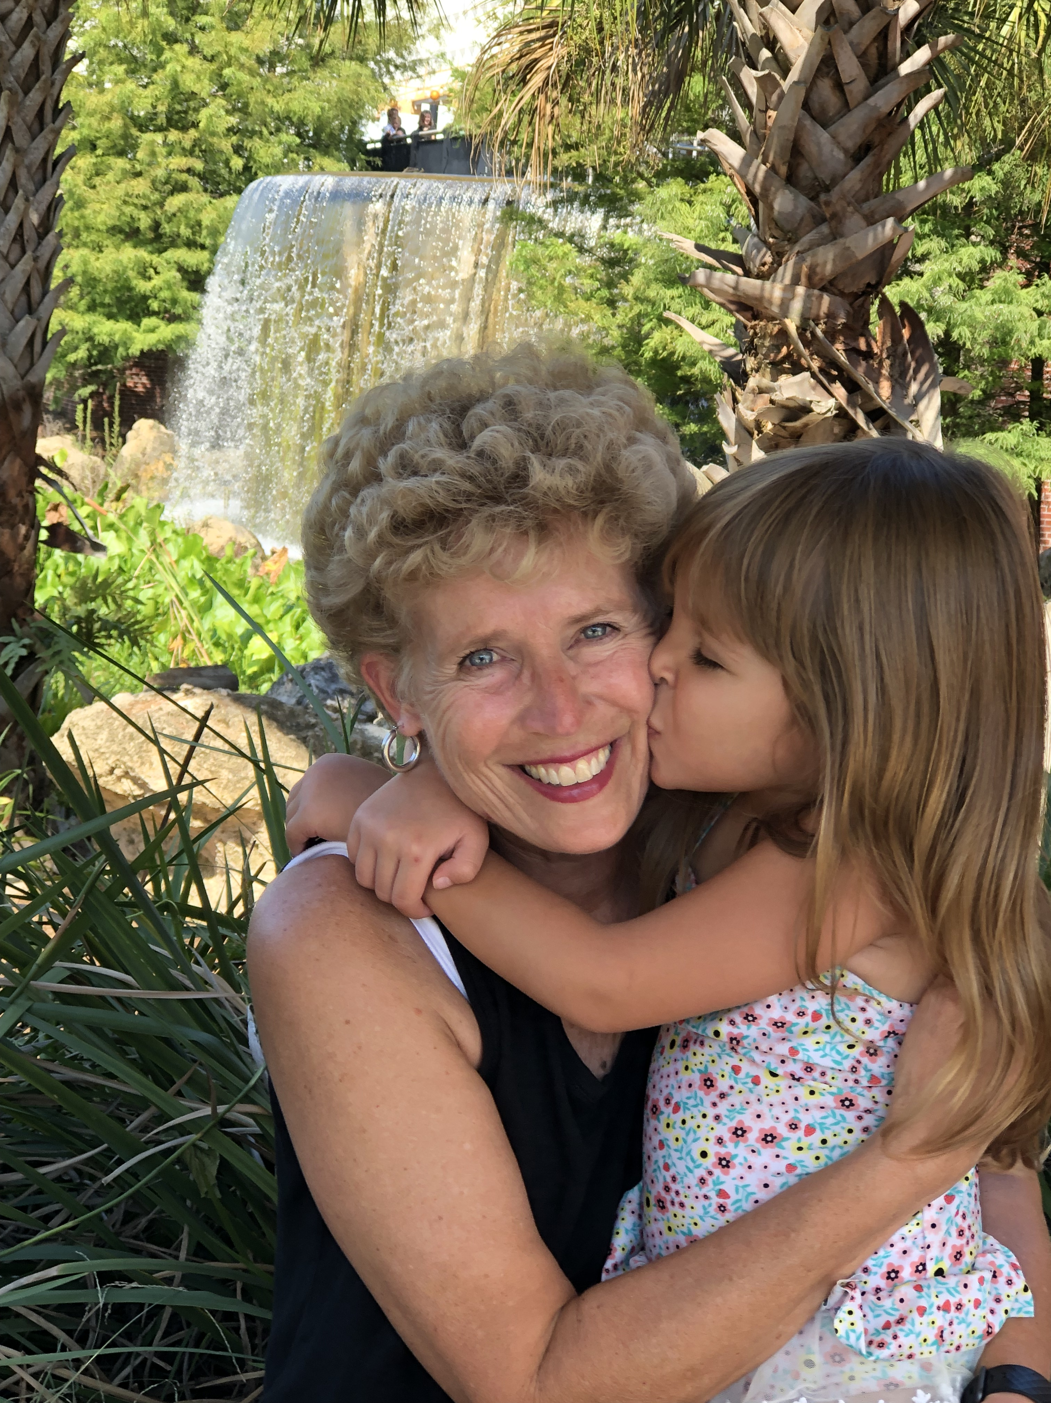
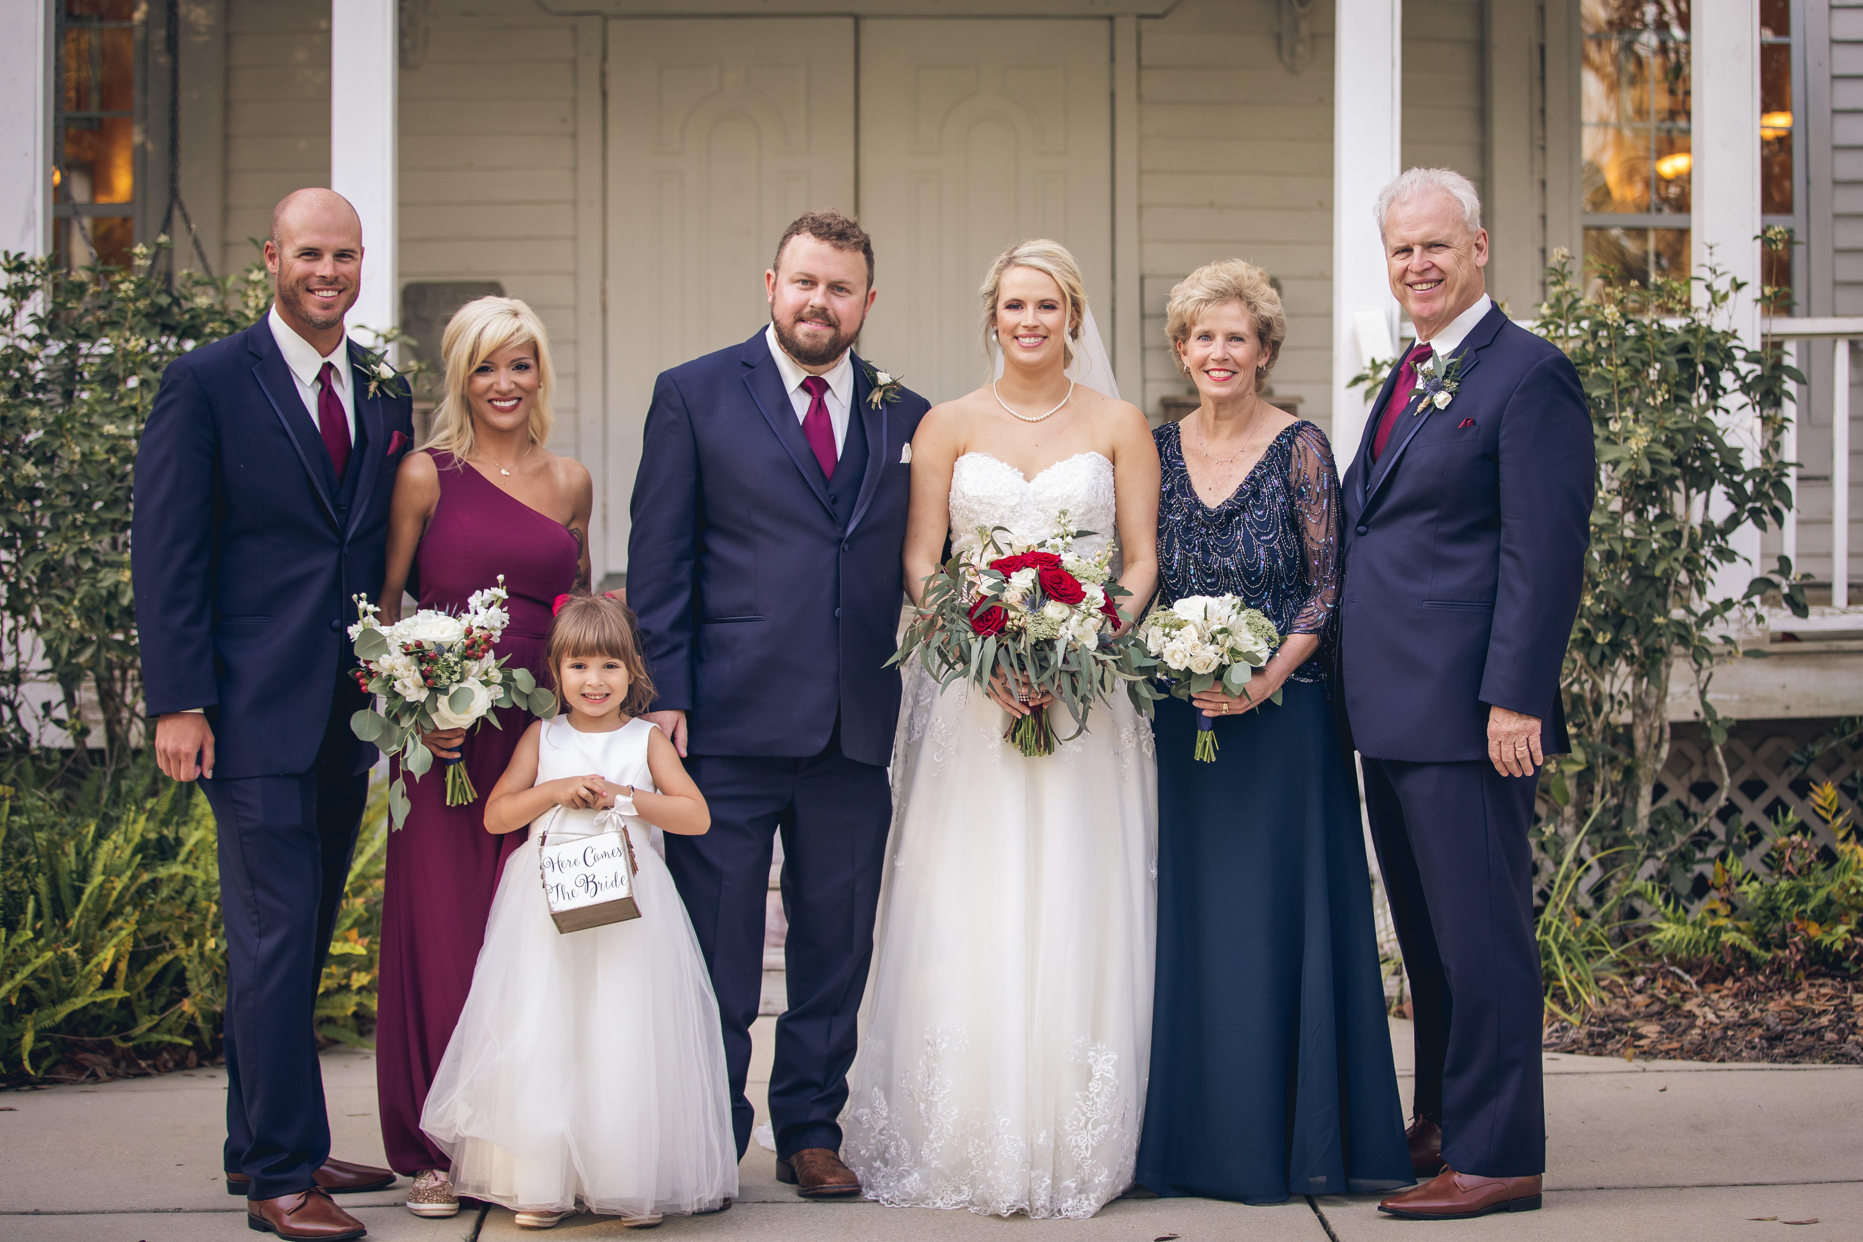
Welcome! My name is Mrs. Wilson and I am so excited to have you in my class this year!
This is my 17th year teaching Kindergarten at Fort Braden School. I have two grown children who are both married, an adorable granddaughter who will be in kindergarten this year, a great husband named John, and we just celebrated our 37th anniversary.
I enjoy working in my yard, reading, walking, and eating chocolate!

Slide 3
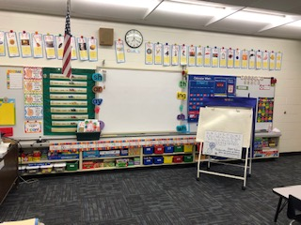
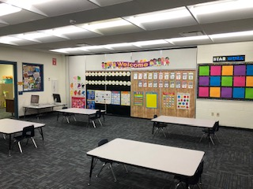
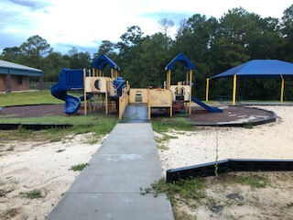
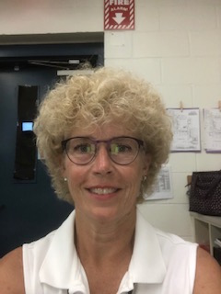
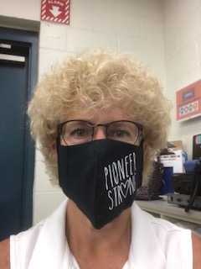
Here are some pictures of our actual classroom. The classroom is just missing all of you! The playground is right outside of our classroom door. I put a picture of myself with and without my face mask so you can see what I look like.

Slide 4
School begins at 8:30
8:45 Morning meeting with Digital Students and Classmates **
9:00 – 11:00 Language Arts Instruction and Writing, Student Conferences
11:00 -12:00 Lunch and Developmental Play
12:00 – 1:20 Math Instruction and Special Area
1:20-2:30 Science or Social Studies, Student Conferences, Accelerated Reader Time
2:30 – 2:50 Review of Day and Prepare for Dismissal
** First day meeting time will be later do to 9:00 first day drop off for Kindergarten
***Kindergarten students will begin transitioning to car pick-up area at 2:30***

Slide 5
Please check your email for a Student Information Form that I would like for you to complete. Once completed, please email the form back to me at my email address:
wilsond@leonschools.net.

Slide 6
We are unable to assist students in tying shoes, opening and closing food/drink items, putting back-packs on, helping with zippers, snaps, or buttons. PLEASE help your child learn to do these tasks before the start of school.
PLEASE make sure your child is able to properly wear their face mask for an extended amount of time without touching their mask/face.
Please make sure that your child is able to use the restroom on their own, flush, and wash their hands.
Students are encouraged to bring water bottles to school to sip thorough out the school day. Water only please!

Slide 7
Download the Remind app to communicate and stay up to date on information! Please click on the link below to register now!
https://www.remind.com/join/27c3e94
Fort Braden School 488-9374

Slide 8
Please click on the attached link to hear the story,
Look Out Kindergarten Here I Come read by Mrs. Wilson.

Slide 9
