Slide 1
2.2 Graphs of Functions

Slide 2
Graphs give a picture of the behavior of the function
f(x) = mx + b linear function
f(x) = b constant function
f(x) = x² quadratic function
f(x) = x³ cubic function
f(x) = radical function

Slide 3
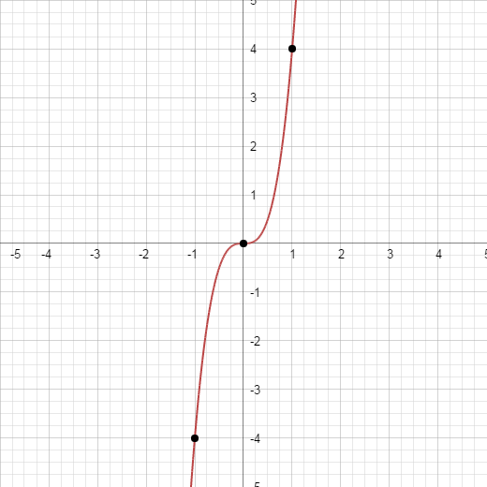
Ex graph y = 4x³

Slide 4
If n is even f(x) = x^{n} is similar to the parabola y = x².
If n is odd f(x) = x^{n} is similar to that of y = x³.

Slide 6
Domain and Range

Slide 7
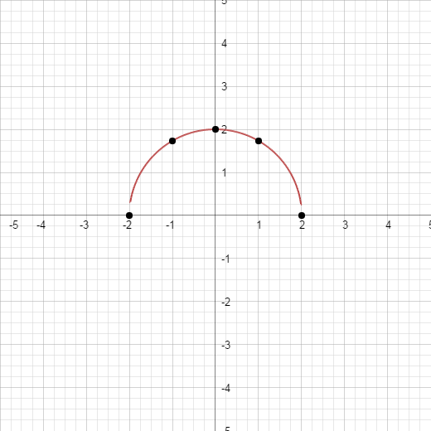
Graph and find the domain and range:

Slide 8
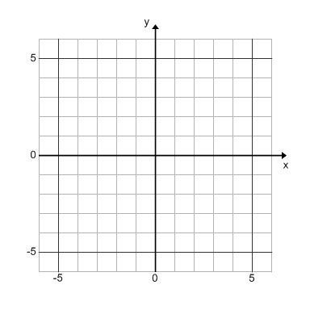
Graph:

Slide 9
Graph:

Slide 10
Greatest Integer Functions (step function) f(x) = [x]
The cost of a long-distance call from Toronto to Mumbai, India, is 69 cents for the first minute and 58 cents for each additional minute (or part of a minute). Draw a graph of the cost (in dollars) of the phone call as a function of time (in minutes).

Slide 12
The Vertical Line Test
Used to determine which curves in the xy-plane are functions.
A curve is a function if and only if no vertical line intersects the curve more than once. (x-values cannot repeat)

Slide 13
Are the following functions?

Slide 14
Are the following functions?
y – x² = 2
x² + y² = 4
x + y² = -5

Slide 15
Homework
Pg 167
#6-16 even, 24, 28-36 even, 42-50 even, 53-54,57,60,60-68 even

