Slide 1
Puerto Rico 3
Las tareas domÉsticas, verbos regulares en –ar, -er, -ir

Slide 2
Puerto Rico 3 (Las tareas domésticas, verbos regulares en –ar, -er, -ir)
LAS TAREAS DOMÉSTICAS
Barrer el suelo – to sweep the floor
Cortar el césped – to cut the grass
Lavar los platos – to wash the dishes
Limpiar el baño – to clean the bathroom
Ordenar la casa – to straighten the house
Pasar la aspiradora – to vacuum
Pasear al perro – to walk the dog
Sacar la basura – to take out the trash
Sacudir los muebles – to dust the furniture
ACCIONES HABITUALES EN LA CASA
Abrir la ventana – to open the window
Apagar la luz – to turn the light off
Prender la luz – to turn the light on

Slide 3
Puerto Rico 3 (Las tareas domésticas, verbos regulares en –ar, -er, -ir)
Verbs. The infinitive
In English, an infinitive is the verb form that uses the word to: to wash, to cook, to talk, to run. In Spanish, the infinitive always ends in –ar, -er, or –ir:
-ESTAR (to be) -SER (to be) -TENER (to have) -ABRIR (to open)
Verbs in the infinitive form are not conjugated (changed to agree with the subject).
To conjugate means to change the verb to agree with the subject.
The verb estar in its infinitive form is estar (to be).
The conjugated form of estar is:
Yo estoy I am
Tú estás you are
Él está He is
Nosotros estamos We are
Ellos están They are

Slide 4
Puerto Rico 3 (Las tareas domésticas, verbos regulares en –ar, -er, -ir)
Verbs. The infinitive
Verbs in the infinitive form are not conjugated (changed to agree with the subject).
The verb ser in its infinitive form is ser (to be).
The conjugated form of ser is:
Yo soy I am
Tú eres You are
Él es He is
Nosotros somos We are
Ellos son They are

Slide 5
Puerto Rico 3 (Las tareas domésticas, verbos regulares en –ar, -er, -ir)
Verbs. The infinitive
Verbs in the infinitive form are not conjugated (changed to agree with the subject).
The verb tener in its infinitive form is tener (to have).
The conjugated form of tener is:
Yo tengo I have
Tú tienes You have
Él tiene He has
Nosotros tenemos We have
Ellos tienen They have

Slide 6
Puerto Rico 3 (Las tareas domésticas, verbos regulares en –ar, -er, -ir)
Verbs. Regular verbs and irregular verbs
Regular verbs – Regular verbs follow a typical conjugation pattern.
Irregular verbs – Irregular verbs do not follow a typical conjugation pattern. When conjugated the stem or the ending changes.

Slide 7
Puerto Rico 3 (Las tareas domésticas, verbos regulares en –ar, -er, -ir)
Regular verbs. The infinitive
In English, an infinitive is the verb form that uses the word to: to wash, to cook. In Spanish, the infinitive always ends in –ar, -er, or –ir:
-AR lavar (to wash) -ER prender (to turn on) -IR abrir (to open)
Regular verbs have a stem that is used with all subjects. They also have a set of endings that are added to the stem to identify the subject. To find the stem of the verb, remove the –ar, -er, or –ir ending.
lavar -> lav ar prender -> prend er abrir -> abr ir
To conjugate regular verbs, find the stem of the verb, and attach the appropriate ending based on the subject.

Slide 8
Puerto Rico 3 (Las tareas domésticas, verbos regulares en –ar, -er, -ir)
Regular –ar verbs are conjugated this way:
Regular –ar verbs are conjugated by finding the stem and attaching this ending to it.
Singular |  | Plural
Yo | o | Nosotros Nosotras | amos
Tú | as
Usted Él Ella | a | Ustedes Ellos Ellas | an
VERB LAVAR (TO WASH) in the present tense.
Singular |  |  | Plural
Yo | lavo | I wash | Nosotros Nosotras | lavamos | We wash
Tú | lavas | You wash
Usted Él Ella | lava | You wash He washes She washes | Ustedes Ellos Ellas | lavan | You all wash They wash They wash

Slide 9
Puerto Rico 3 (Las tareas domésticas, verbos regulares en –ar, -er, -ir)
Regular –er verbs are conjugated this way:
Regular –er verbs are conjugated by finding the stem and attaching this ending to it.
Singular |  | Plural
Yo | o | Nosotros Nosotras | emos
Tú | es
Usted Él Ella | e | Ustedes Ellos Ellas | en
VERB BARRER (TO SWEEP) in the present tense.
Singular |  |  | Plural
Yo | barro | I sweep | Nosotros Nosotras | barremos | We sweep
Tú | barres | You sweep
Usted Él Ella | barre | You sweep He sweeps She sweeps | Ustedes Ellos Ellas | barren | You all sweep They sweep They sweep

Slide 10
Puerto Rico 3 (Las tareas domésticas, verbos regulares en –ar, -er, -ir)
Regular –ir verbs are conjugated this way:
Regular –ir verbs are conjugated by finding the stem and attaching this ending to it.
Singular |  | Plural
Yo | o | Nosotros Nosotras | imos
Tú | es
Usted Él Ella | e | Ustedes Ellos Ellas | en
VERB ABRIR (TO OPEN) in the present tense.
Singular |  |  | Plural
Yo | abro | I open | Nosotros Nosotras | abrimos | We open
Tú | abres | You open
Usted Él Ella | abre | You open He opens She opens | Ustedes Ellos Ellas | abren | You all open They open They open

Slide 11
Puerto Rico 3 (Las tareas domésticas, verbos regulares en –ar, -er, -ir)
Conjugate the following verbs. (find the stem, look at your chart, attach the ending).
Yo Cortar ________________________________________________
Tú Pasar ________________________________________________
Ella Ordenar ________________________________________________
Nosotros Pasear ________________________________________________
Ellos Lavar ________________________________________________
Regular –ar verbs are conjugated by finding the stem and attaching this ending to it.
Singular |  | Plural
Yo | o | Nosotros Nosotras | amos
Tú | as
Usted Él Ella | a | Ustedes Ellos Ellas | an

Slide 12
Puerto Rico 3 (Las tareas domésticas, verbos regulares en –ar, -er, -ir)
Conjugate the following verbs. (find the stem, look at your chart, attach the ending).
Cortar ________________________________________________
Lavar________________________________________________
Limpiar________________________________________________
Ordenar________________________________________________
Regular –ar verbs are conjugated by finding the stem and attaching this ending to it.
Singular |  | Plural
Yo | o | Nosotros Nosotras | amos
Tú | as
Usted Él Ella | a | Ustedes Ellos Ellas | an

Slide 13
Puerto Rico 3 (Las tareas domésticas, verbos regulares en –ar, -er, -ir)
Conjugate the following verbs. (find the stem, look at your chart, attach the ending).
Pasar________________________________________________
Pasear________________________________________________
Sacar________________________________________________
Apagar________________________________________________
Regular –ar verbs are conjugated by finding the stem and attaching this ending to it.
Singular |  | Plural
Yo | o | Nosotros Nosotras | amos
Tú | as
Usted Él Ella | a | Ustedes Ellos Ellas | an

Slide 14
Puerto Rico 3 (Las tareas domésticas, verbos regulares en –ar, -er, -ir)
Conjugate the following verbs. (find the stem, look at your chart, attach the ending).
Janet y yo (Cortar) _______________________________________________
Ustedes (Lavar) _______________________________________________
Bobby y Linda (Limpiar) _______________________________________________
Tú (Ordenar) _______________________________________________
Janet (Pasar) _______________________________________________
Yo (Pasear) _______________________________________________
Johnny (Sacar) _______________________________________________
Nosotros (Apagar) _______________________________________________

Slide 15
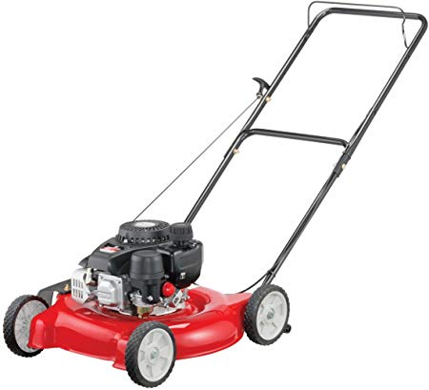
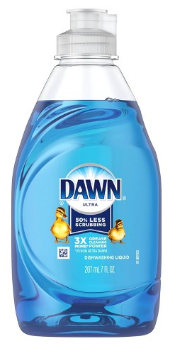
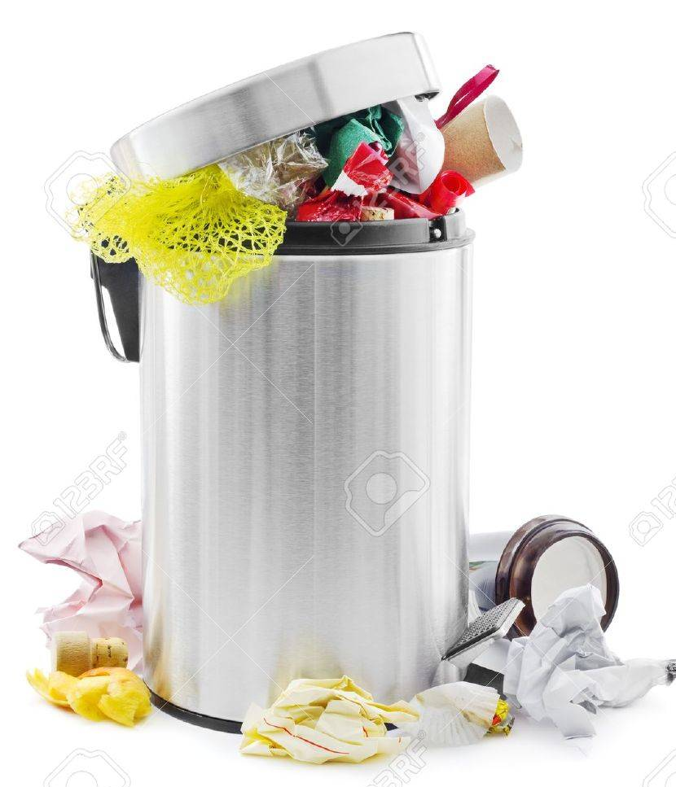
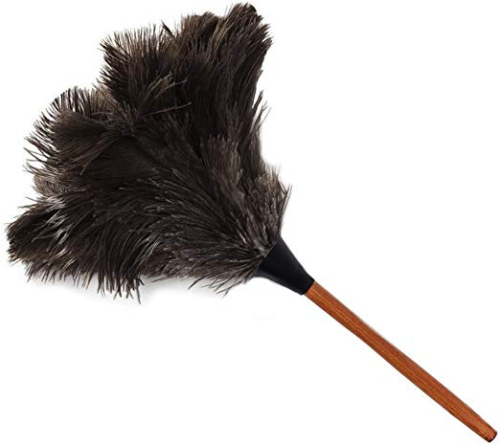
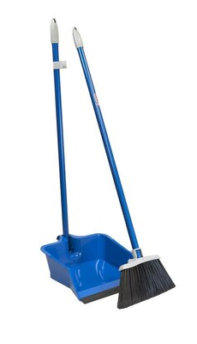
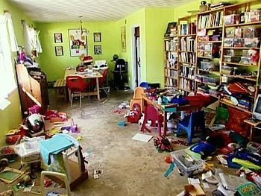
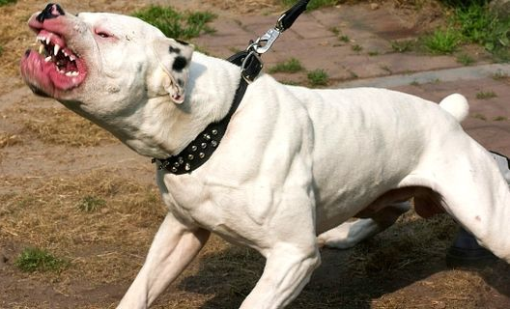
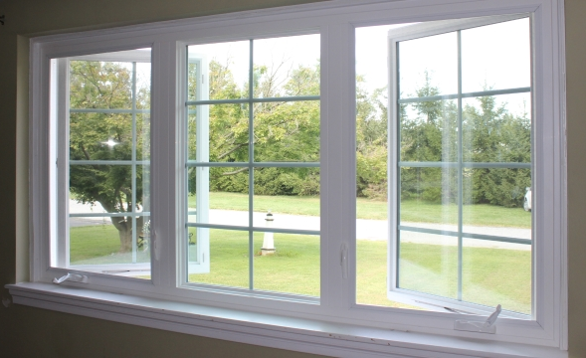
SPN I
1
2
3
4
5
6
7
8
9
10

Slide 16
SPN I
1
2
4
3

