Slide 1
Friday
May 15th 2020
Ms.Reshard’s Class

Slide 2
THis week’s Learning Goals
Reading
Math
Science
Social studies
I can combine 3-dimensional shapes to create a new shape (composite shape) and build new shapes from composite shapes.
can build and draw shapes that have specific defining attributes.
I can identify who is telling the story at various points in the the text.
I can identify ways Earth’s surface changes. Students will explain how Earth surface changes affect living things.
I can idenify what a community is and explain why its important.

Slide 3
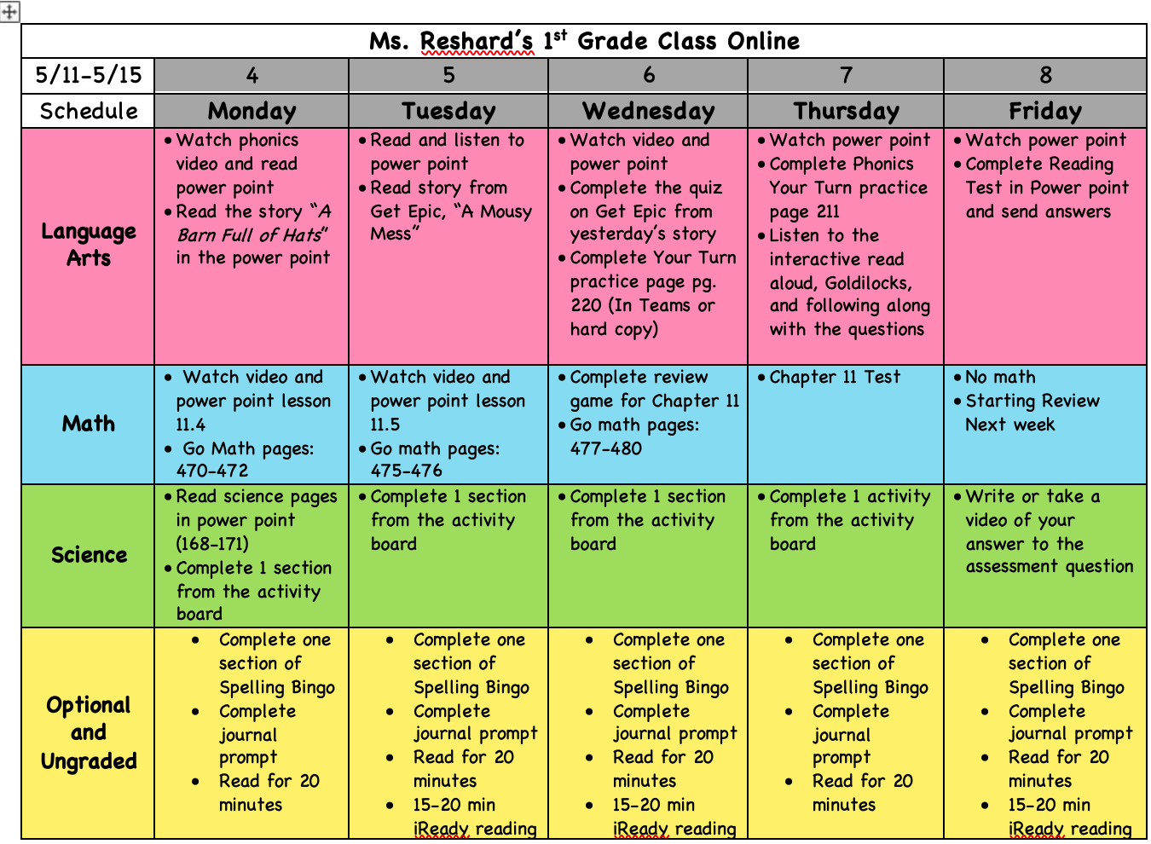
Weekly Calendar

Slide 4
Daily Affirmations
I can be anything I want to be.
I am an important person in this world.
I can dream dreams and make them come true.
Every new day is a chance to improve.
I can learn from my mistakes.
I can take risks and do hard things.
I can learn from others and they can learn from me.
I can make smart choices.
I control the good that happens to me.
I am kind. I am respectful. I am loved.

Slide 5
Reading

Slide 6
REading to do list
1.
Review Focus Slide
2..
Unit 5 Week 1 Test

Slide 7
THis week’s skills
comprehension
phonics
grammar
Structural analysis
Essential question
Point of view
/ar/
Irregular plurals
Expanding and combining sentences
How can we classify and categorize things?

Slide 8
UNit 5 week 1 Assessment
You may complete this assignment by printing out the paper version from teams and sending me pictures or using the following pictures and writing the answers down on a piece of paper. You’ve worked hard all week! Show me what you know!

Slide 9
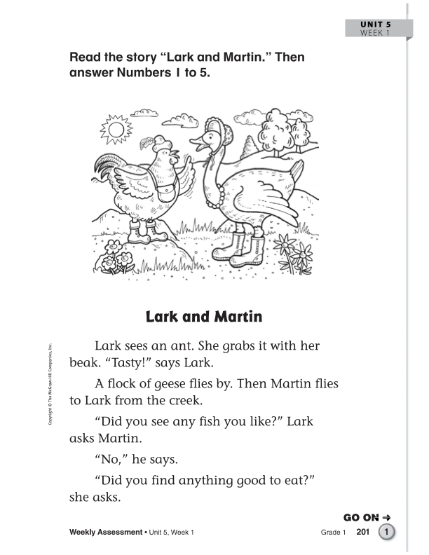

Slide 10
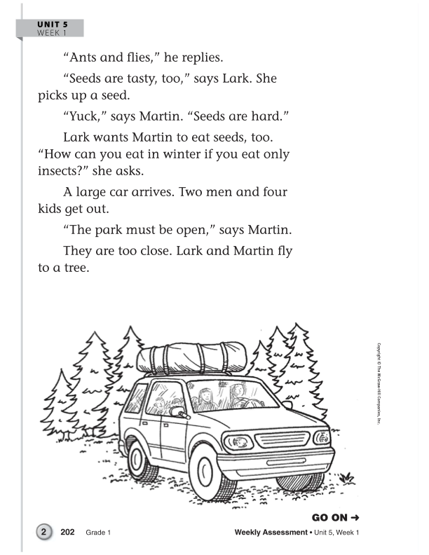

Slide 11
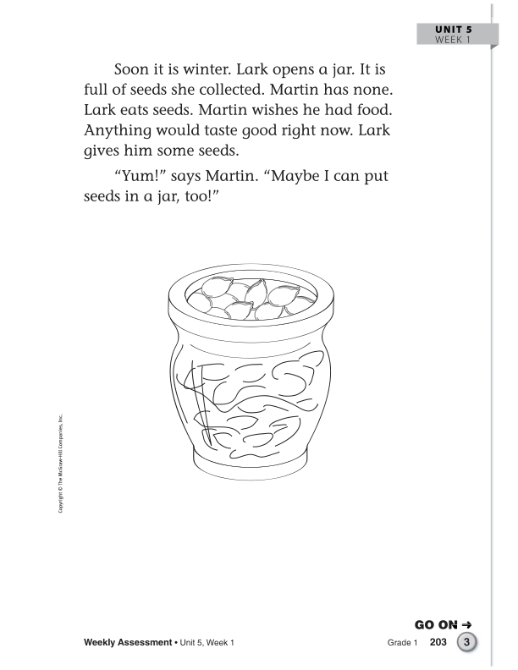

Slide 13
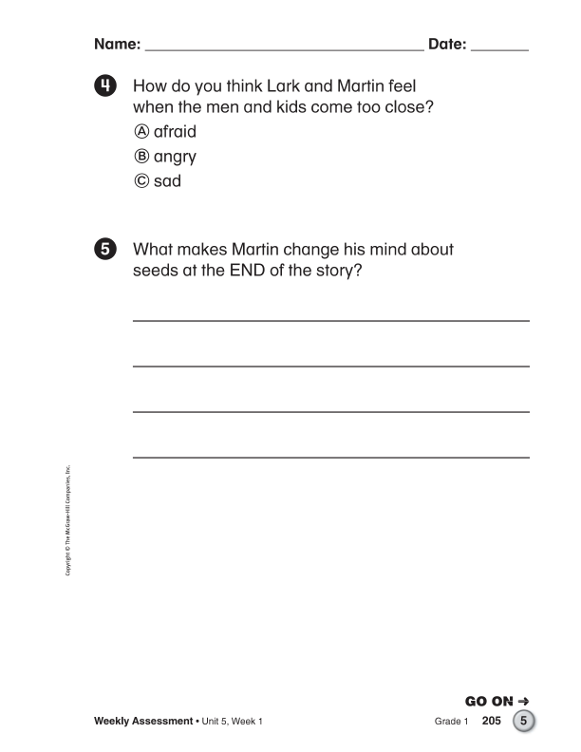

Slide 14
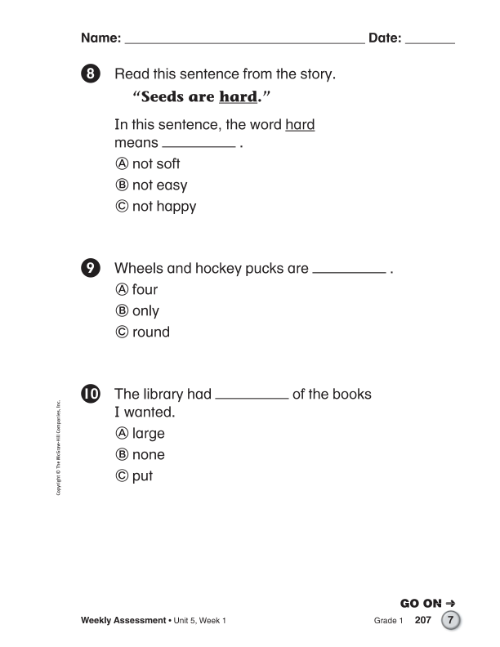

Slide 15
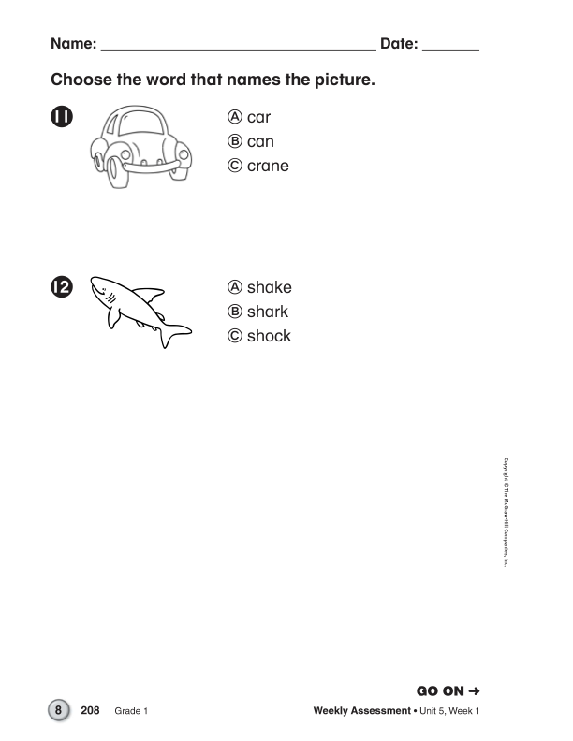

Slide 16
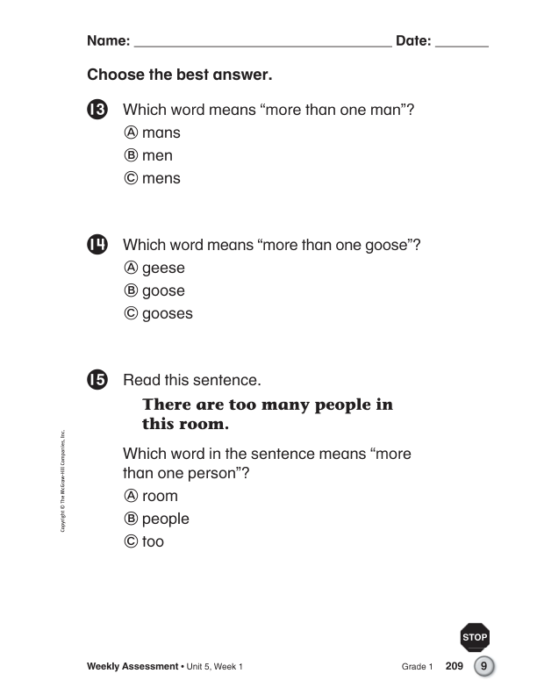

Slide 17
A.R test
The following slides give you directions!
I encourage you to login and take an A.R if you are able to on any of the books we’ve been reading this week!

Slide 18
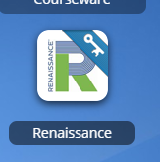
How to take an A.r Test
1.
2.
3.
Login to classlink and click on the renaissance app.
Click on the orange square that says accelerated reader.
Search the book you read and press take quiz.

Slide 19
mATH

Slide 20
math to do list
1.
NO MATH TODAY

Slide 21
SCIENCE

Slide 22
Science to do list
1.
Complete your last a activity!

Slide 23
Science activities: Complete onE each day
1
5
2
4
3
Watch the video, “Volcanoes for Kids,” at https://www.youtube.com/watch?v=3Jxeh-yAXek. Write 3 facts you learned from the video.
Complete the experiment on the next slide.
Draw a quick picture and write a definition for the following fast change words: volcano, earthquake, flood
Draw a quick picture and write a definition for the following slow change words: weathering, erosion, drought
Watch the video, “Weathering and Erosion” at https://www.youtube.com/watch?v=R-Iak3Wvh9c. Write or draw to explain the meaning of weathering
and erosion.

Slide 24
TURN THESE THINGS INTO MS. RESHARD
Unit 5 Week 1 Assessment
Send your favorite science activity

Slide 25
More practice These things are optional

Slide 26
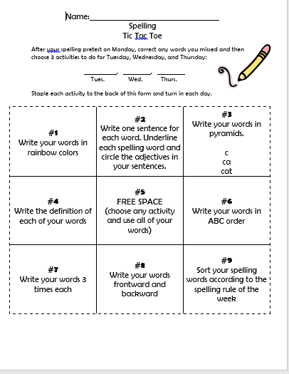
Spelling tic tac toe:
Pick one activity to complete! Pick a different one to complete every day of the week.

Slide 27
Unit 5 Week 1 spelling words
Cart
Barn
Arm
Art
Yarn
6. Harm
7. Happy
8. Key
9. Four
10. None
11. Large
12. Only
13.Put
14. Round

Slide 28
Getting ready for your daily journal:
Writing checklist
Copy the sentence and fill in the blanks, then add one sentence all on your own!
Check your punctuation and capitalization.
Check your spelling.
Make sure you use finger spaces.
Draw a picture about your writing.

Slide 29
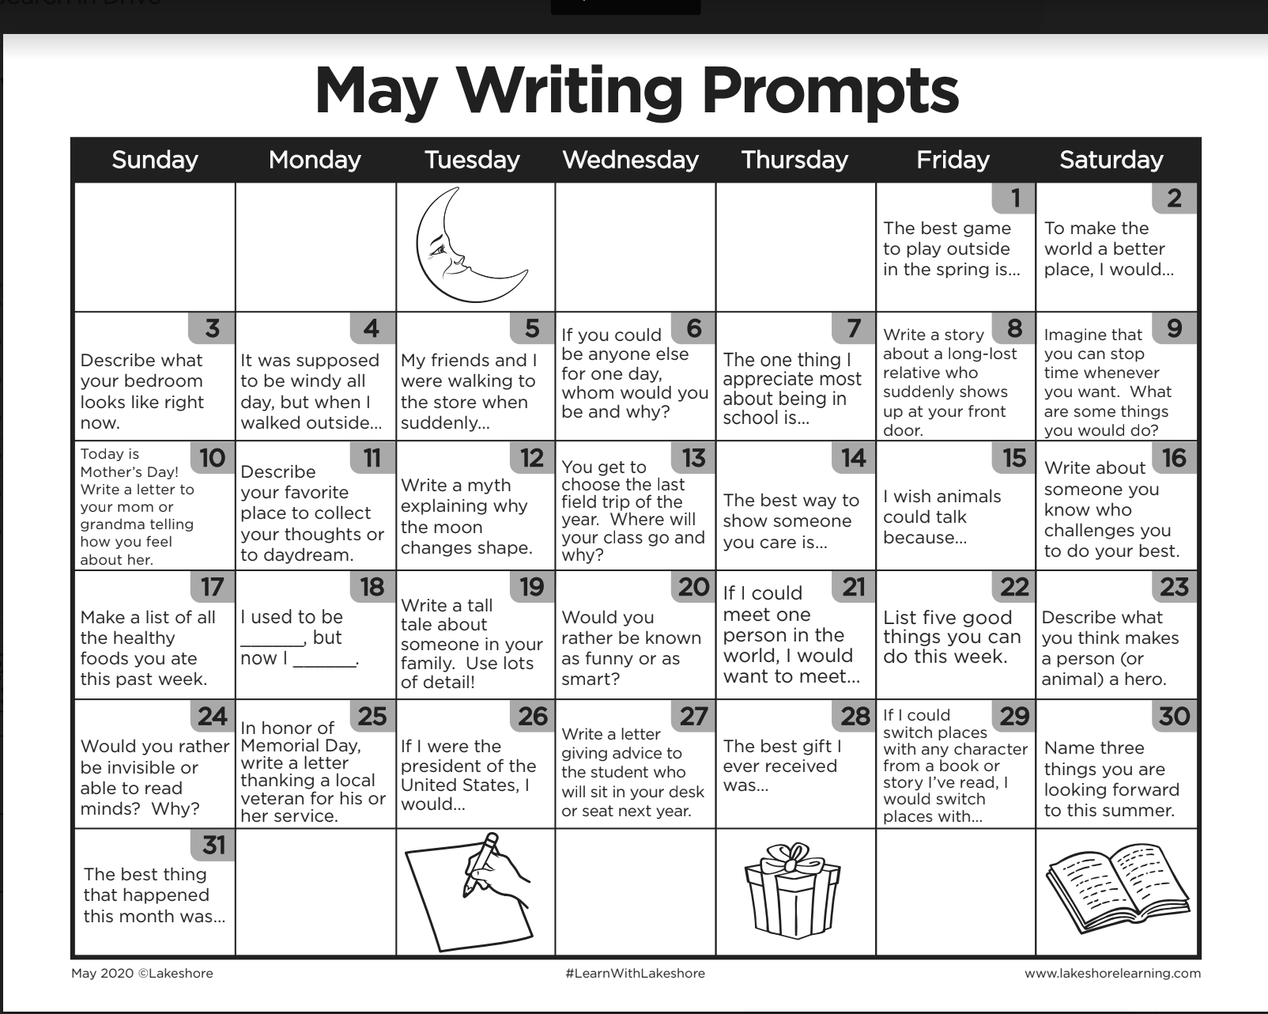
Writing prompt example response

Slide 30
YOU’RE ALMOST DONE!
COmplete 20 minutes of iready
Complete 20 minutes of independent reading

Slide 31
You're finished!

