Slide 1
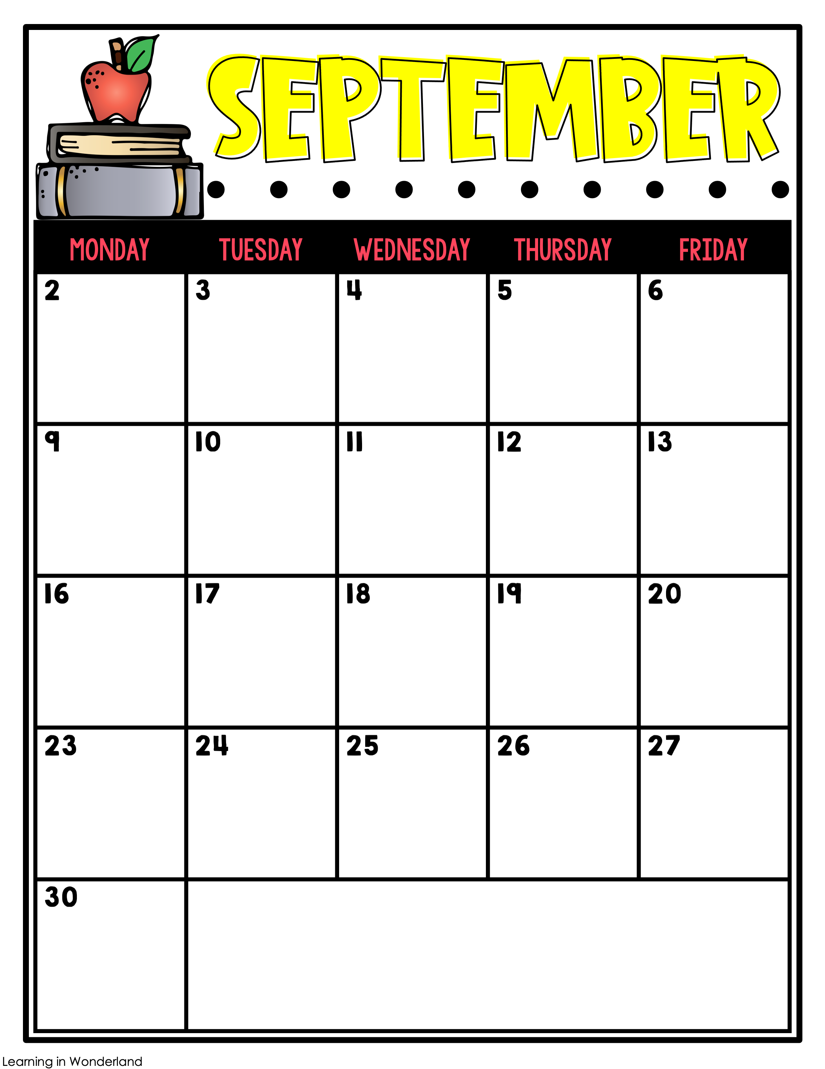
Math 2.4
Sci. 3.4
Music
Math 2.5
Fact Fluency
Chp. 3 Science Review
PE
Math 2.6
Chp. 3 Review Quiz
Skate World Share Night @ 5:00
Guidance
Math 2.7
Chp. 3 Sci. Test
Friendship Friday Lunch
26% of AR Goal
PE
Labor Day/
No School
1.2 Spelling Quiz
Math Chp. 2 Review
Sci. 4.1
Art
Reading 1.2 Test
Math Chp. 2 Review Quiz
Sci. 4.1
PE
Math Chp. 2 Test
Fact Fluency
Sci. 4.1
Progress Reports
STEM
Math 3.1
Sci. 4.2
Music
Math 3.2
Sci. 4.2
39% of AR Goal
PE
Math 3.3
Sci. 4.2
Guidance
Math 3.3
Sci. 4.3
PE
Math 3.4
Fact Fluency
Sci. 4.3
Art
Math 3.5
Sci. 4.3
PTO @ 7 pm
PE
Reading 1.3 Spelling/ Grammar Quiz
Math 3.5/ Review
Sci. 4.4
52% of AR Goal
STEM
Reading 1.3 Test
Math Chp. 3 Review Quiz
Sci. 4.4
Music
Math Chp. 3 Test
Sci. 4.4
PE
Math 4.1
Fact Fluency
Chp. 4 Sci. Review
Guidance
Math 4.2/4.3
Chp. 4 Sci. Review Quiz
PE
Math 4.4
Chp. 4 Sci. Test
65% of AR Goal
Art
Upcoming Events in October
Math 4.5
S.S. Maps
PE
3rd Fall Holiday/ No School 4th Grand Hawks Day 10th Picture Day 18th End of 1st Nine Weeks/ AR Rally | 21st Teacher Planning Day/ No School 25th Family Movie Night 28th-1st Red Ribbon Week 31st Pirate Day

