Slide 1
2.5 Quadratic Functions
Maxima and Minima

Slide 2
The maximum or minimum value of a function is the largest or smallest value of the function on an interval.
Relative (local)max/min: the greatest or least value that the function can attain on some interval.
If a relative max/min is the greatest or least value of the function over its entire domain, then it is the absolute max or min.

Slide 3
Relative maximum – when the y-coordinate is not the greatest value of the function, although it represents a maximum for a small interval.
Relative minimum – the least y-value on some interval of the domain.
Absolute Max – the greatest value that a function assumes over its domain
Absolute Min – the least value of a function
Extrema are values of the function – they are the y-coordinates of each max and min point.

Slide 4
Find the relative and absolute max or min.

Slide 5
Parabola’s
Standard Form: y = ax² + bx + c
C is the y-intercept
To convert from standard to vertex form you must CTS!
Vertex Form: y = a(x – h)² + k
Vertex is at (h, k)

Slide 6
Write in vertex form and graph: y = 3x² – 6x + 10

Slide 8
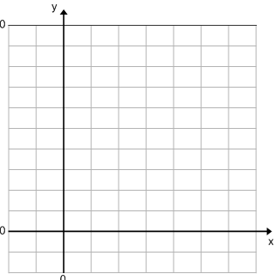
Write in vertex form, graph and find the max or min:
y = 2x² – 20x + 53

Slide 9
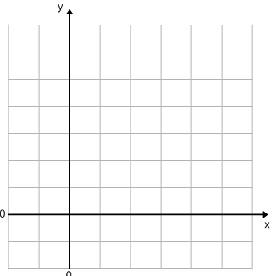
Write in vertex form, graph and find the max or min:
y = -x² + x + 5

Slide 10
If you only want to find the max or min then use the chart below.

Slide 11
Find the max or min:
f(x) = x² + 8x f(x) = -4x² + 8x - 2

Slide 12
Most cars get their best gas mileage when traveling at a relatively modest speed. The gas mileage M for a certain new car is given by
, where the speed is between 15 and 70 miles per hour.
What is the car’s best gas mileage and at what speed is it attained?
Max or min?

Slide 13
Pg 201 #1,3,5,11,17,19,23,35,51-57 odd

Slide 14
Homework
Worksheet 2.5

