Slide 1
5.1 b Graphing Slopes

Slide 2
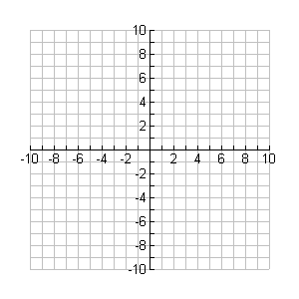
Example 1
Graph the slope given the y-intercept.

Slide 3
Example 2
Graph the slope given the y-intercept.

Slide 4
Example 3
Graph the slope given the y-intercept.

Slide 5
WB Page 141 #1-4

