Slide 1
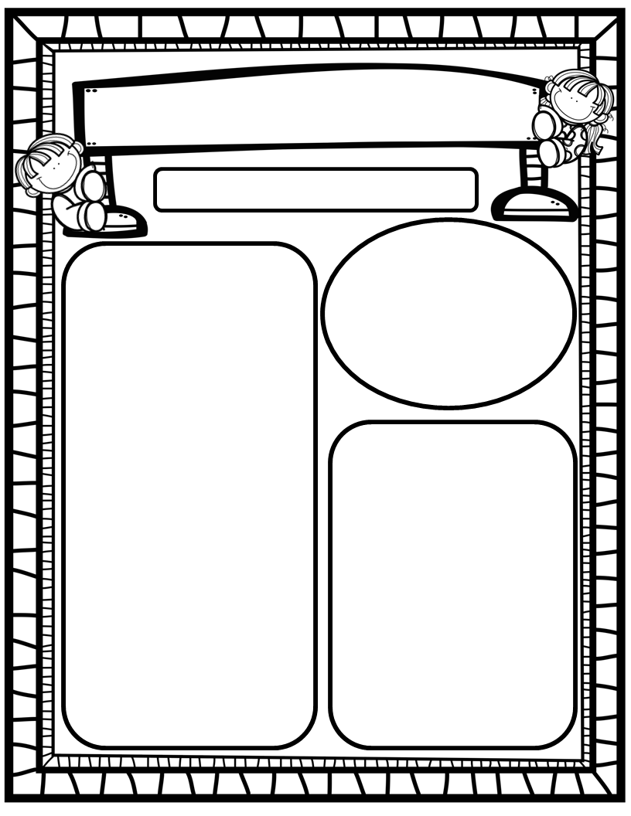
The Deason Digest Weekly Blast
April 7th, 2025
We Are Learning About…
Reading: We will focus on the digraphs WH, PH, NG, as well as HFW’s could, would, should, or, for. We will identify author’s purpose and fiction and nonfiction texts we read. We will look at pictures, get our mouths ready, and use digraph chunks to help us stretchy-snake tricky words faster. EQ: What helps plants live in hot climates?
Writing: We will focus on printing and tracing upper and lowercase letters, as well as using stretchy-spelling and sight words to write complete sentences!
Math: We will begin Ch. 17: 2-Dimensional Shapes!
Science: We will continue learning about living things and non-living things!
Social Studies: We will continue to practice I-Care Rules. We will practice what it means to be Resilient! We will also begin learning about our community and the helpers within our community!
Homework:
Read to and with your child each night and complete Reading Rally Log!
Practice HFW’s: the, I, and, a, is, as, said, to, do, of, see, he, be, me, from, was, you, have, what, your, want, go, no, so, goes, says, she, we, they, their, were, talk, walk, could, would, should, or, for
Go Math Home Practice for Ch. 14 and 16
UFLI Home Practice Pages
Go over Weekly Work and discuss
Important Dates:
April 7 & 11: Sight Word Testing Days
April 15: Field Trip to Publix, 9:00-1:00 (approximate time span)
April 18: Spring Holiday; No School
April 23-30: PTO Online Silent Auction (more info to come)
April 26: HRES “Flight Fest” Carnival (more info to come)

