Slide 1
5.3 a Slope-Intercept Form

Slide 2
What is Slope-Intercept Form?
Equation:
m: slope
b: y – intercept
(where the graph touches the y-axis!)
y
y=mx+b
(0,b)
x

Slide 3
Write an equation in slope intercept form for the line with …
E1 slope of ¼ and a y-intercept of (0,1).
E2 slope of -½ and a y-intercept of (0,-3).

Slide 4
Identify the slope and the y-intercept.
E3 E4

Slide 5
Rewrite the equation in slope intercept form. Then Identify the slope and the y-intercept.
E5 4y = 3x - 8 E6 x + y = 4

Slide 7
Write the equation in slope intercept form that goes through the points.
E7 E8

Slide 8
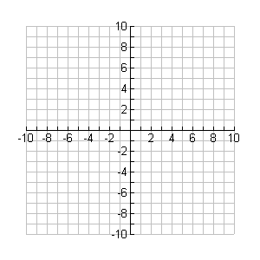
Example 9
Write the equation in slope-intercept form from the graph.

Slide 9
Example 10
Write the equation in slope-intercept form from the graph.
m =
b =

Slide 10
WS 5.3 a

