Slide 1
Wonders lesson: Unit 5 Week 4 – Day 2

Slide 2
Day 2 – April 14, 2020
Vocabulary using context clues:
INSIDE – Look inside the word for prefixes, suffixes, root or base words
OUTSIDE – Look in the sentence being used
AROUND – Look in the paragraph, or text features (pictures, graphs, charts, etc.)
BEYOND – Dictionary or glossary

Slide 3
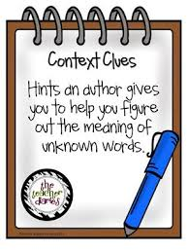
Day 2 – April 14, 2020
Use the next slide to help you complete the Context Clue graphic organizer.
Remember – ONLY complete the columns labeled “word”, “clues” and “what I think it means….”
After completing all 8 words, go to your online glossary and see how close you were and fill in “what it really means”.

Slide 4
Day 2 – April 14, 2020

Slide 5
Day 2 – April 14, 2020
How to access your Wonders Literature Anthology and glossary to check your answers using Classlink. Just press play on the bottom left!

Slide 6
Day 2 – April 14, 2020
Today’s “To-Do” List
Email, text, Remind your answers to the following:
1. Completed graphic organizer.
2. P. 231 in your “Your Turn” practice book

